Slide 1
What is a good neighbour?

Slide 2
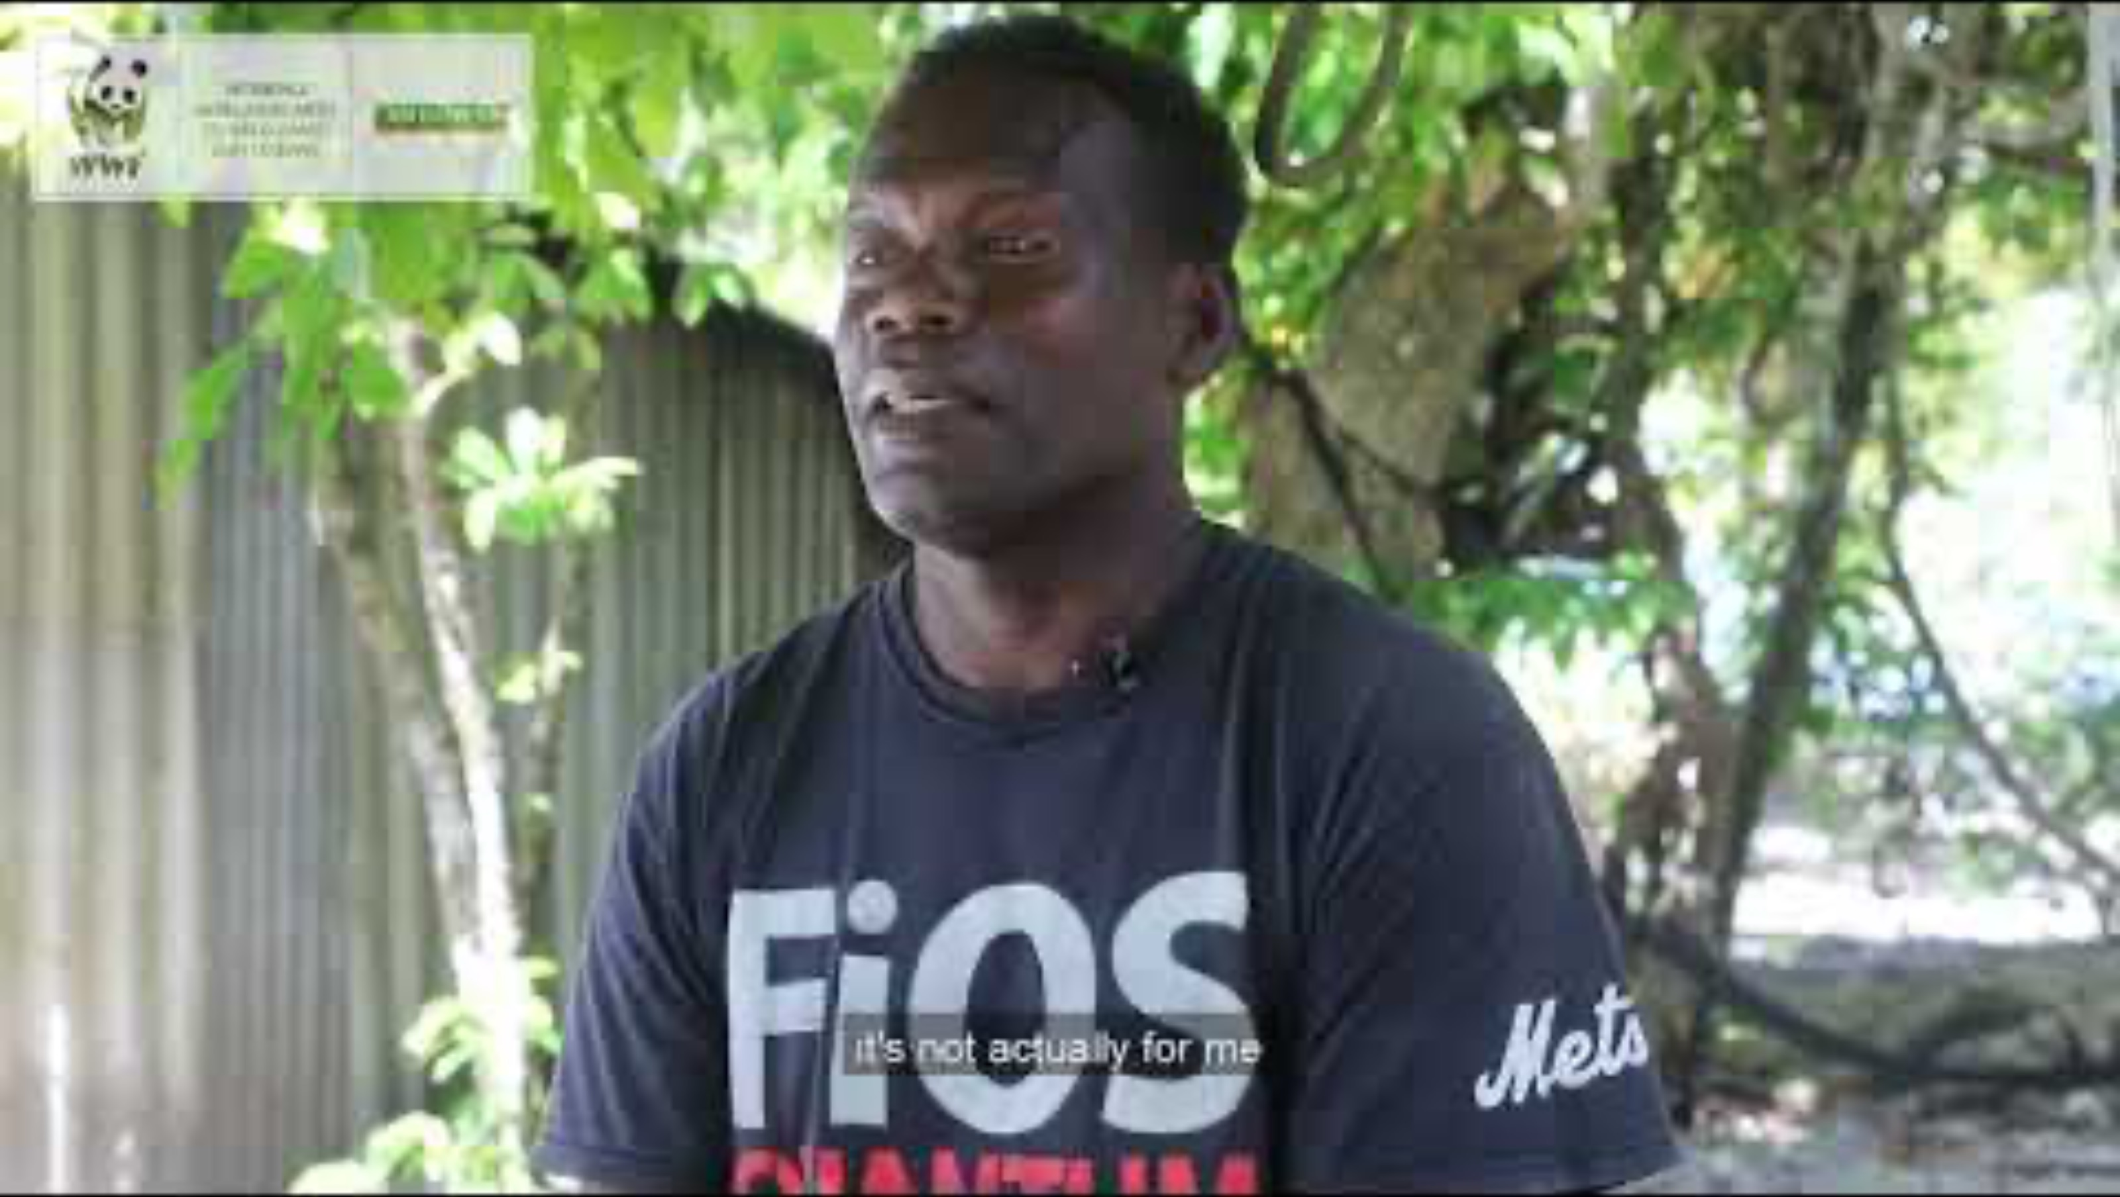

Meet Duncan Arthur from the Solomon Islands
The fisheries
of our Pacific Island neighbours
face many threats — from overharvesting,
climate
change and inappropriate development.
Notes:
Show students where the Solomon Islands are on the map – they are very near neighbours of Australia. Tell students that Australia is working in partnership with people in the Solomons and Papua New Guinea to help them accurately audit their fish stock, so they can fish in more sustainable locations. Show the video on the webpage: Sustainable coastal fisheries | WWF Australia) https://wwf.org.au/what-we-do/oceans/coral-triangle/sustainable-coastal-fisheries/. In this video, Duncan Arthur talks about the problem with fishing management. Partnerships are often about shared problems – Australia is also facing problems with overfishing in some parts of the country – and opportunities to learn from each other.

Slide 3
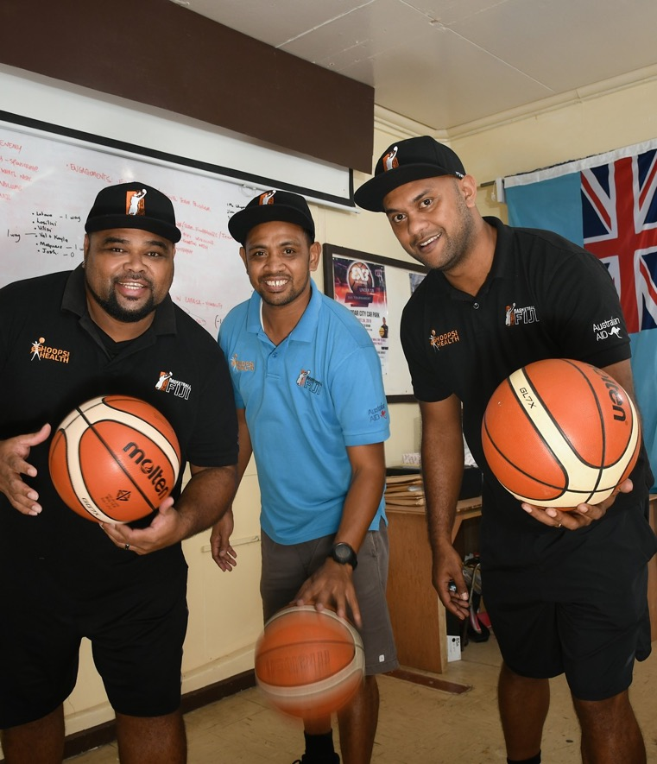
Meet Apenisa (Ben) Tuimabualau from Fiji
‘We have a growing health problem here, with an increase in non-communicable diseases, such as diabetes.’
Ben says the main thing he learned from his colleagues in Fiji is resilience. ‘Even though there isn’t much in Fiji in terms of resources to do with basketball, the team still makes the effort every day to make sure the kids get an opportunity to play basketball.’
‘In Western culture money is often available to throw at problems; in Fiji that is not the case – our wealth is in our relationships and cultural connections.’
Notes:
Show students where Fiji is on the map. Say that Australia is working in partnership with people like Ben to build the sport of basketball in Fiji as a way of supporting children and teenagers to be more active.
Partnerships are about two-way learning and gaining different perspectives, as shown by this example.
Image credit: © Darren James / Australian Volunteers Program, CC BY 4.0

Slide 4
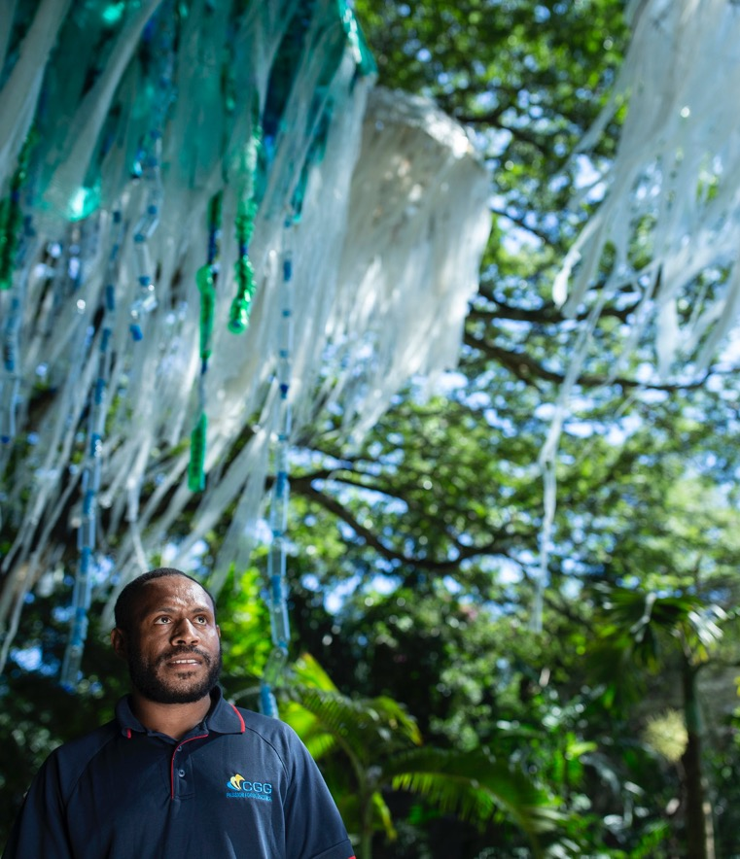
Jellyfish sculptures in PNG
Plastic pollution is an issue all across the world but it’s a really big issue in Papua New Guinea (PNG), especially in the capital, Port Moresby, as there are limited recycling facilities.
Jessica Lumb took her skills as an artist, curator and events manager to Port Moresby.
Notes:
Show students where Papua New Guinea (PNG) is on the map. Jessica’s goal was to educate park visitors on the issues of plastic pollution and waste management. She worked with schools, a local artist and a professor from a local uni. Often partnerships include education and local capacity-building. You may need to explain what capacity-building is. (A simple definition suitable for this age group is ‘helping people develop skills or knowledge so that they can do things themselves, rather than always relying on others.’)
Image credit: © Harjono Djoyobisono / Australian Volunteers Program, CC BY 4.0

Slide 5
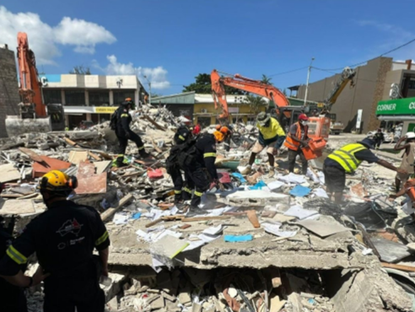
Earthquake in Vanuatu
When an earthquake hit Vanuatu in 2024 Australia sent a Disaster Assistance Response Team (DART) to undertake search and rescue operations and a six-member Australian Medical Assistance Team.
They also provided humanitarian relief supplies.
Notes:
Show students where Vanuatu is on the map. The teams helped with clearing collapsed buildings and with improving water sanitation. Sometimes development support is provided in a crisis because the sooner you can help fix a problem that a neighbour has, the safer the region will be – not just the local people.
Image credit: © Queensland Fire Department

Slide 6
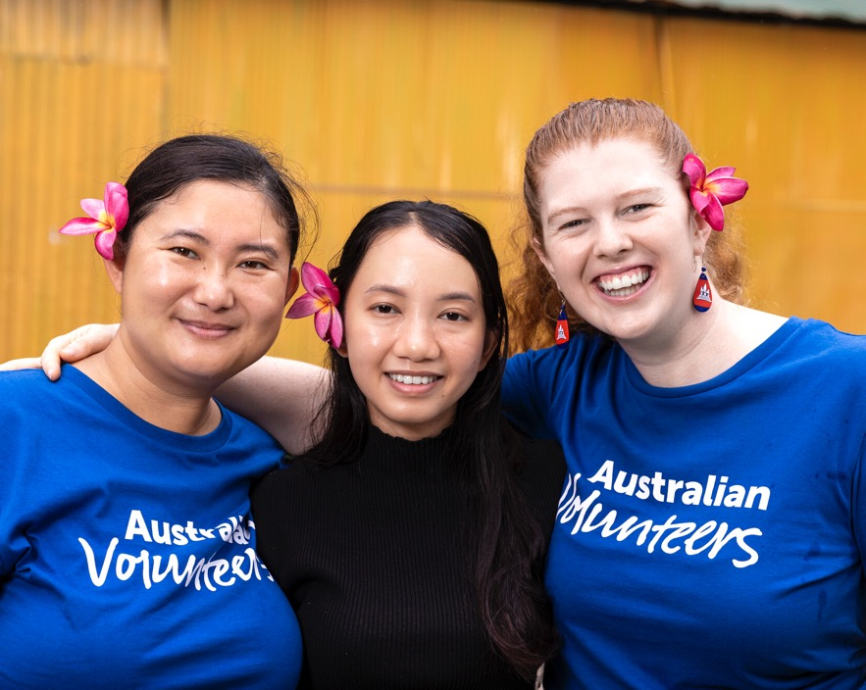
Meet Meg and Ugyen in Cambodia
Australian volunteers Meg and Ugyen work on a project that provides toilets in rural areas. ‘Having a toilet is something that Australians take for granted … Here in Cambodia, we are working to build toilets in challenging environments, such as communities that experience seasonal flooding, floating villages, hard ground, high ground water and water-scarce areas.’
Notes:
Show students where Cambodia is on the map. Meg and Ugyen are two engineers specialising in water, sanitation and hygiene (WASH). They volunteer with Engineers without Borders in Cambodia as part of the Australian Volunteers Program. Meg says: ‘I've learned so much more than I’ve been able to give.’ This is an example of a partnership where the rural people in Cambodia receive better sanitation and therefore better health outcomes, and the Australian engineers learn different ways of working.
Image credit: © Harjono Djoyobisono / Australian Volunteers Program, CC BY 4.0

