Slide 1
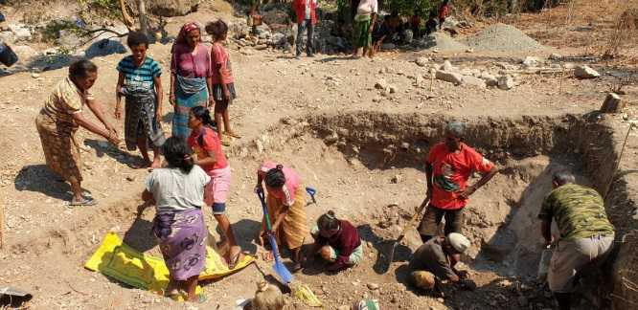
PARTISIPA
Still to be changed
July-December 2019
Progress Report

Slide 2
Structure of this presentation
PNDS Support Program
Startup of PARTISIPA

Slide 3
Factors Impacting the Program
Politics
Budget / Duodecimo
PNDS National Secretariat
Uma K’bit Laek program preparation
Transition into PARTISIPA
Deteriorating PNDS assets
New PARTISIPA design

Slide 4
What to celebrate
PNDS New projects
Changing scope of the Support Program
New relationships
Oe-cusse transfer and all bank transfers
Our team

Slide 5
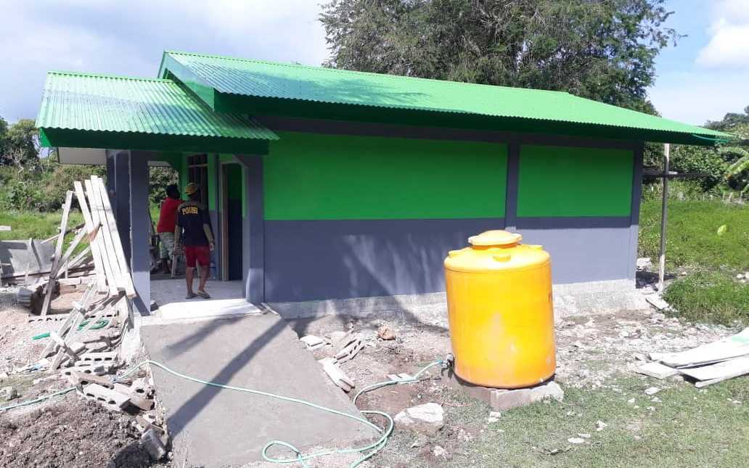
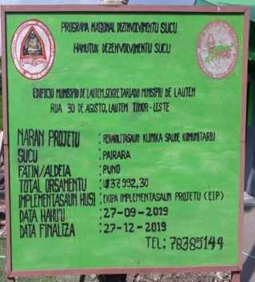
Progress for PNDS Program Support

Slide 6
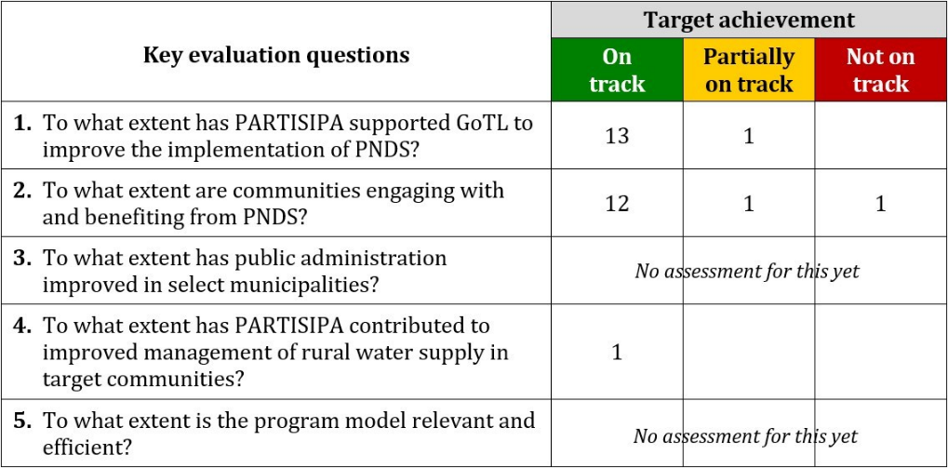
Overall Target Achievement
July – December 2019

Slide 7

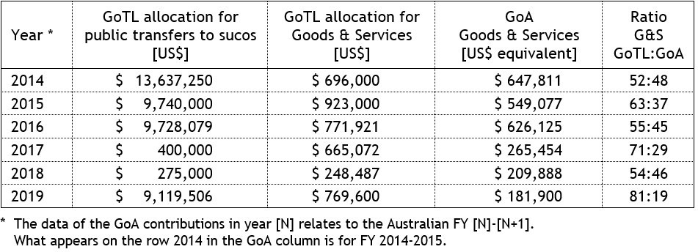
Amounts of investment into PNDS

Slide 8
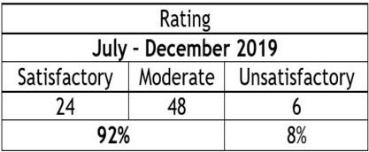
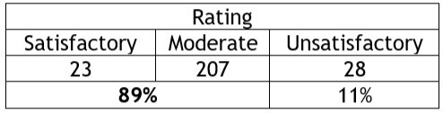
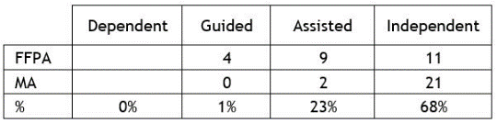
% sucos that achieve moderate or higher rating in the use of GFM 4 financial monitoring tools
FST Finance Officers visited 181 Sucos (326 visits). FSTs used the GFM 4 monitoring tool in 78 Phase 3 sucos.
There were 258 GFM 4 reports by FFPA and Municipal Accountants, submitted through the MIS application. Their rating is shown in the table on the right.
Capacity of PNDS Finance Staff to use the GFM 4 monitoring tool.

Slide 9


Gender Equality in PNDS projects
Target: 40% female participation / project priorities
30% female workers on PNDS construction
(29% in Cycle 1; 30% in Cycle 2).
40% female attendance all PNDS meetings / activities across all cycles (39% for Cycle 2). For 2019, % female attendance was 37%
Women priorities are 28% of the total, and
31% of the projects built came from women’s priorities.

Slide 10
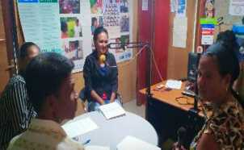
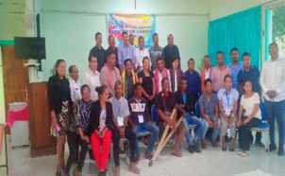
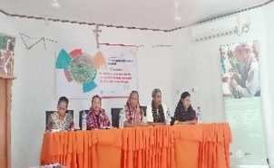
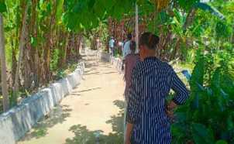
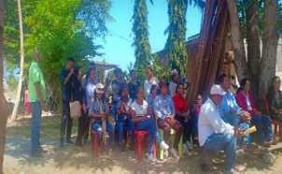
PNDS Gender & Social Inclusion Activities
Target: 75% of activities on-track
Two gender working group meetings.
Four radio talk shows.
Gender seminar and mini expo in Lautem.
Municipal Suco Cross-Visit to Suco Lalawa, Tilomar, in Covalima.
Inclusive development training for PWDs in Kupang, NTT, Indonesia.

Slide 11
Increase in number of PNDS projects

Slide 12
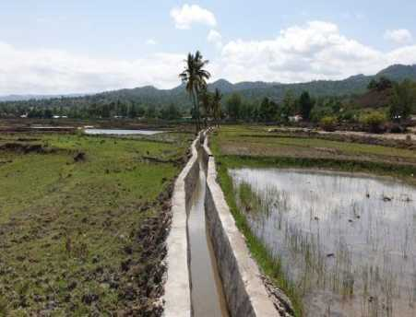
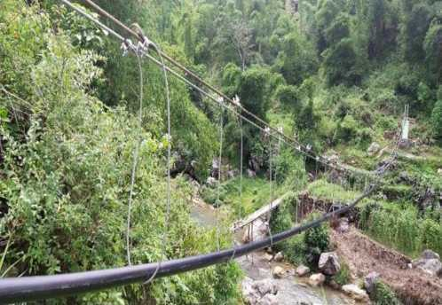
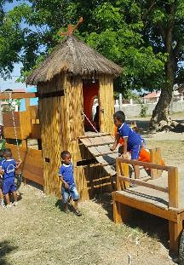
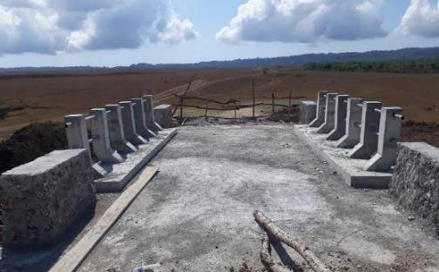
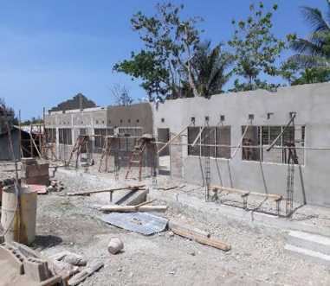
Suco Uatuhaco, Baucau. L: 1.8 km
Suco Atara, Ermera. Crossing: 52 m, L: 2 km
Suco Mascarenhas, Dili
Suco Fuiloro, Lautem.
Suco Tirilolo, Lautem. Progress: 47%

Slide 13
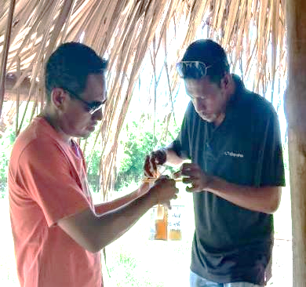
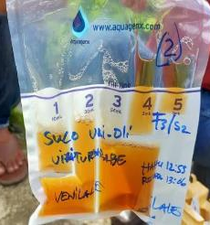
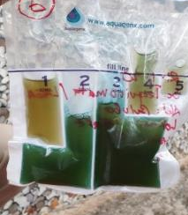
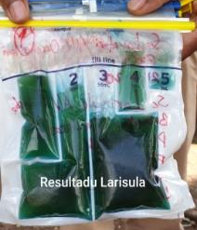
Water testing for e-coli in PNDS water supply projects
Tests conducted in 139 water supply projects
(12 Municipalities & RAEOA).
in 48 Administrative Posts (74%) and 112 Sucos (26%).
The E-coli test kits were obtained from PHD (150 kits). Some of these were used during the training.
The tests were conducted in two weeks in January 2020.
Low risk / safe
Intermediate risk /
possibly safe
Unsafe

Slide 14
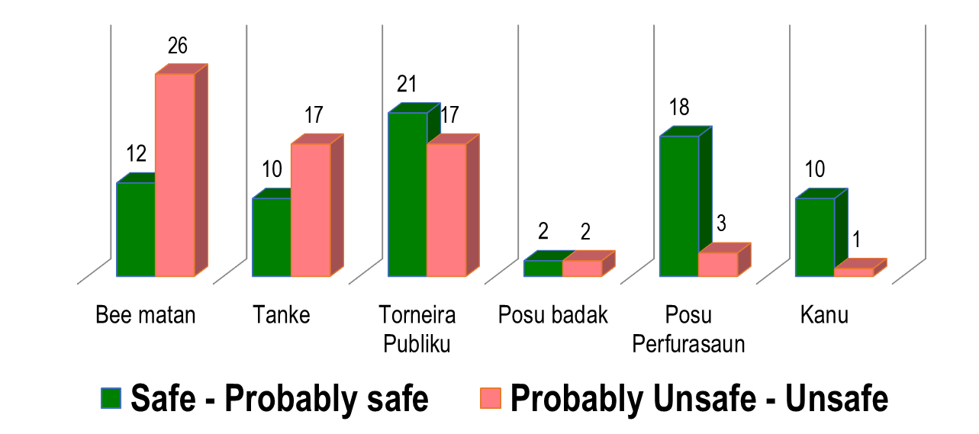
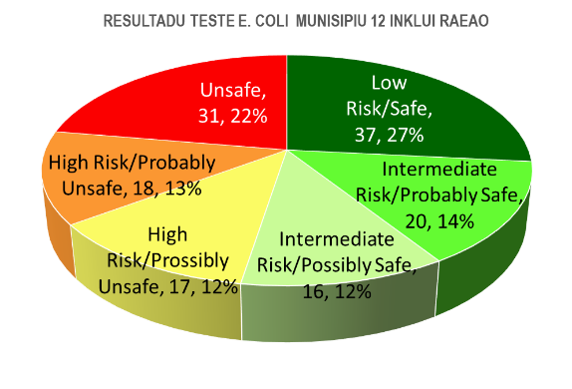
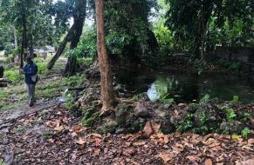
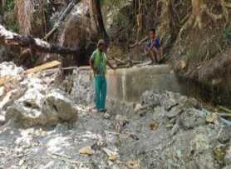
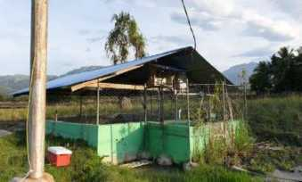
Water testing for e-coli in PNDS water supply projects

Slide 15
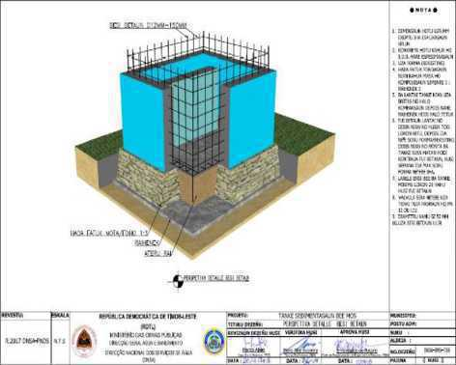
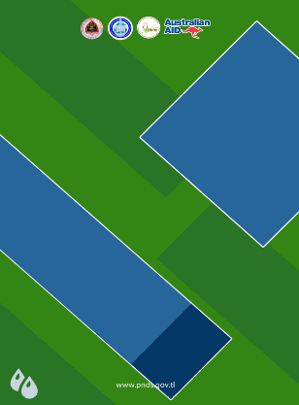
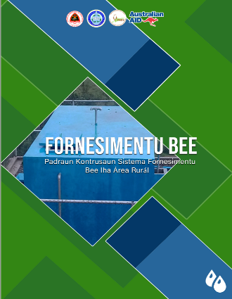

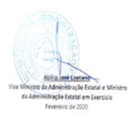

Instances of improved systems for service delivery

Slide 16
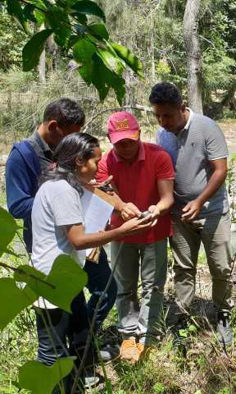
Frequency and coverage of Field Support Team visits
FSTs visited 224 Sucos with a total of 1,160 visits.
FSTs also provided support to the Municipal and Postu Teams on survey and design of the Education Infrastructure Projects implemented in nine Sucos, and to support with the 66 Playgrounds in 58 Sucos).

Slide 17
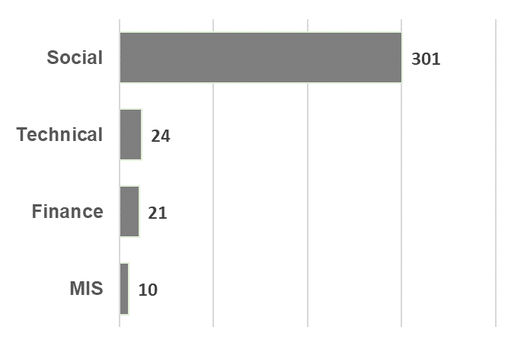
Frequency and coverage of Field Support Team visits
47 weekly wrap-up meetings with Municipal teams and Postu teams to discuss issues identified and encountered during field visits. There were 356 issues identified and reported by FSTs.
Social: 85%.
E.g. non-compliance with PNDS principles and implementation guidelines; issues about the motivation and capacity of the staff.
Technical: 7%.
E.g. project construction not in line with technical design; poor quality due to deviation from construction and material standards; not functioning or little uses projects (mostly water systems and road projects).
Finance: 6%.
E.g. suspicion of fraud/mis-management of funds; amount of cash-in-hand over the amount permitted.
MIS: 3%.
E.g. MIS data is not updated regularly; lack of capacity of Municipal MIS officers and others to input data.

Slide 18
Percent of MIS data complete on social, financial and technical activities input by municipal staff (target 70%)
MIS reporting for the 202 Phase 3 sucos
282 Cycle 2 projects, July to December 2019
Social data: For four events (i.e. signature of grant and implementation agreements, suco socialisation and priority setting), and 11 training modules - 76% complete.
Finance data: Operational Funds reporting: 93% complete
Infrastructure Fund reporting: 90% complete.
Physical progress data, from when construction started:
63% complete.

Slide 19
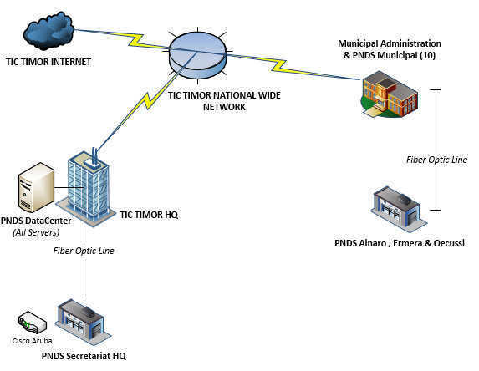
Migration of PNDS ICT infrastructure to TIC Timor
Objectives of the migration:
Better sustainability of ICT services through a full integration of the PNDS ICT infrastructure into the GoTL ICT agency (TIC Timor).
Eliminating, as of FY 2019-2020, a yearly cost of around
US$ 65,000 for PNDS internet & intranet services.

Slide 20
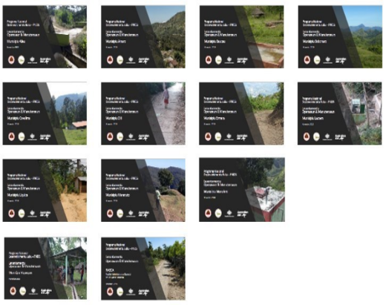
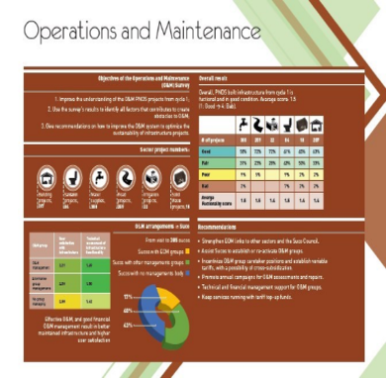
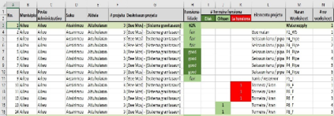
Follow-up to O&M Survey
Additional outputs prepared:
13 municipal summary reports.
Briefing note on O&M survey results (Tetun & English).
Spreadsheets with project assessment details.

Slide 21
Amount of budget spent on PNDS staff training and number of PNDS APF staff trained
Training delivered to PNDS staff (national and sub-national staff in July – December 2019)
GoTL (HCDF)
Technical training on the construction of school building projects;
Training on monitoring and evaluation of community projects;
Training/cross visit on gender and social inclusion;
Effective communication and teamwork skills training (focusing on PNDS priority settings and final accountability meeting);
Specialized technical training on operation and maintenance of water pump.
GoA (DFAT)
The water quality test (tools) training;
Intra-municipal finance cross visit (suco level)
Workshop on 2020-2021 GSI annual action plan review
GoNZ (HANDS)
Playground training on social, finance and technical aspects.
Descriptions | GoTL (HCDF) | GoA (DFAT) | GoNZ (HANDS) | Total
# of Training Covered | 5 | 3 | 1 | 9
# of Training Participants | 158 | 68 | 315 | 541
# of Training Days | 555 | 141 | 525 | 1221
# of Training Budget | $ 47,411.60 | $ 4,440 | $ 19,000 | $ 70,851.60
The reach of training by gender for PNDS Administrative Post Facilitators
Descriptions | M | % | F | % | Total
GoTL (HCDF) | 36 | 63% | 21 | 37% | 57
GoA (DFAT) | 6 | 40% | 9 | 60% | 15
GoNZ (HANDS) | 118 | 63% | 69 | 37% | 187
Total | 160 | 62% | 99 | 38% | 259
The proportion of support to training from the three governments during the period was 67:6:27 (GoTL:GoA:GoNZ).
If only comparing GoTL:GoA, then the ratio is 91:9.

Slide 22
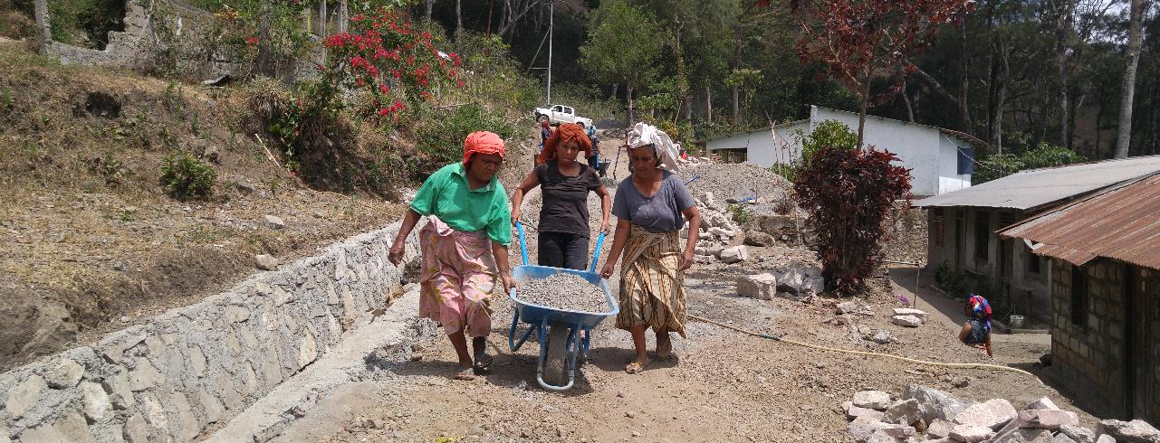
Corporate Services & Logistics:
PARTISIPA’s operational platform that supports program implementation with a focus on efficiency, compliance and risk management

Slide 23
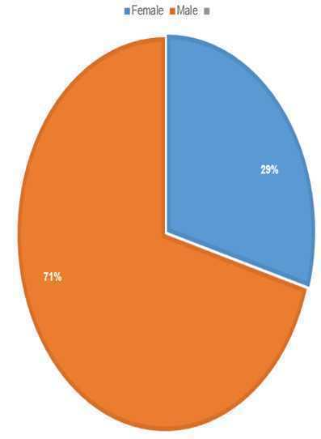
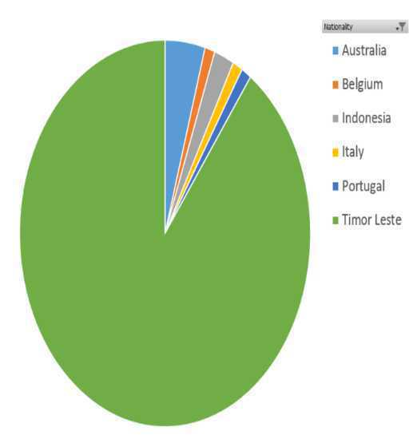
PARTISIPA Staffing Profile
Gender balance and nationality

Slide 24
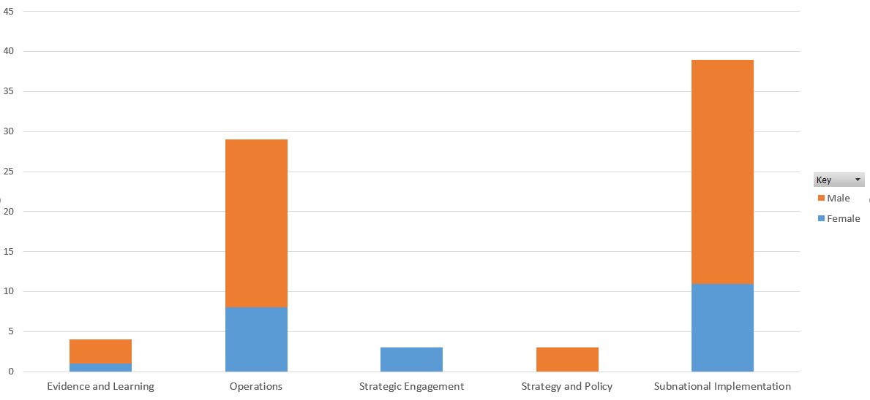
PARTISIPA Staffing Profile
Gender balance by team

Slide 25
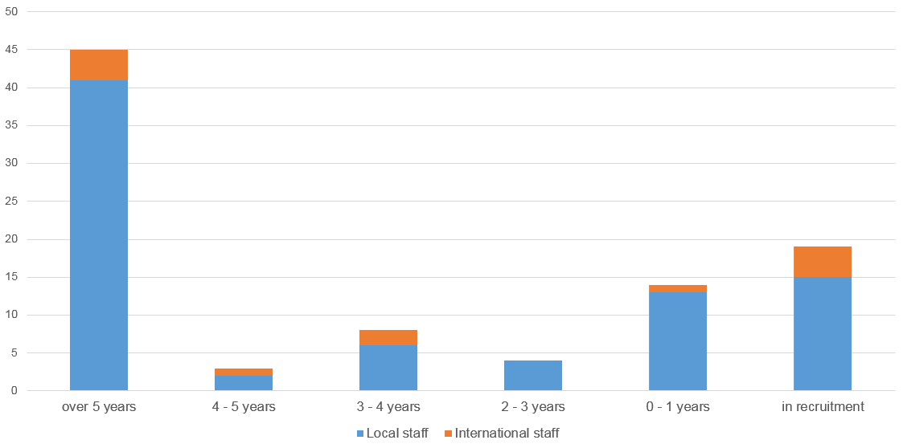
PARTISIPA Staffing Profile
Length of service

Slide 26
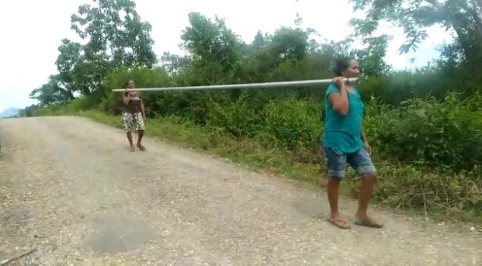
Logistics

Slide 27
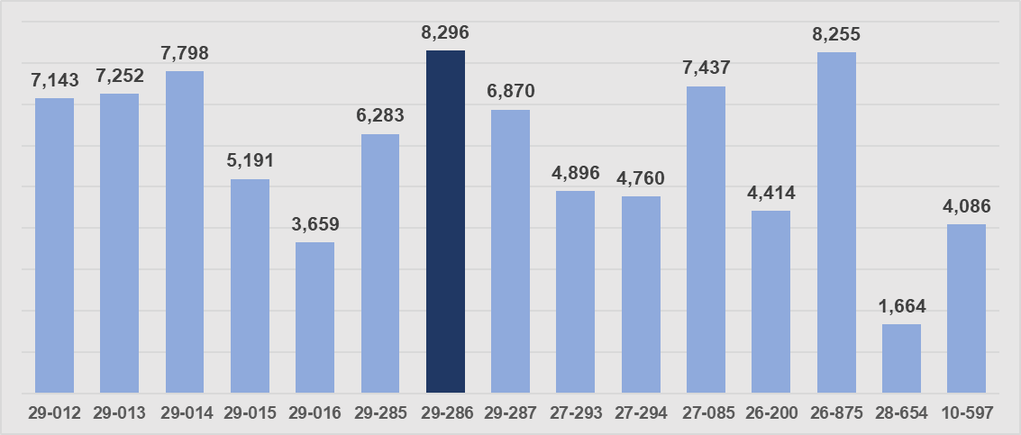
Transportation fleet Operations & Maintenance
Odometer readings for cars July to December 2019
Distance covered
Total for all vehicles (15 cars & 19 bikes): 90,232 km
(i.e. 2 x around the earth).
Max for a Land Cruiser: 8,296 km.
Average: 5,490 km per vehicle.
Fuel costs
Total fuel cost (6 months): $12,181
Max for a Toyota Land Cruiser: $1,233
Average: $641 per vehicle
Maintenance
Total maintenance costs (6 months): $20,389
Max for Ford Ranger 27-294: $5,900
Average: $1,274

Slide 28
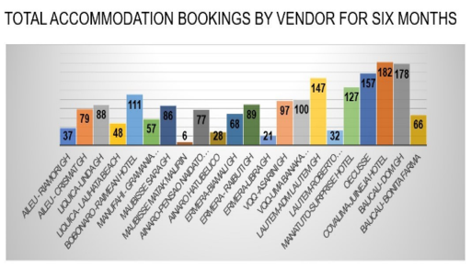
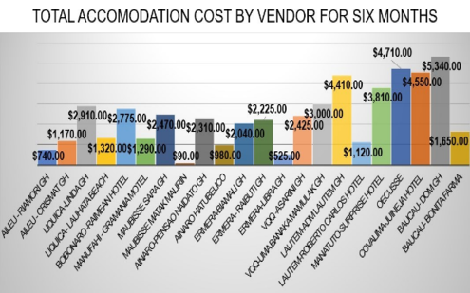
Accommodation bookings & costs
22 vendors with 1,881 bookings
(6 months), with an average of 85 bookings each
Highest bookings were Covalima Juinesa guest house at (182 individual bookings) and Baucau DOM guest house (178 bookings).
Total cost: $39,180
Highest Municipal costs were Ainaro ($5,850) and Baucau ($6,990).
Lowest Municipal costs was Aileu ($1,910).
Average booking cost (6 months) for all 22 GHs was $2,367.

Slide 29
Total number of activities & cost by month
4 activities
4
8
7
5
4
Total of 32 activities supported for six months.
Total activity cost as per procurement records was $78,681
Oct was the busiest month procuring approximately $42,000 of activities followed by Sep and Nov.

Slide 30
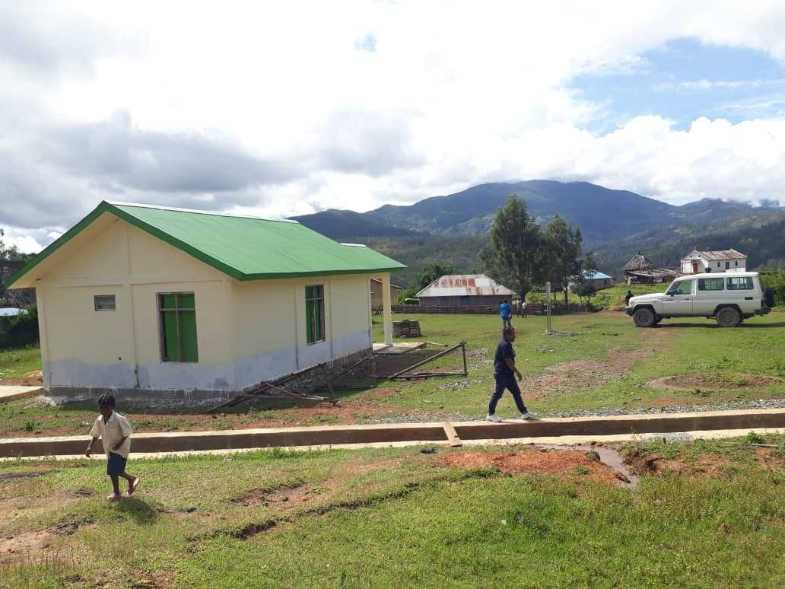
Startup of PARTISIPA

Slide 31
PARTISIPA Start Up - People
New team structures and expanded organisation chart
Team | Description | New Positions
Subnational Implementation Team | Support the PNDS Secretariat with the delivery of the PNDS Program Cycle Support the PNDS Secretariat and DNSAS develop and implement guidelines, technical construction standards, the PNDS Program Operations Manual | Senior Manager Subnational Implementation Team FST Engineering Coordinator x 2 (Dili-based) Development Coordinator Water Advisor (Ministry of Public Works) Operations and Maintenance Coordinator Water Officers x 3
Strategy and Policy Team | Support the development/co-ordination of inputs into legislation and policies for PNDS, rural water and municipal development Support the sharing of information from field, technical staff into decision makers, and vice versa | Senior Manager Strategy and Policy Team Senior Municipal Development Advisor Municipal Development Advisor Baucau Municipal Development Advisor Bobonaro Municipal Development Advisor Ermera Planning and Coordination Advisor Public Financial Management Advisor Gender and Social Inclusion Advisor Inclusion Coordinator

Slide 32
PARTISIPA Start Up - People
New team structures and expanded organisation chart
Team | Description | New Positions
Strategic Engagement Team | Support the bilateral relationship mechanism between GoA and GoTL in relation to PARTISIPA Compliment and strengthen the relationships across senior levels of Government Co-ordinate selected policy or advocacy activities within PARTISIPA | Legal Advisor Graphic Designer x 2 (STA)
Evidence and Learning Team | Lead on M&E, reporting and work planning Co-ordinate training support for GoTL (including HCDF) Co-ordinate ICT technical support for both GoTL & PARTISIPA | Capacity Development Coordinator Communications Officer Database Coordinator
Operations Team | Logistics, procurement, facilities, asset management, WHS and security, human resources, finance, administration, contracts, program policies and compliance | Operations Manager Senior Driver Driver x 2

Slide 33
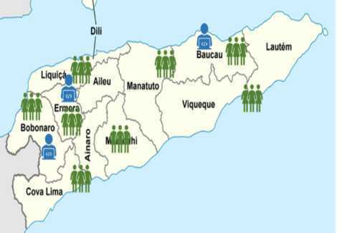
PARTISIPA Start Up - People
Basing staff in subnational locations
All staff had Dili-based contracts under PNDS-SP. PARTISIPA will have staff permanently based in Baucau, Bobonaro and Emera.
This has required changes to operational policies and procedures in:
Recruitment
Contracting
Personnel management
Logistics and fleet management
Per diems and accommodation
Assets and equipment

Slide 34
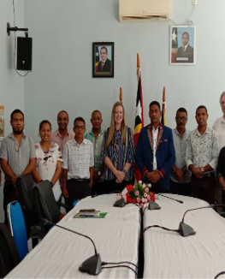
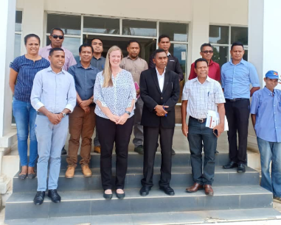
Municipal Approach
Committee lead by PARTISIPA staff – representing advisors, operations and field support team
Development of a concept paper, consultation with broader staff
Development of a menu of PARTISIPA scope for municipalities
Discussion on operational implications: logistics, activity management, lines of reporting, reporting
Planning of relocation to the Municipalities
Development of situation analysis template
Preparing for first Municipality priorities workshop

Slide 35



Strategy & Engagement
PMO - Comms materials PMO guidelines for PMO Comms, VIII GOTL comms strategy presented and approved by TMR, VIII Govt 2019 and 2020 budget comms materials, Uma K’bit Laek initiative
Legal Advisor – drafting PNDS, PDIM, Division of Territorial Administration Law
MAE strategic work – PARTSIPA approach, recruitment, discussion around expanded scope
The start of a more structured way of working – next step is work on the broader policy agenda

Slide 36

To what extent is the program model relevant and efficient?
This time last year we were asking the questions – what did the complexities mean for the relevance and future of PNDS-SP?
Season of adaptation – broadening scope, new relationships, changes in roles, even our name!
Early days – however some assumptions are proving accurate – that a broader scaffolding provides a more relevant set of interventions in a complex landscape
Some risks (ie PNDS push back) did not take place, in fact the change in dynamic has been positive
GoTL relationships are strengthened both bilaterally and within the program
The program is much more visible
The foundation stones are being laid to build a program that instead of being a silo, is well placed to strengthen the broader aid program – a sector blind foundation that can test, implement and understand service delivery challenges from national to village level

Slide 37


