Slide 1
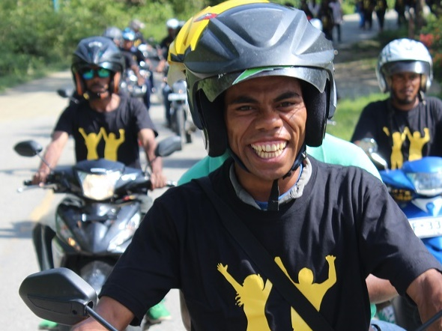
Nabilan 6 monthly progress briefing January – June 2018

Slide 2
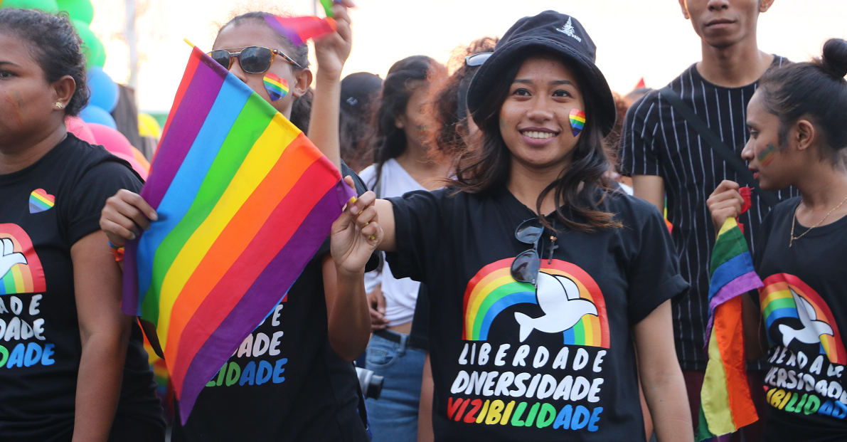
Context update
Increasing recognition of Nabilan’s high quality social norms change work.
Budget cuts from MSSI for services partners (FOKUPERS, UMS & Casa Vida) putting increased strain on services.
Personal/group activism increasing and becoming more visible (e.g. Pride March 2019).
UN-EU Spotlight initiative will inject considerable funding into EVAW programs in Timor. Creates both high risk and opportunities.

Slide 3
Our key evaluation questions
KEQ1 How effective was the Nabilan program in ensuring women and children who experience violence have access to adequate and responsive services?
KEQ 2 To what extent are individuals, communities and institutions taking action to reduce violence against women?
KEQ 3 What key factors will contribute to the sustainability of the Nabilan program outcomes beyond the end of the program?
KEQ 4 Are there indications that the Nabilan programming model has contributed, or could contribute, to changing social norms relating to VAWC in Timor-Leste?
EOPO1: Women and children who experience violence have access to quality and inclusive services
EOPO2: Individuals, communities and institutions take action to reduce violence against women and children
Sustainability
Appropriateness

Slide 4
KEQ1, EOPO 1: What did we do?
Continued funding 6 key services & ATJ partners. Provided total USD $405,891.42 in grants: ALFeLa, PRADET, Casa Vida, FOKUPERS, UMS and JSMP.
Completed delivery of third round of Cert III in Social Services for 23 students.
Funded PRADET to train 13 new medical forensic examiners.
Trained 14 services staff on counselling skills.
Audited 132 cases from services partners. PRADET separately audited 67 medical forensic protocols.
Continued to provide training and TA to partners, including partnering with HAI and Catalpa on training for midwives.

Slide 5
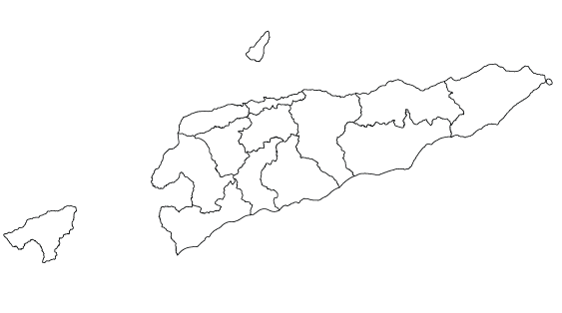
VAWC services
Nabilan Partner Locations:
5 municipalities
14 offices
Dili
FOKUPERS
Casa Vida
PRADET Fatin Hakmatek
ALFeLa
300
50
353
Other Service Locations: 6
225
Baucau
PRADET Fatin Hakmatek
ALFeLa
30
184
FFCJ (shelter)
75
120
Uma Paz Baucau (shelter)
Maliana
PRADET Fatin Hakmatek
FOKUPERS Maria Tapo Maliana
64
120
Lospalos
Uma Mahon Lospalos (shelter)
15
Viqueque
Uma Mahon Viqueque (shelter)
Oecusse
PRADET Fatin Hakmatek
ALFeLa
14
106
52
FPWO (shelter)
5
Manufahi
Uma Paz Manufahi
Total likely number of unique VAWC cases reaching service provider/s per year: 800 – 1,000
Total no. of ever-partnered women/girls aged 15-49: 286,890
% who have experienced IPV in last 12 months: 49% = 140,576
% who have ever reported to health clinic or legal aid org or NGO: 0.04% = 562
2
Suai
PRADET Fatin Hakmatek
ALFeLa
Uma Mahon Salele
FOKUPERS (MSSI-Uma Tranzitu)
85
51
23
60

Slide 6
KEQ1, EOPO 1: What did we achieve?
Nabilan Services partners supported 738 new clients new clients (695 F, 43 M), compared with 561 new clients in previous reporting period.
Total of 4,048 services provided, compared with 4,298 in the previous reporting period.
13 new medical forensic examiners graduated – this brings the total active examiners to 41, compared with 28 before the training .
22 students (21 F/ 1 M) will graduate from the Cert III course (out of 23).
Counselling training reinforced key ethical behaviours and core counselling skills with post-test showing positive changes.
VAWC and referrals training for health professionals in Lospalos and Illiomar showed improvements across 6 key knowledge questions.
On track against: indicator 1: No. of new clients steady compared with 2017.
On track against indicator 2: No. of services steady compared with 2017.
On track against indicator 3: No. of participants completing Cert III, 4R and MFE training.
On track against indicator 4: At least 50% of participants in each training demonstrate improved skills/knowledge at end of training.

Slide 7
New clients by age
New female clients who are FHH
New female clients by disability status
On track against indicator 8: Maintain or increase in proportion of clients with disabilities (and other vulnerable clients)

Slide 8
New clients by municipality

Slide 9
New clients by case type

Slide 10
Referrals made to partners
On track against indicator 9: 5% increase in referrals from outside the referral network by 2020; and 10% increase in referrals made between service providers

Slide 11
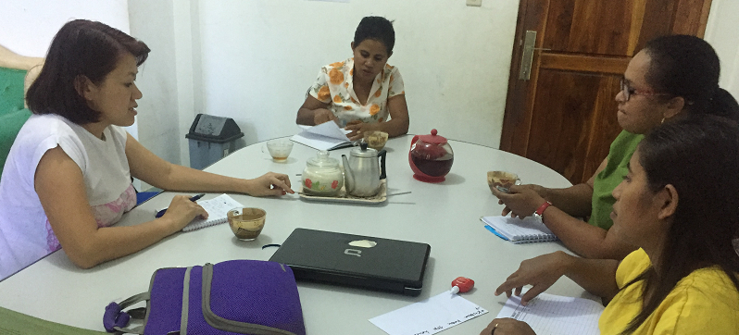
Case audit
November 2018 – audited 207 cases
July 2019 – audited 132 new cases (24%)
On track against indicator 9 – by June 2019, at least 70% of cases meet minimum standards. By June 2021, at least 70% of cases demonstrate high quality.

Slide 12
Cases monitored by type
Charging in DV physical assault cases
Sentencing in DV physical assault cases
Indicators 10 & 11: waiting full 2019 year statistics from JSMP.

Slide 13
KEQ1, EOPO 1: Findings
EOPO1: Women and children who experience violence have access to quality and inclusive services – is On Track.
Quality of services has increased, including capability of partner staff through Cert III, case audits, counselling training and regular TA.
Many clients supported by Nabilan are particularly vulnerable – 24% children; 11% FHH; 3% with disability.
Challenges remain in delivering services to people with disability, such as lack of specialist support for people with intellectual disability – however these constraints are beyond Nabilan’s sphere of influence.
Low awareness of health sector workers on what is DV and referrals is alarming.
Nabilan partners are likely seeing most cases of VAWC reported in Timor-Leste (based on % prevalence rates for 12 months and % who report to a formal service or police).

Slide 14
KEQ1, EOPO 1: Recommendations
Explore why client numbers are so low in Manatuto and Aileu – discuss with PLAN and World Vision (Aileu) and work through CPSP for training police.
The increase in accredited medical examiners, particularly doctors, will improve victim’s access to timely examination and treatment through the referral hospitals – promote this with MoH.
Consider adding activities/indicators about making services more accessible for PWD, beyond counting no. of clients.
Work more closely with DPOs to identify barriers when referring people to other services and promote links between DPOs and VAWC services.
Consider topics for JSMP thematic reports which will contribute more strategically to EOPO1 e.g. amendments to Penal code and Law Against Domestic Violence; Violence against children; impact of charging on sentencing outcomes.

Slide 15
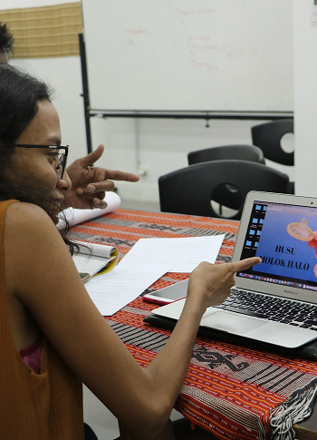
KEQ2, EOPO 2: What did we do?
Provided grants totalling $102,272.44 to 4 prevention partners: FMDC, MHVF, CODIVA and PRADET-PDC.
Set up two partners – CODIVA and PRADET-PDC – to run KOKOSA! in Dili under new grants.
Continued KOKOSA! Phase II (Awareness/Konxiensia) through 12 community mobilisers and 4 community action groups.
Continued to support Change Ambassadors Network and finalised the training manual.
Conducted media monitoring using a new matrix.
Held positive messaging workshop with activists and SEII.
Supported the independent feminist movement, Grupu Feminista and BuiMau, and Movimentu Letres.

Slide 16
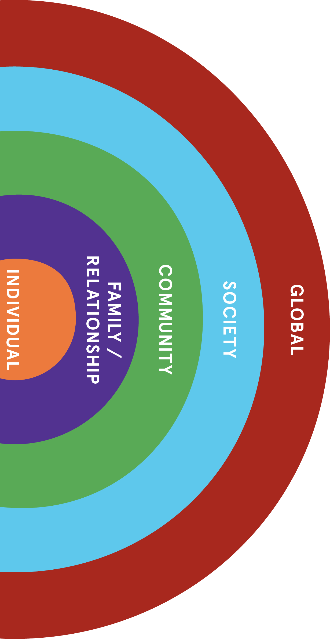
KEQ2, EOPO 2: What did we achieve?
Nabilan is reaching all levels of the ecological model.
Prevention partners (FMDC, PRADET-PDC and MHVF) worked at individual, family/relationship, community and society levels:
covering 5 sukus in 5 municipalities and media coverage in all municipalities
76 activities and 2 follow-up visits
reaching 235 women and 283
FMDC in particular are seeing positive attitude changes in their participants
Nabilan is supporting integration of quality prevention messaging through the Change Ambassadors’ Network.
Nabilan’s SASA! adaptation (KOKOSA!) is contributing to the global understanding of effective EVAW.
Progress against indicator 14: Number of Nabilan-supported prevention activities reaching: individuals, families/relationship level, communities, institutions, society (Target: At least one activity at each level)
Progress against indicator 15: Number of people reached by each prevention activity. Disaggregation: gender, disability, location (when available).

Slide 17
Support to partners
Prevention partners were provided intensive TA to improve their methods. Lancet Effectiveness Scale showed all improved in effectiveness:
On track against indicator 16: Effectiveness score for partner prevention programming. Target: Each partner has an annual score increase of at least 5% or reaches score of 28 by 2022.
 | Pre-program | Post-program | Difference | % difference
FMDC | 19 | 28 | +9 | + 47%
PRADET-PDC | 18 | 27.5 | +9.5 | + 53%
MHVF | 13.5 | 18 | +4.5 | + 33%
FMDC: aggregate pre and post testing of Radio Listening Group participants show pre-radio listening groups show change in attitudes related to VAWC:
On track against indicator 22: Proportion of participants displaying improved knowledge and attitudes related about VAWC Disaggregation: gender
Pre-test: agreement/ strong agreement with gender inequitable statements | Post-test: agreement/ strong agreement with gender inequitable statements
49% of female participants 44% of male participants | 17% of female participants 16% of male participants

Slide 18
Positive messaging for social change
Nabilan continued to support the feminist movement in Timor and activists.
An example was the positive messaging workshop with 16 activists and SEII which built their capacity to develop effective social norms change messages.

Slide 19
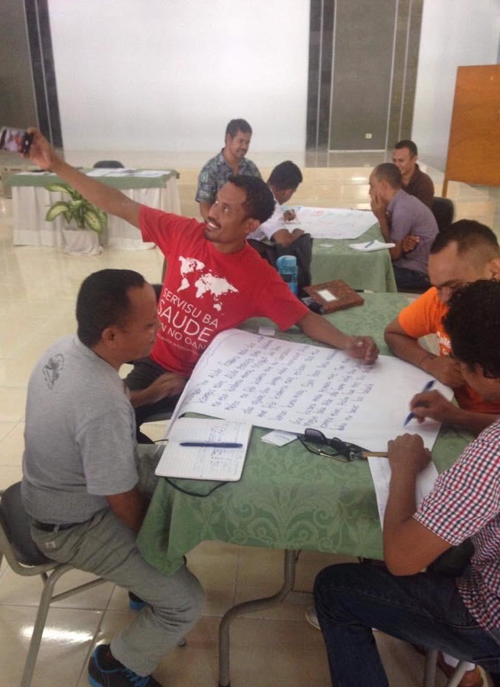
Promoting quality prevention work
Members of Change Ambassadors’ Network are sharing their learnings and materials with staff and other organisations – good examples from Care, MSTL and PNDS.
Active members: RHTO, PNDS, ALFeLa, MHVF, PHD, FMDC, Water Aid, R4D, HAI, Care, PRADET, Plan, FOKUPERS, MSTL
Non-active members: TOMAK, WDPTL, Child Fund, ADTL, CVTL
Making progress against indicator 19: Examples of Change Ambassadors integrating quality prevention approaches in their own programs.
On track against indicator 20: At least 20 by end 2019 have continued to participate in the network.
On track against Indicator 21: At least 70% of Change Ambassadors have improved knowledge and feel confident about integrating effective prevention messaging into their programs

Slide 20
KOKOSA!
KOKOSA! is gaining momentum in Suku Letefoho.13 Community Mobilizers (9 F/3 M) conducted 86 activities involving 983 community members (570 F; 413M – all above 15 years old) – total population of Suku Letefoho is 7,573 – therefore KOKOSA! directly reached around 12.9% of the population.
There are KOKOSA! activities happening at the institutional level through the newly created Prevention Network, strengthening the relationships with the Municipal Administrator, SEII and MSSI and other partners.
15 new mobilizers have approached Nabilan and received Start training.
Promising signs of the community taking self-led, collective action on VAW.
Delayed against Indicator 23: Completion of all four phases of SASA! in Suku Letefoho by July 2020. Expect to complete Phase II (Awareness) between September – December 2019.
Not on track against Indicator 24: No. of activities conducted by CMs to prevent VAWC in Suku Letefoho – Phase II – minimum 4 activities per CM per month.
On track against Indicator 25: Number of collective action taken by community members in Suku Letefoho to prevent VAWC

Slide 21
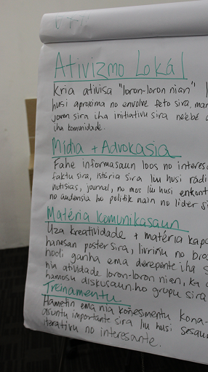
Nabilan’s influence
Nabilan baseline data used by UN and EU as basis for the Spotlight intervention. UN is interested in supporting SASA! work in Timor under Spotlight.
The scale-up of KOKOSA! in Dili (Suku Santa Cruz and Suku Caicoli & Mascarenhas) will increase visibility of KOKOSA! and has potential to influence more organisations and government agencies.
Nabilan’s work (KOKOSA!, Hamahon etc) is regularly referenced by SEII, for example:
GoTL VNR on SDGs in New York
Progress against Peking Declarations on 11 April 2019
Statements during CSW 2019
On track against Indicator 26: Instances where other agencies have adopted the key approaches and learning from the CBA pilot.

Slide 22
Media monitoring results
Sex of journalist
Topic
114 relevant articles analysed Jan – June 2019
Quality of reporting
Information source

Slide 23
KEQ2, EOPO 2: Findings
EOPO2: Individuals, communities and institutions taking action to reduce violence against women– is On Track.
Substantial progress against EOPO2 in the last 6 months, with greater clarity and structure to Nabilan’s approach to social norms change, and a substantial increase in community and partner engagement (“more hope”!)
The main activity under EOPO 2 is KOKOSA!, the expansion of which is on track. KOKOSA! Letefoho is still behind but we are catching up.
Slight delay with the Change Ambassadors work, as the approach to the network and to M&E continues to be refined.
KOKOSA! in Dili has the potential to create that larger momentum for social norms change.
Nabilan is highly regarded by Raising Voices as a responsible partner in SASA! implementation.
Nabilan is trusted by feminist groups and activists. This trust has been built by providing flexible funding and giving groups space to develop their own messaging, with our support.

Slide 24
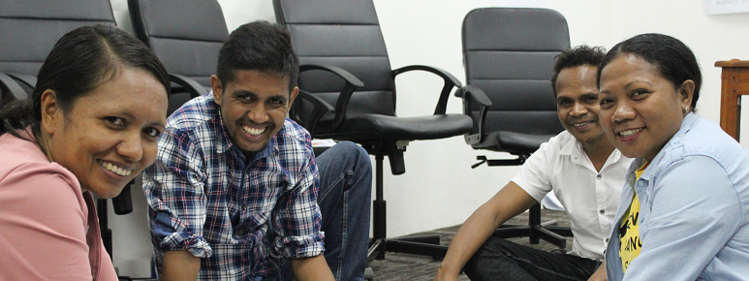
KEQ2, EOPO 2: Recommendations
Use results of media monitoring for further training with journalists.
Consider how to strengthen evidence collected by prevention partners.
Update MELF to reflect change in programming.
Need to be more systematic about capturing impact of Change Ambassadors’ Network and get the manual out. Consider also where to from here for the Network – increasing demand for training and Spotlight.
Keep going – we are now on track!

Slide 25
Update on KEQ3: Sustainability
Rated as “some delay’.
PRADET has been given a 20 year lease at Vera Cruz – however there is no funding for building a new FH.
While SEII supports Nabilan’s prevention activities, this has not translated to extra resourcing. SEII’s execution of its own budget has been very low. Spotlight and other competing demands on SEII’s attention is a risk.
MSSI has reduced its funding overall for community, EVAW and disability sector - $2.5 million reduced to $1.4 million. They specifically reduced funding for Nabilan partners.

Slide 26
VAWC services funding
Total MSSI funding commitment for specialised VAWC services in 2019: $380,935.70 (+ Uma Paz Baucau – figure not available)
Total Nabilan commitment for VAWC services in 2019: $853,600.00

Slide 27
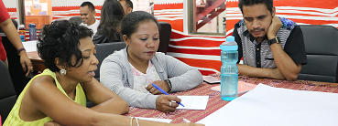
Looking forward
Implement our new Government-approved workplan for July 2019 – June 2020.
Support services partners to advocate for increased MSSI funding – using CEDAW and budgeting process.
New round of counselling training in October.
Raising Voices visiting Dili in October to check on KOKOSA! work.
Baseline for KOKOSA! Dili and set-up phase continuing.

Slide 28
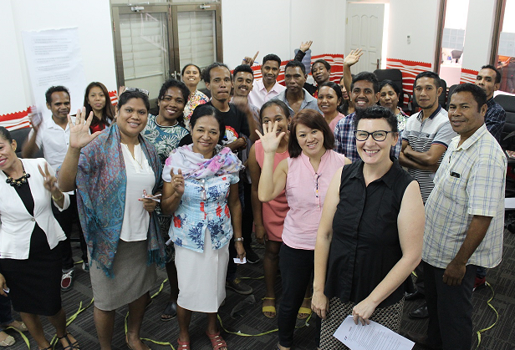
Obrigada

