Slide 1
Sustaining water
Notes:
Map adapted from: © VectorStock

Slide 2

Module learning intentions
We will learn about:
water resources in our Indo-Pacific community
water challenges and how communities are working to develop sustainable solutions.

Slide 3
Module success criteria
We will be able to:
talk about water resources using geographic words
describe water challenges and how they affect people
think of technological solutions for challenges and explain how they could help now and in the future.

Slide 4
Water as a valuable resource
Lesson 1
Notes:
Image credit: © Australian Government Department of Foreign Affairs and Trade

Slide 5
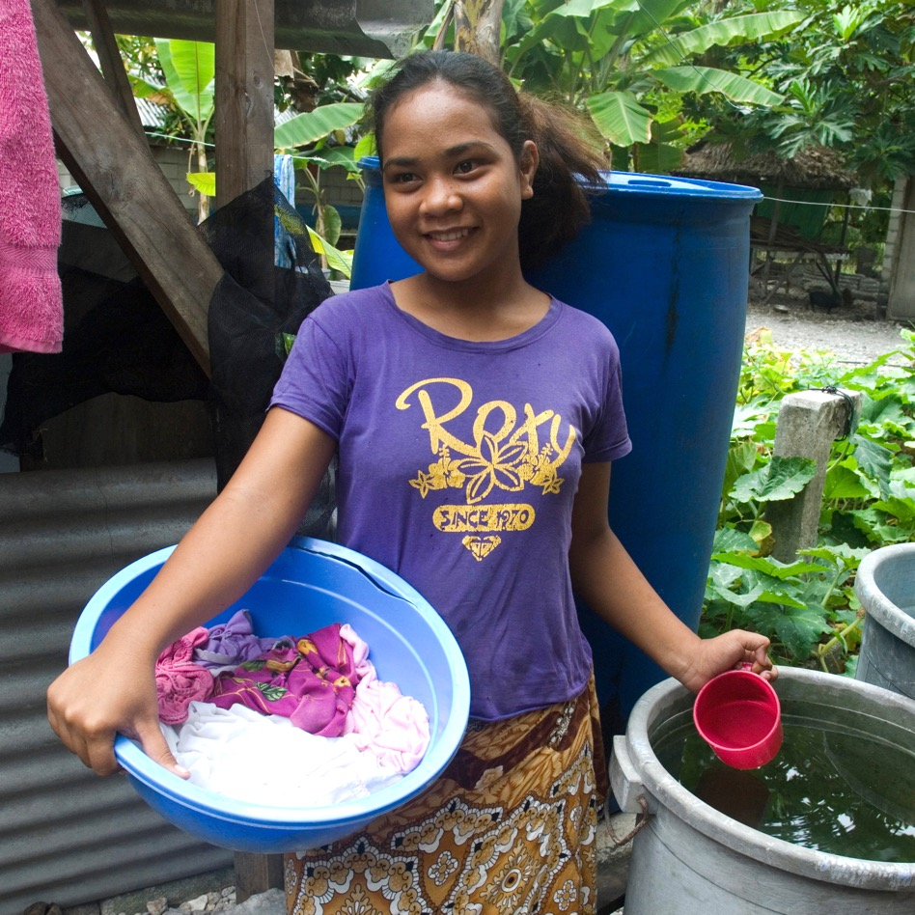
Learning intentions: Lesson 1
To think about why water is important in Australia and other Indo-Pacific countries.
To learn how water resources are managed.
Notes:
Image credit: © Australian Government Department of Foreign Affairs and Trade

Slide 6
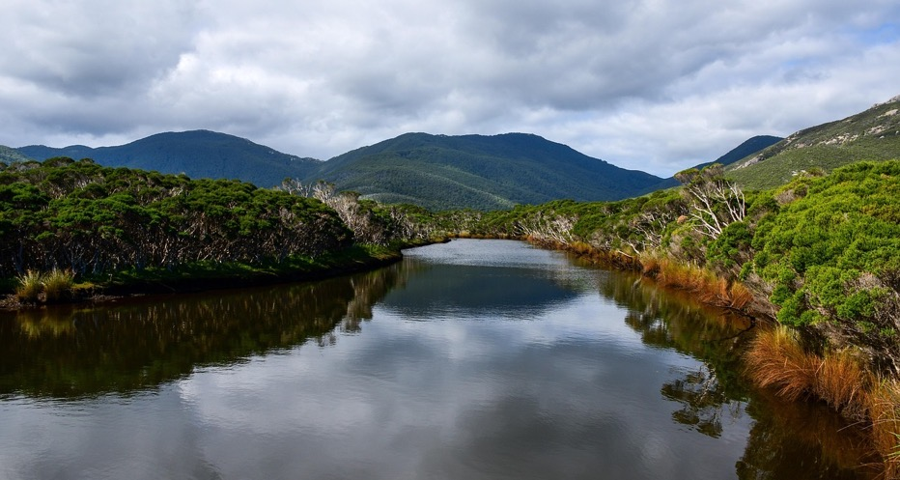
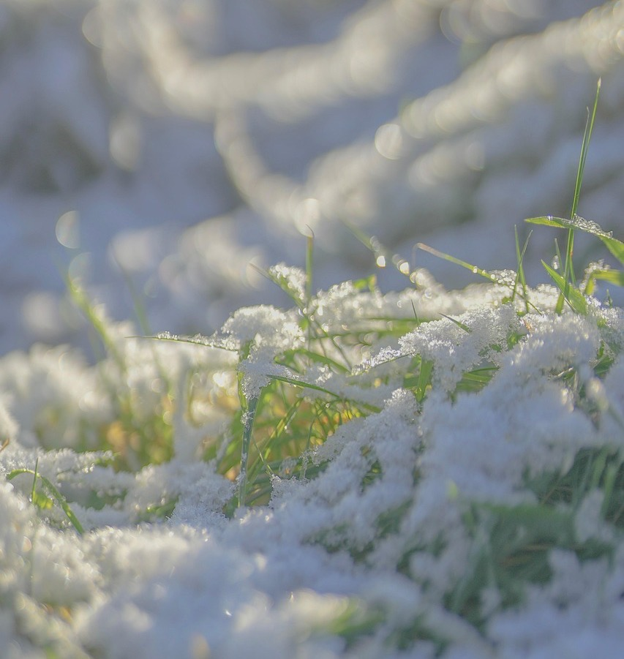
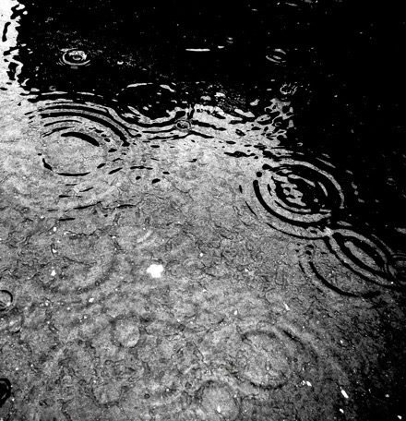
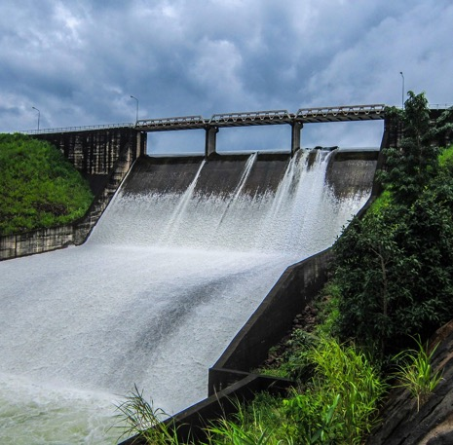
Surface water
Notes:
Surface water
Surface water is the fresh water on the surface of our Earth. It comes from rain and snow, and runs into rivers, streams, creeks and lakes (water catchments). In cold places like Antarctica, surface water is ice. Most tap water is surface water even though surface water only makes up a tiny fraction of the water on Earth (1%).
Image credits (clockwise from top left): rossbry via Pixabay; mariya_m via Pixabay; soukmano via Pixabay; Lernestorod via Pixabay

Slide 7
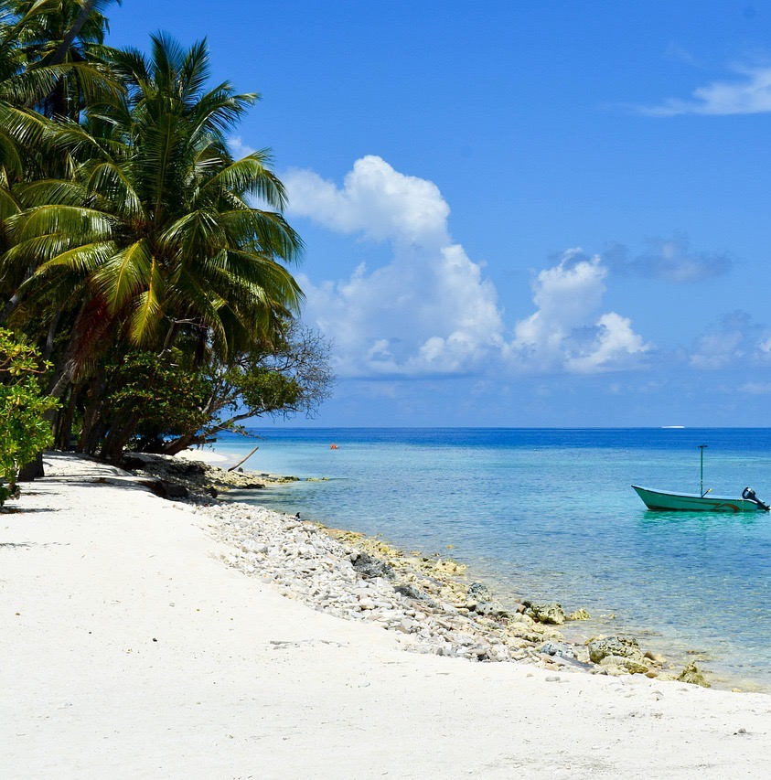
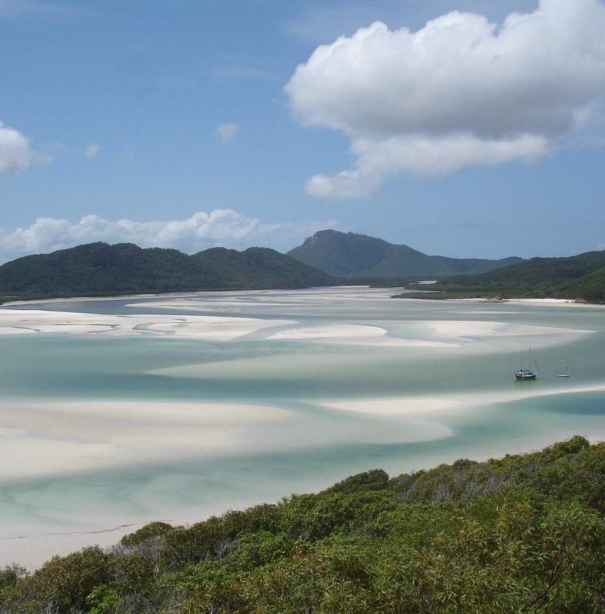
Sea water
Notes:
Sea water
Sea water comes from the seas and oceans. Most of the water in the world is sea water (97%) but we cannot drink it in its natural state because it is too salty. It can be desalinated (which means the salt is removed) in special water treatment centres. In Australia, some cities such as Perth and Adelaide use desalinated tap water, but it is rarely desalinated in other cities, such as Melbourne and Brisbane.
Image credits: Shine2705 via Pixabay; Birger Kühnel via Flickr, CC BY-SA 2.0

Slide 8
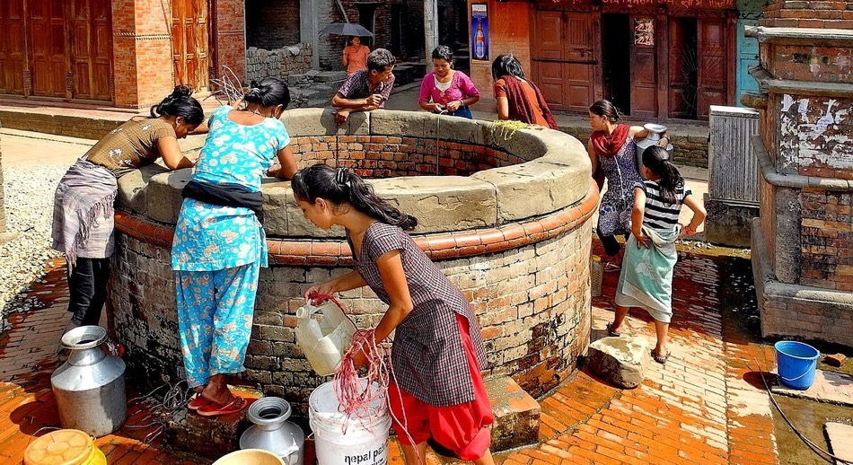
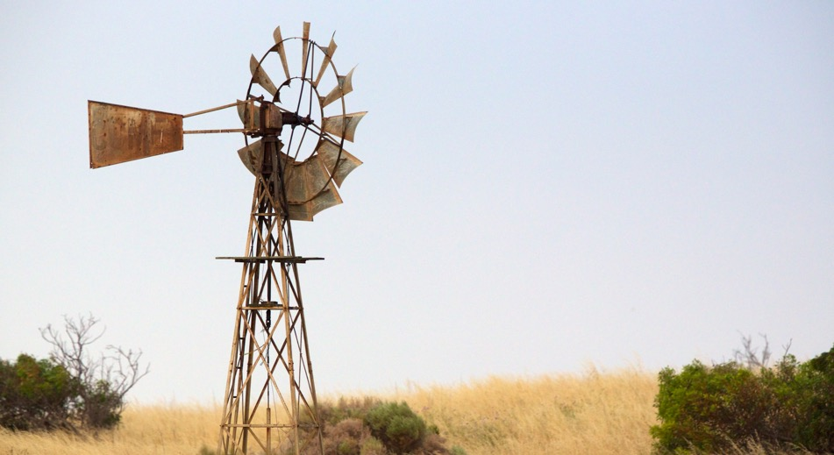
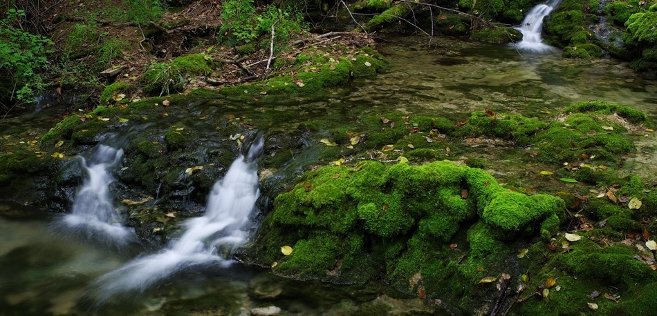
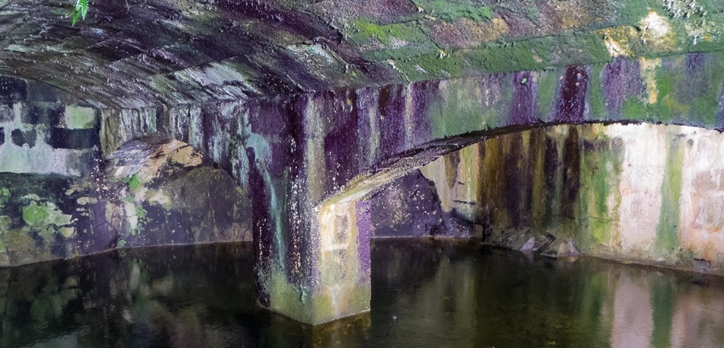
Underground water (groundwater)
Notes:
Underground water (groundwater)
Underground water starts off as surface water (rain, ice and snow) that seeps into the ground and is stored in underground basins (aquifers). It is reached through wells or natural springs or pumped out of the ground from a bore. Some underground water can be very clean (such as spring water); other underground water requires treatment to clean and improve it. In Australia, underground water is mainly used for watering crops and parks and feeding animals on farms. Any tap water that uses underground water is specially labelled as bore water and is not safe to drink. Underground water makes up 30% of all the world’s fresh water but much of it is unused.
Image credits (clockwise from top left): Wikimedia Images via Pixabay; julie burgher via Flickr, CC BY-NC-SA 2.0; Carlos_Ramón_Bonilla via Pixabay; wbuz010 via Pixabay

Slide 9
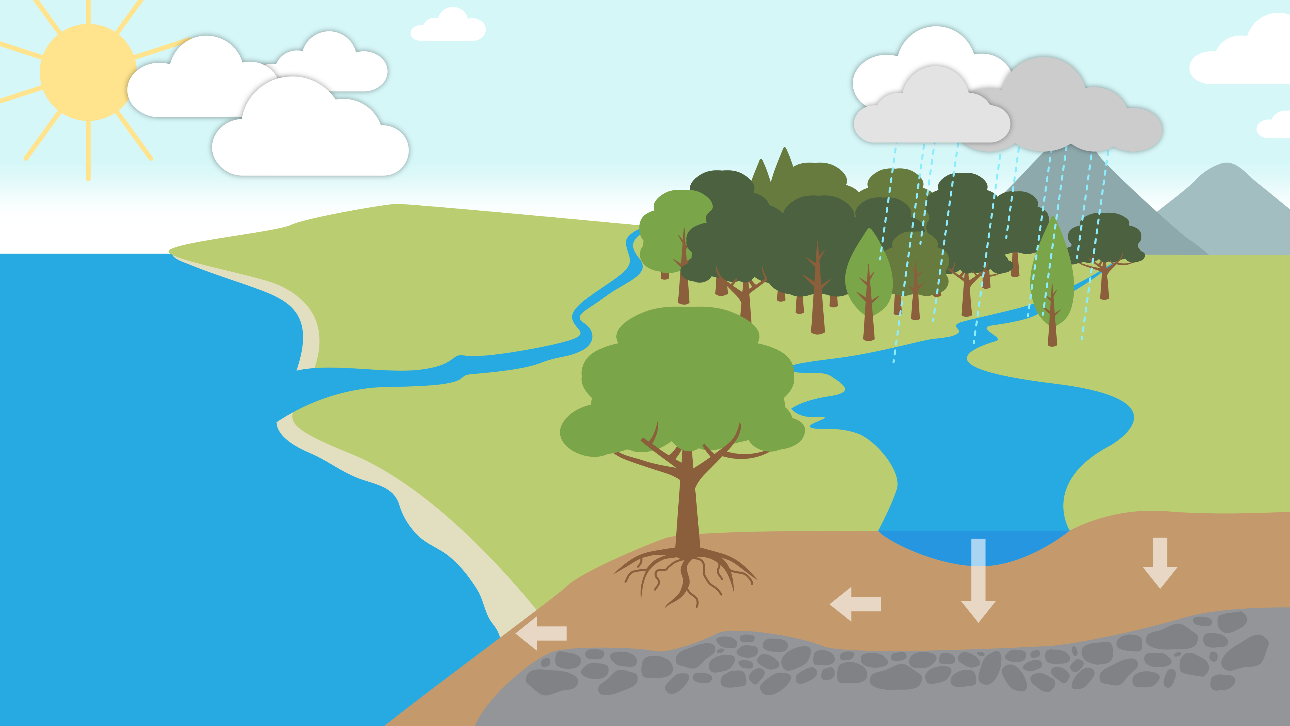
Water sources infographic of water cycle
Water sources
?
?
?
Notes:
Water is stored in rivers and lakes (surface water), and seas and oceans (sea water). Some water soaks into the ground (groundwater).

Slide 10
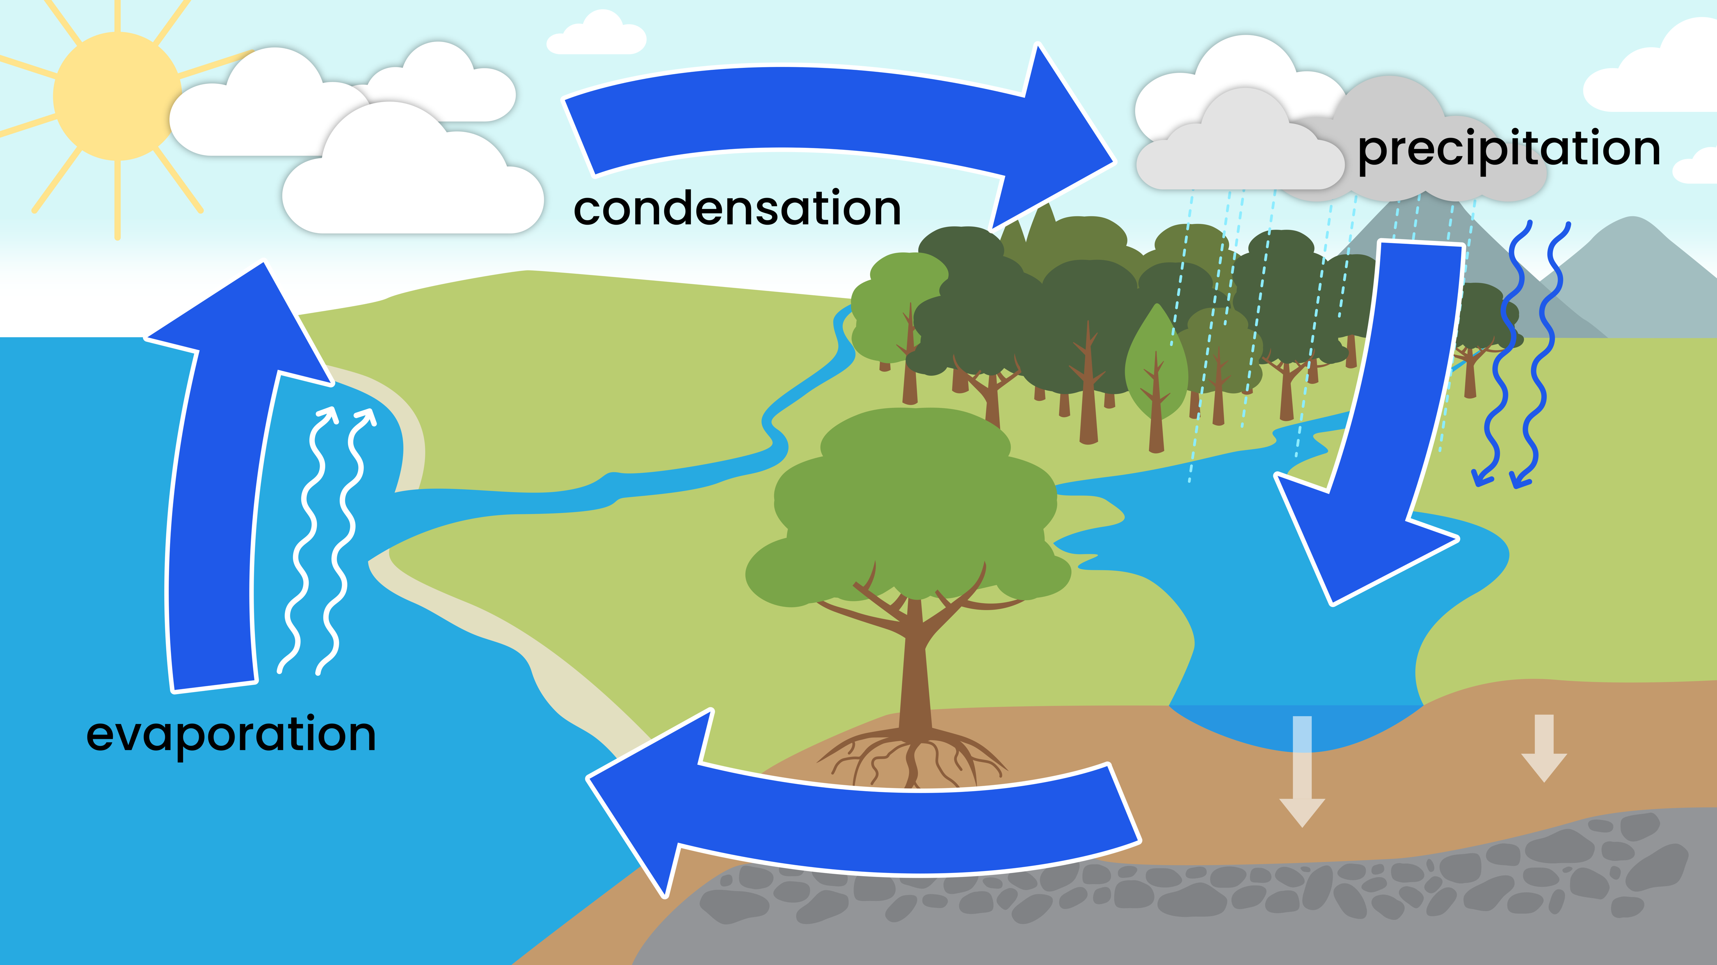
Water cycle
Water cycle
Notes:
Water cycle
The water cycle shows how water moves around Earth.
Evaporation The sun warms the water stored in the oceans, lakes and rivers. The warm water turns into vapour (a gas) and rises into the air.
Condensation The water vapour gets cooler high in the sky and turns into tiny drops. These drops form clouds.
Precipitation (rain or snowfall) When the clouds get too heavy for the air to hold all the drops, the water falls back to Earth as rain, snow or hail.
Then the cycle starts again.

Slide 11
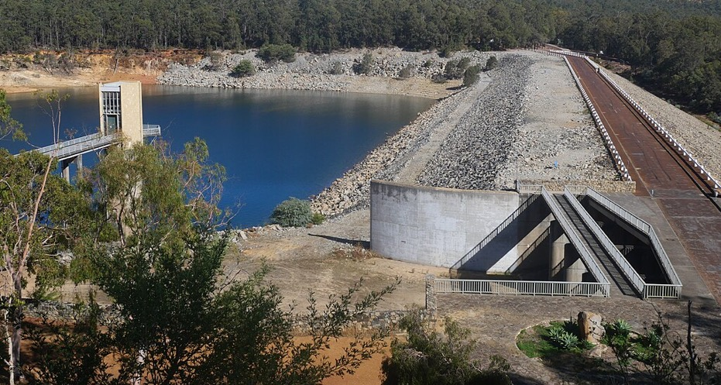
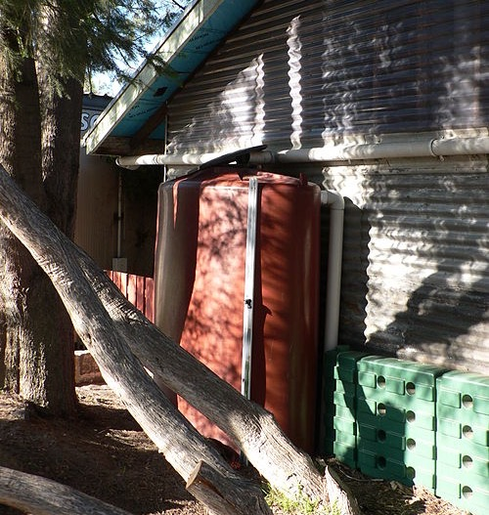
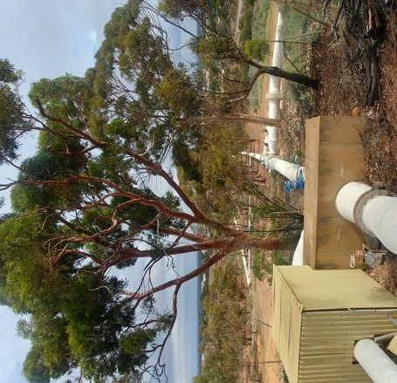
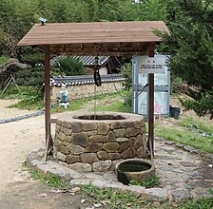
Water storage and transport technologies
Notes:
Water storage and transport technologies
In Australia, surface and desalinated sea water is stored mainly in dams (reservoirs) or natural catchments such as rivers and lakes. We also collect (harvest) rainwater in gutters on our houses and other buildings and save it in rainwater tanks. Underground water is usually stored and accessed through wells or bores. We use pipes and pumps to transport water from place to place, and technologies such as taps, hoses, showers and buckets to distribute it.
Image credits (clockwise from top left): Arthur Taksin via Wikimedia Commons, CC BY 4.0; Pengo via Wikimedia Commons, CC BY 2.5; Bernard Gagnon via Wikimedia Commons, public domain; Sam Wilson via Wikimedia Commons, CC BY-SA 4.0

Slide 12
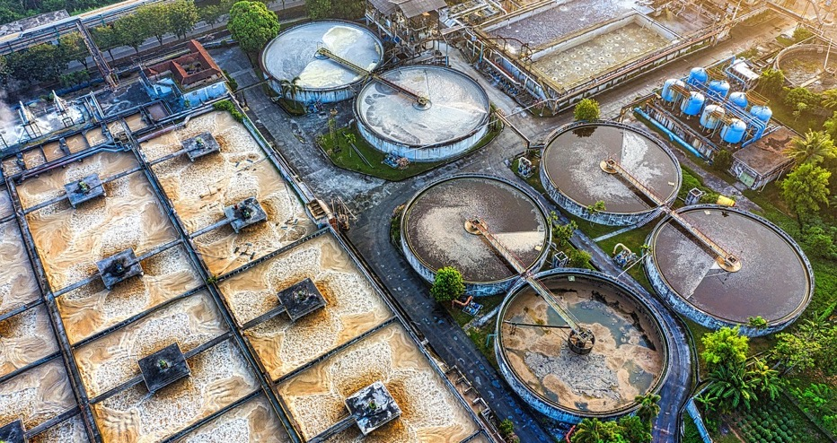
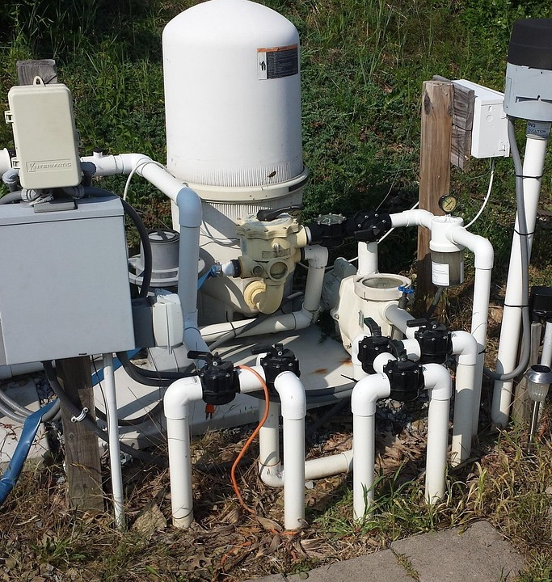
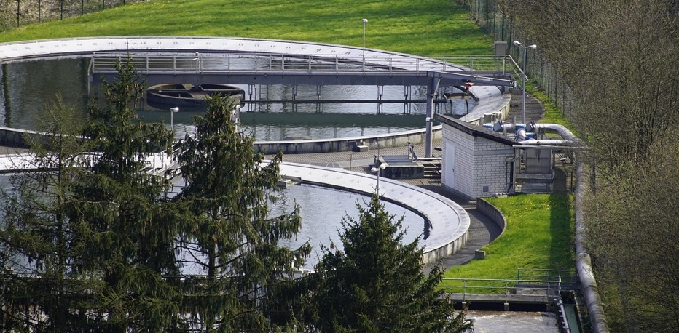
Water treatment
Notes:
Water treatment
In Australia, water is piped to treatment centres where it is filtered, cleaned and disinfected to remove germs. Sometimes natural chemicals are added to the water to improve its quality. It is then ready for use. Water for drinking and washing our bodies is made very clean. Bore water, which can be less clean, is often used for watering football ovals or gardens. Home rainwater is often used to water gardens, flush toilets or wash clothes.
Image credits (clockwise from top left): u_nnjglrk13q via Pixabay; lorjay via Pixabay; jhenning via Pixabay

Slide 13
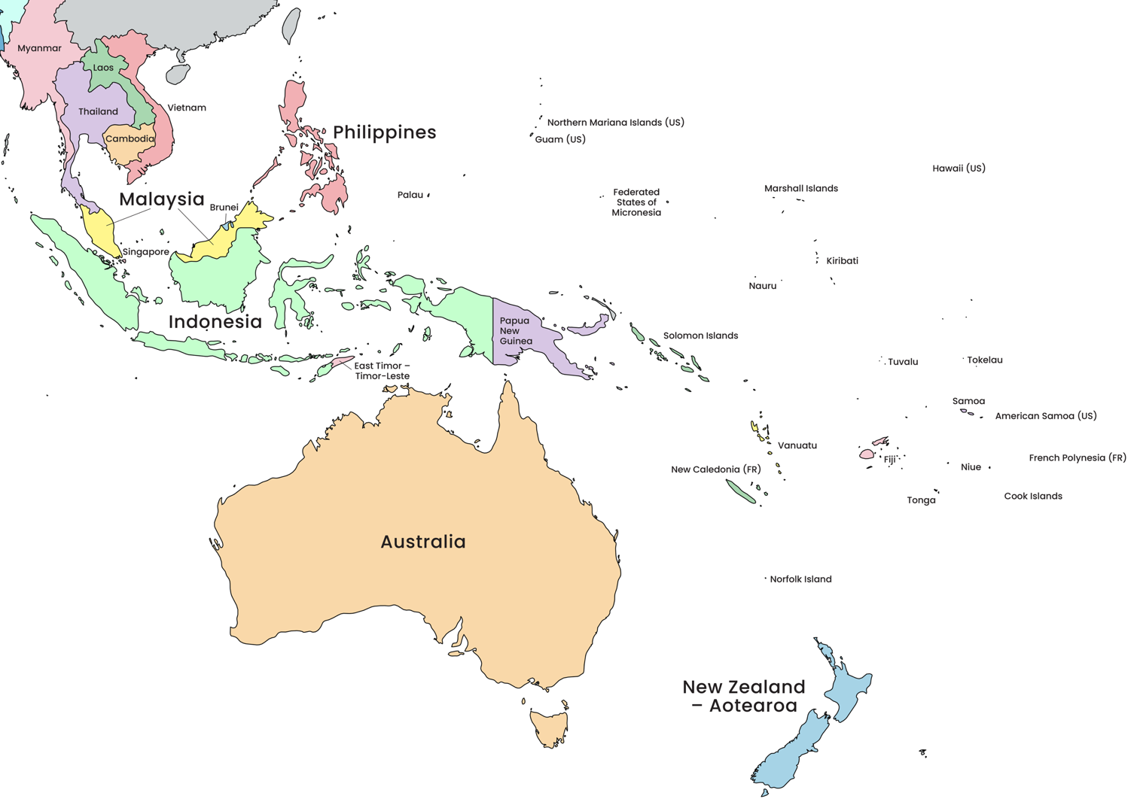
Our Indo-Pacific community
Notes:
Adapted from: © VectorStock

Slide 14
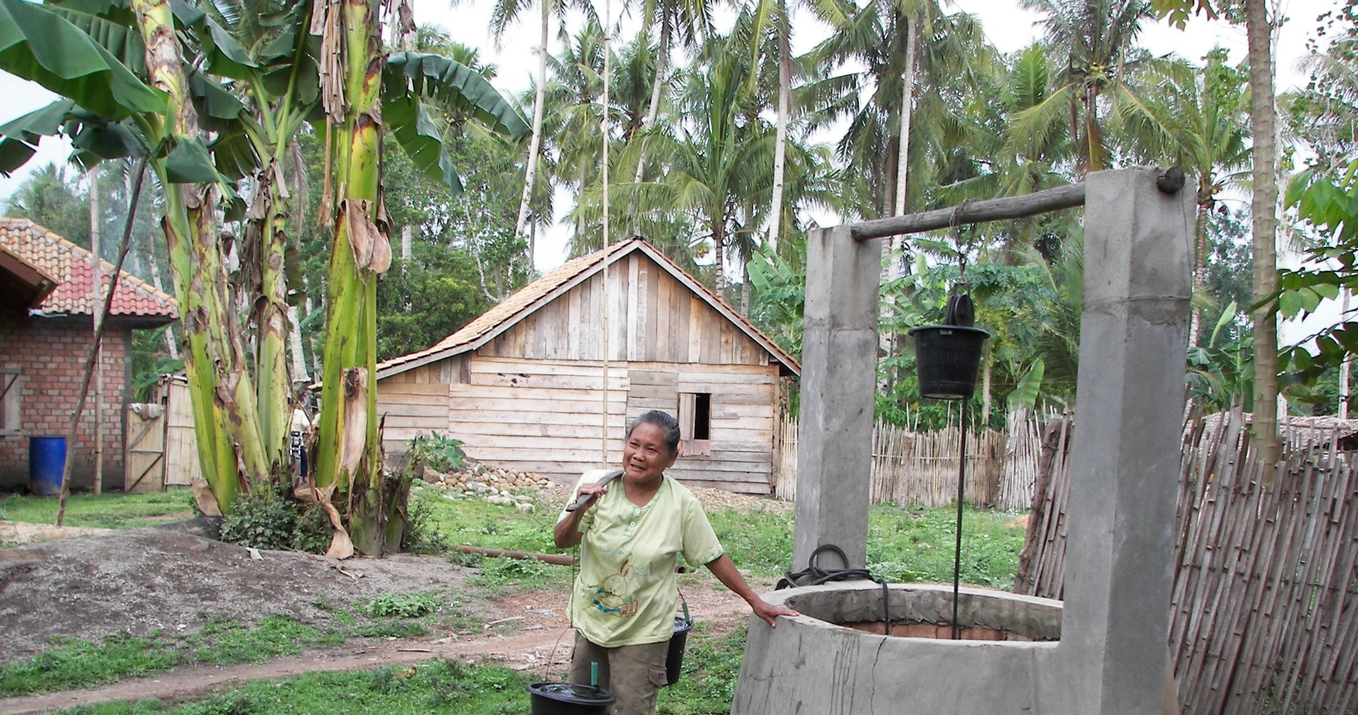
Woman at a water well in rural Indonesian community
Notes:
Guiding question: What does this image tell us about water in a rural community in Indonesia? (Responses may include: water from underground, shared local source, carried elsewhere.)
Image credit: © Australian Government Department of Foreign Affairs and Trade

Slide 15
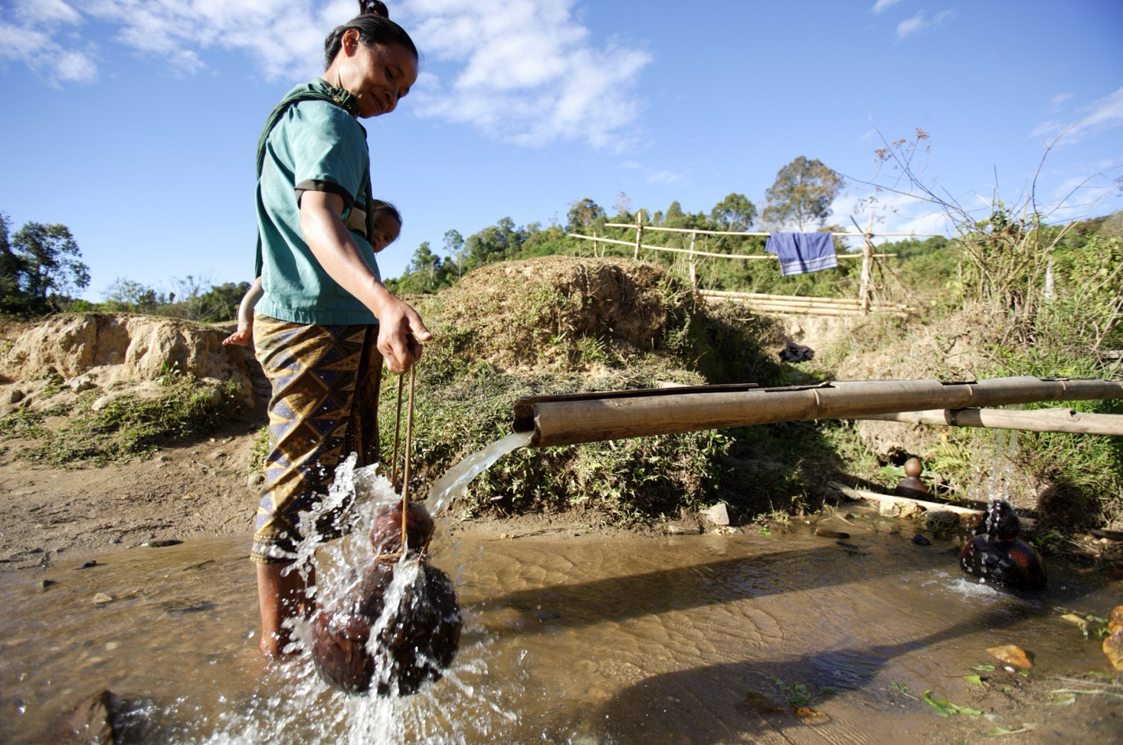
Water sources in rural communities
Notes:
Guiding question: What does this image tell us about water in a rural community in Laos? (Responses may include: possibly surface water, a shared source, collected by a woman, carried elsewhere, above-ground pipes made from bamboo.)
Image credit: © Jim Holmes / Australian Government Department of Foreign Affairs and Trade

Slide 16
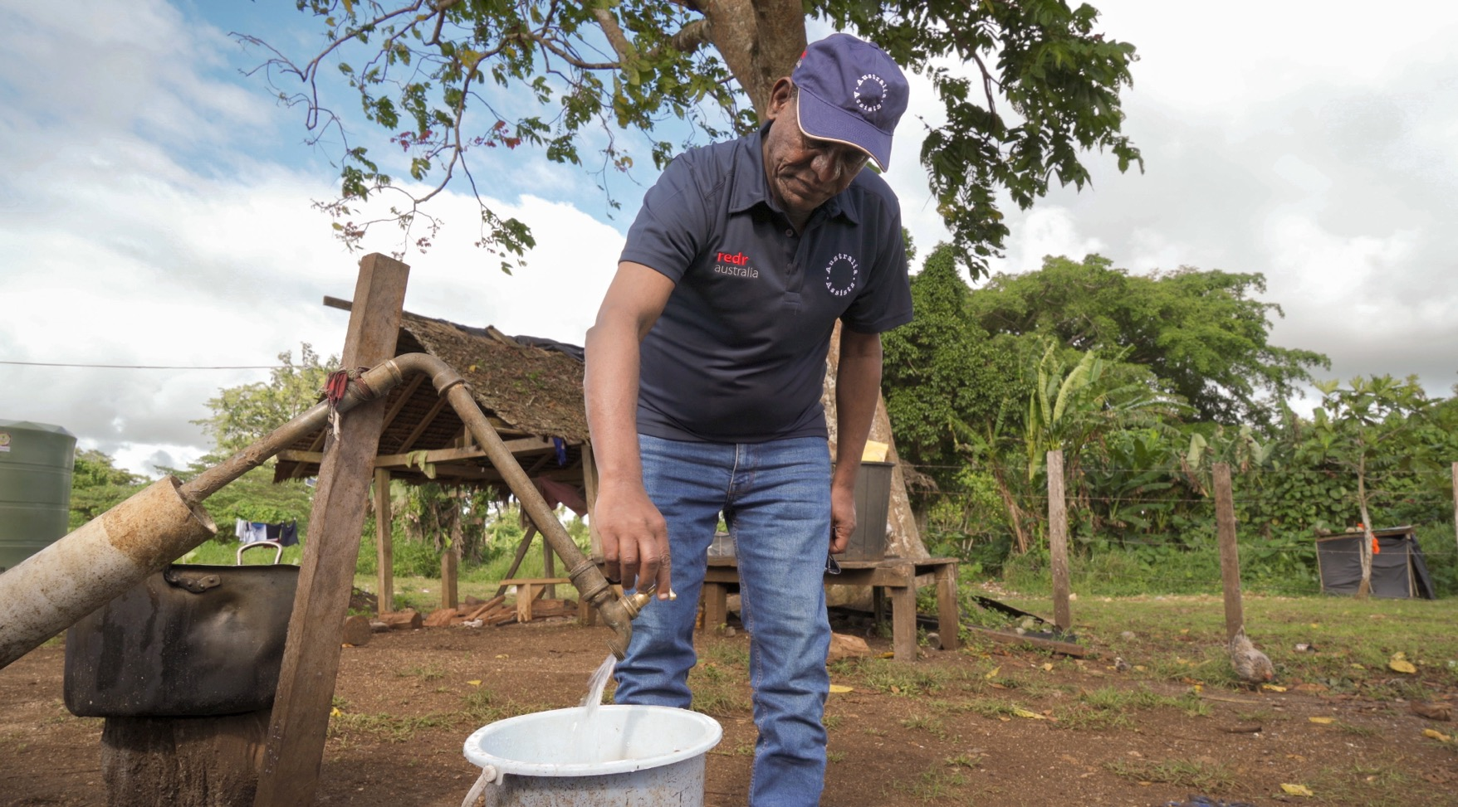
Water sources in rural communities (Vanuatu)
Notes:
Guiding question: What does this image tell us about water in a rural community in Vanuatu? (Responses may include: there is a shared local source, water is piped and tapped.)
Image credit: © Carmen Holman / Australian Government Department of Foreign Affairs and Trade

Slide 17
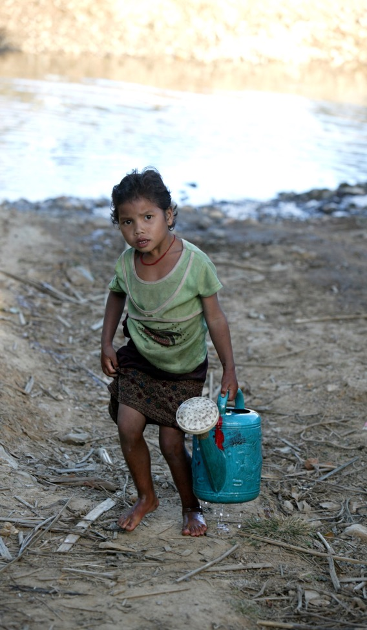
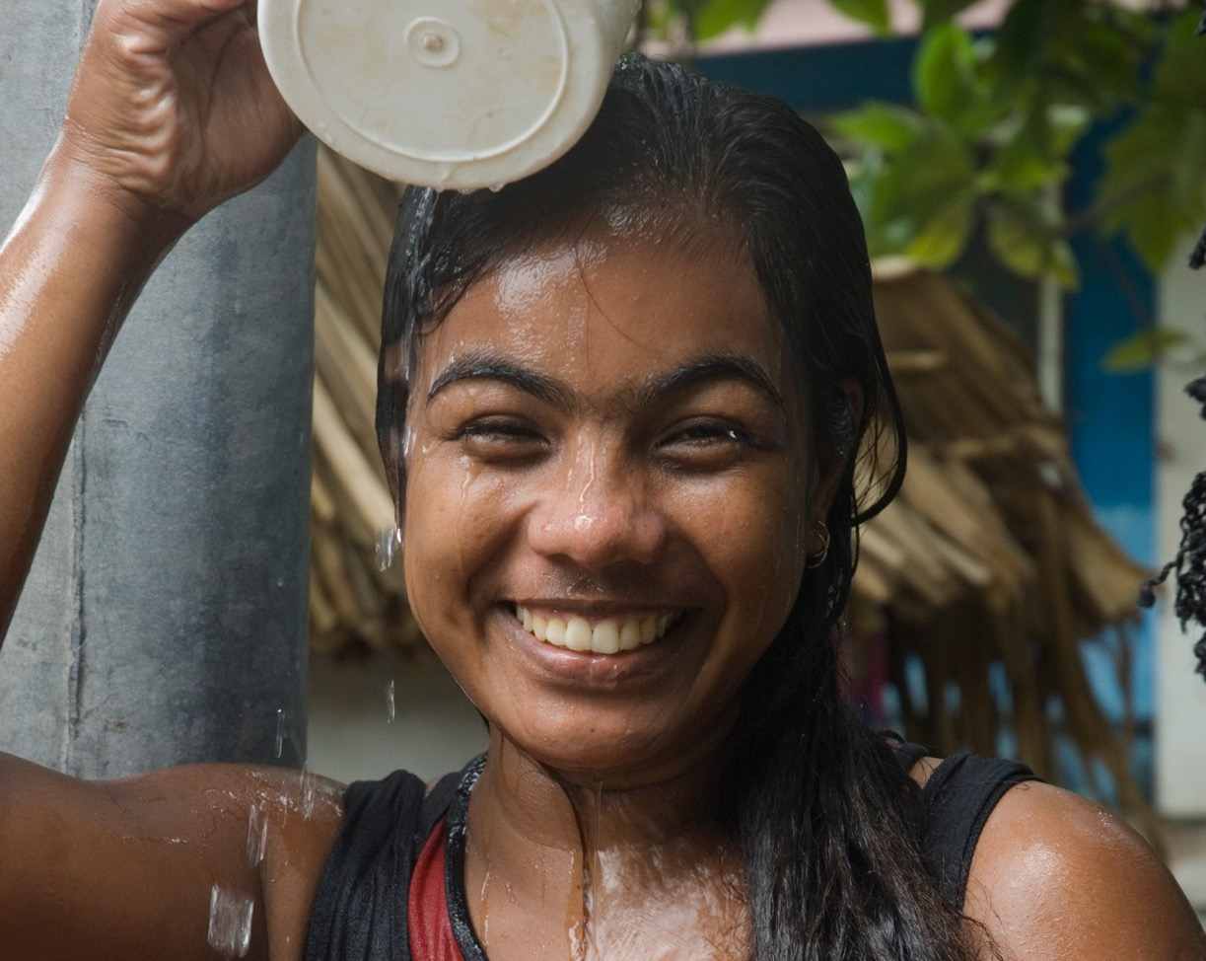
Water collection and use in rural communities
Notes:
Guiding question: What do these images tell us about water in rural communities in Laos and Kiribati?’ (Responses may include: surface water, water can make you tired/happy depending on the labour involved.)
Image credits: © Jim Holmes / Australian Government Department of Foreign Affairs and Trade; © Lorrie Graham / Australian Government Department of Foreign Affairs and Trade

Slide 18
Why do we need safe and clean water for our health?
Lesson 2
Notes:
Image credit: © UNICEF / Australian Government Department of Foreign Affairs and Trade, CC BY

Slide 19
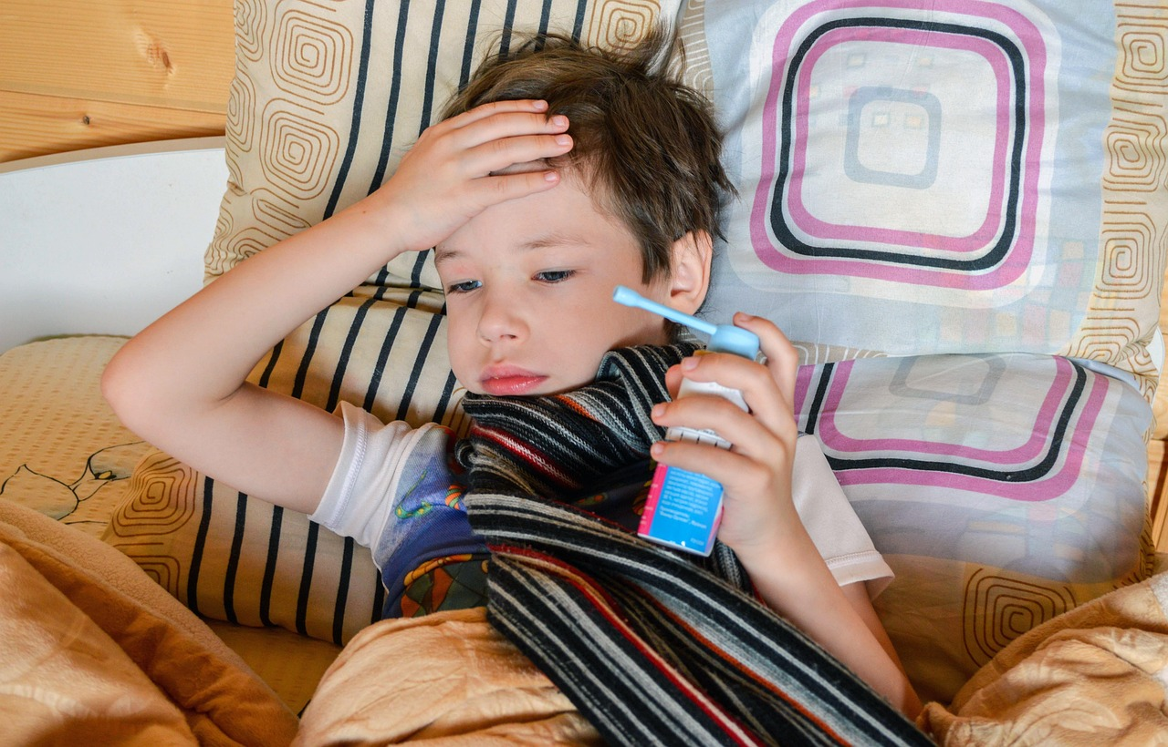
Learning intentions: Lesson 2
To learn about health challenges caused by unsafe or unreliable water resources.
To think about who is most affected by limited access to clean water and why.
Notes:
Lesson 2
Image credit: Sunriseforever via Pixabay

Slide 20
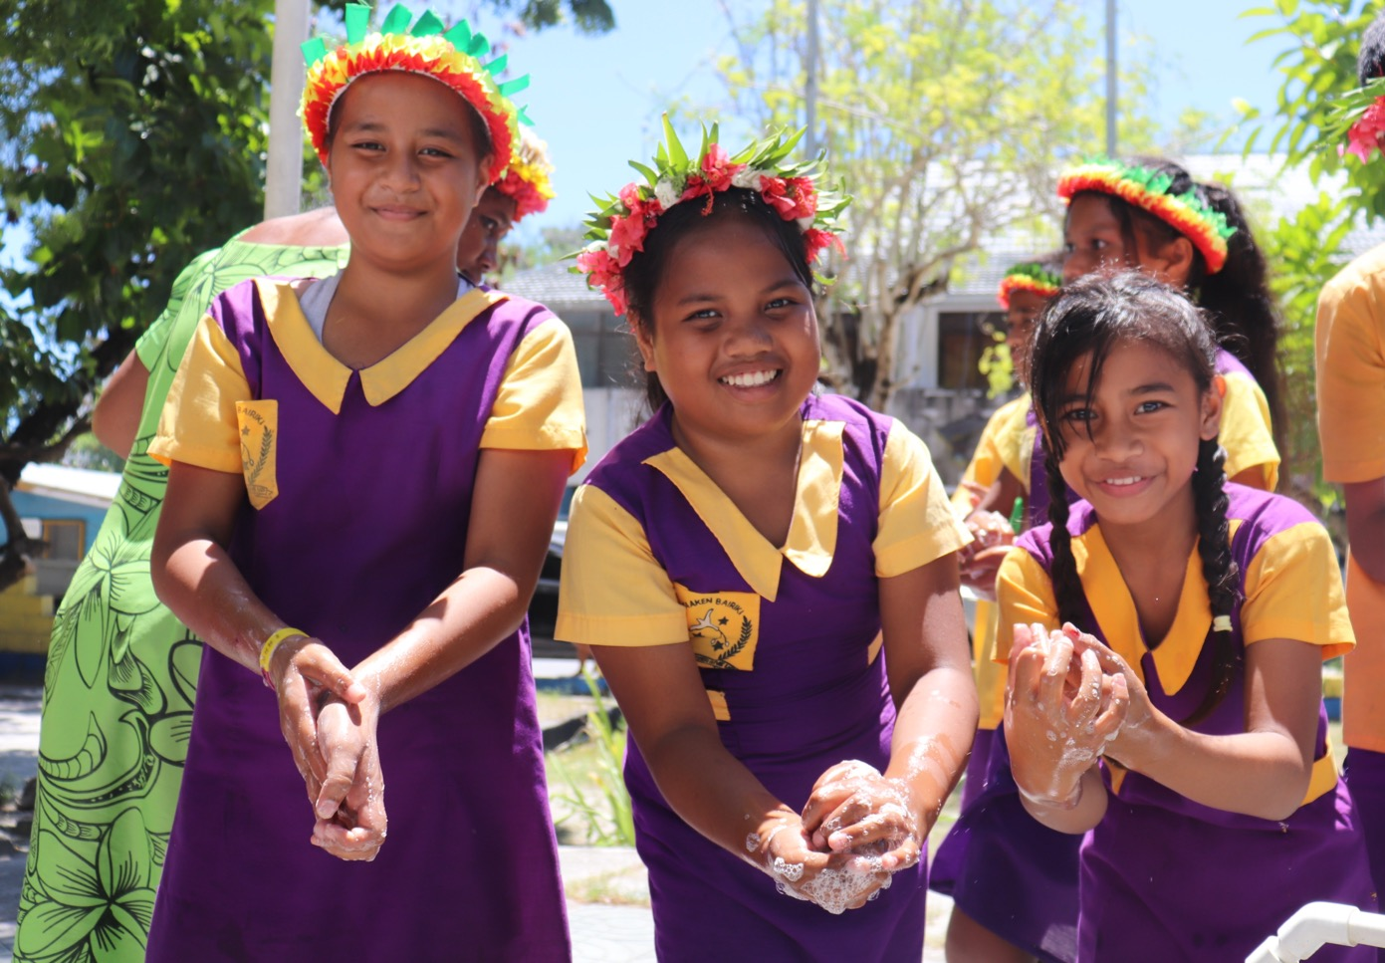
Girls washing hands
Notes:
Image credit: © UNICEF / Australian Government Department of Foreign Affairs and Trade, CC BY

Slide 21
Diseases passed on by sharing water
flu
conjunctivitis
measles
diarrhoea
skin infections
cold
gastro
chicken pox
Notes:
These are all diseases that are passed on by sharing water vapour (coughing or sneezing) or by touch. Their risk of transmission is reduced by handwashing.
Image credit: Sunriseforever via Pixabay

Slide 22
Introducing partnership projects and their solutions for water challenges
Lesson 3
Notes:
Image credit: © University of Sydney and WISH Fiji

Slide 23
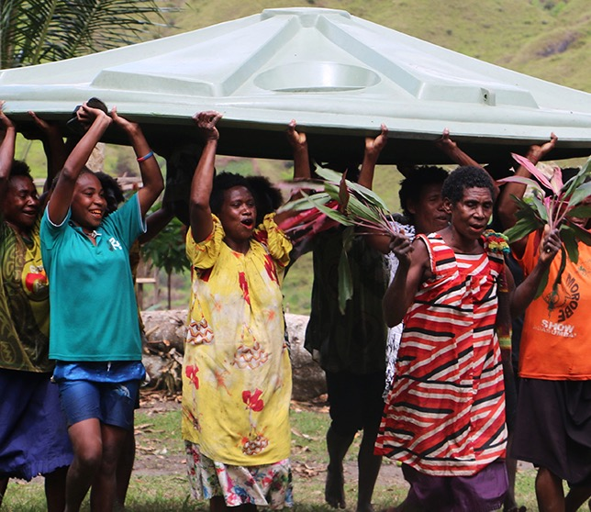
Learning intentions: Lesson 3
To find out how Australians work in partnerships with Indo-Pacific communities to create reliable and sustainable solutions to water challenges.
To understand how water cleaning technologies work.
Notes:
Image credit: © World Vision

Slide 24
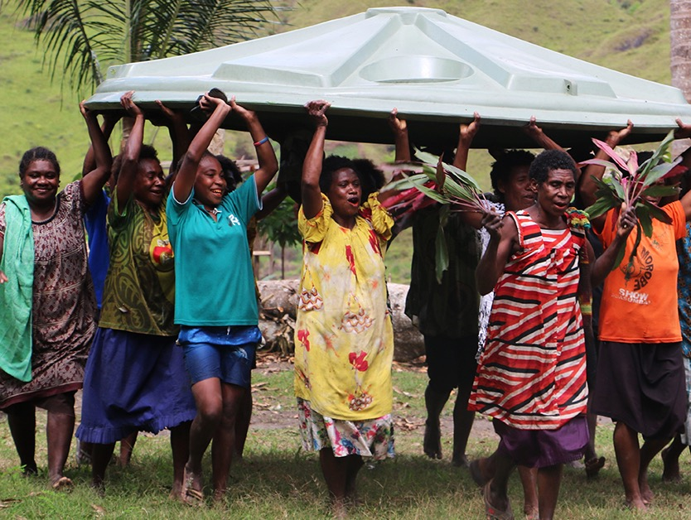
Rainwater tanks in PNG
Where: Bougainville island, Papua New Guinea
Challenge: There was no running water in health clinics for mums and babies.
Solution: New rainwater tanks were installed as well as pipes to take water to taps, toilets and showers.
Results: Mums and babies are clean and safe.
Notes:
Image credit: © World Vision

Slide 25
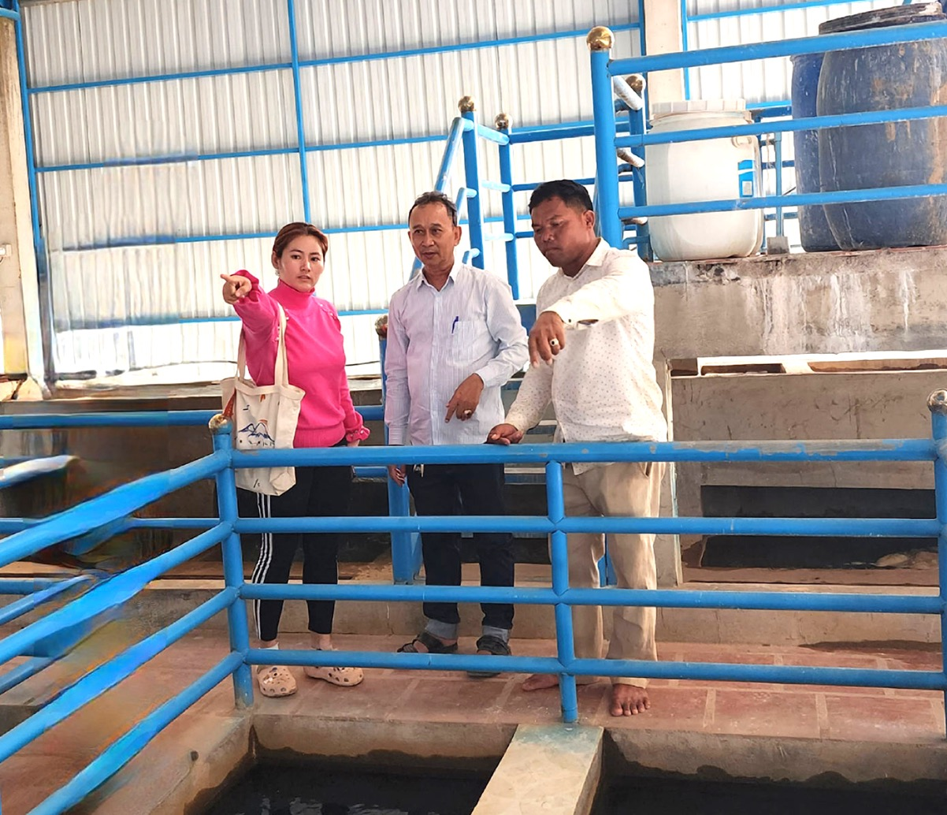
Water treatment plant in Cambodia
Where: Prey Veng Province, Cambodia
Challenge: Women were having to spend a lot of time pumping water from a well and the well water was dirty.
Solution: A water treatment plant was built and pipes installed to take water to villages.
Results: Families are healthier, and women now have time to go to school and work.
Notes:
Image credit: © Thrive Networks / East Meets West Cambodia

Slide 26
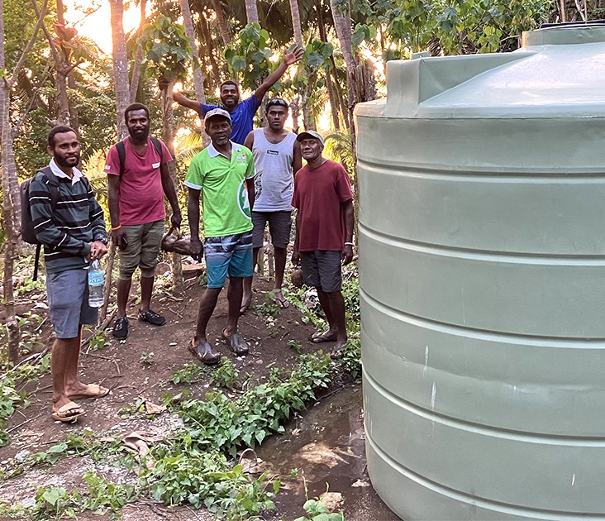
Water storage in Vanuatu
Where: Sanma and Torba Provinces, Vanuatu
Challenge: The river water was not reaching everyone in the community.
Solution: Water was piped from the river into a large, shared water tank.
Results: Water is now accessible to everyone in the community, so there is fairer sharing of water resources.
Notes:
Image credit: © World Vision Vanuatu / Pamela Carlo

Slide 27
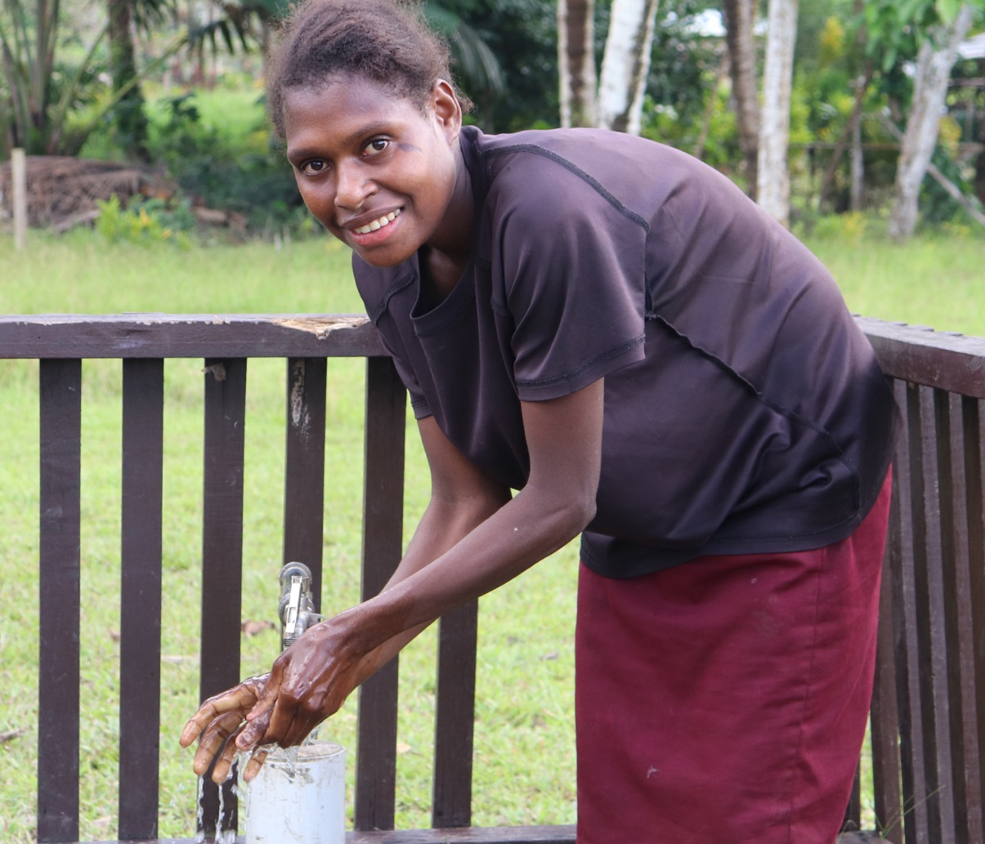
Water sources, Papua New Guinea
Where: Western Province, Papua New Guinea
Challenge: The only water available to a village was unsafe water from a river 5 km away.
Solution: Three big tanks were installed in the middle of the village to catch rainwater, and two new boreholes were drilled at the local school to reach the underground water.
Results: All community members can get to water, and young children are no longer getting sick.
Notes:
Image credit: © World Vision / Abbegail Wafi

Slide 28
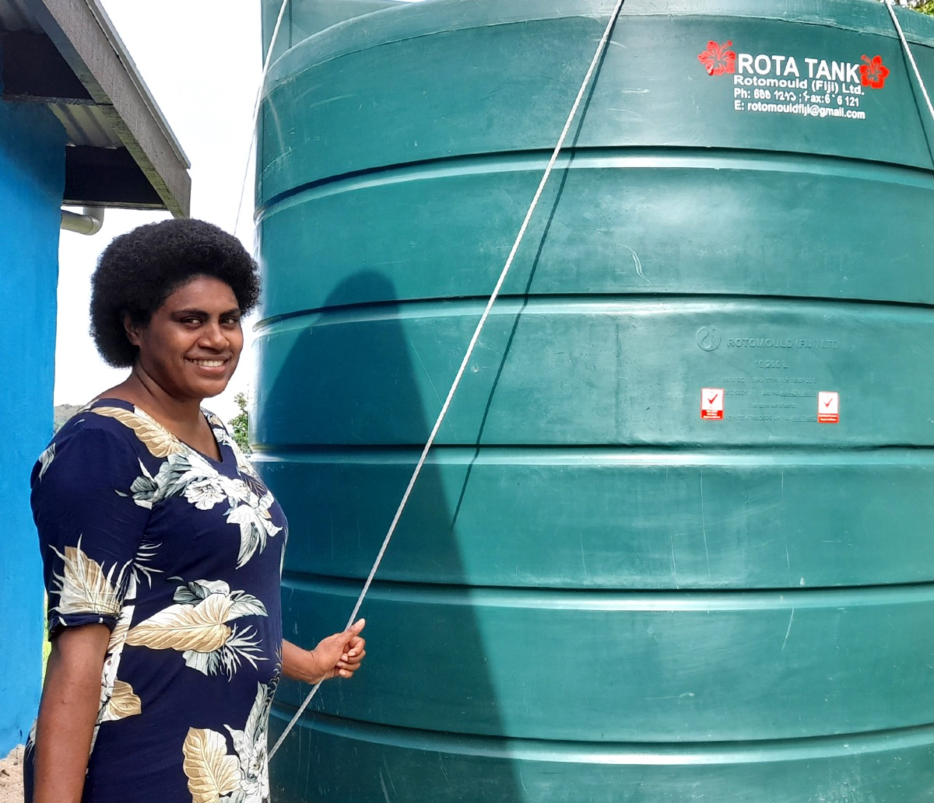
Rainwater tanks in Fiji
Where: Ra and Ba provinces, Fiji
Challenge: In the dry season, the rainwater tanks would empty, leaving only dirty water.
Solution: The community learned how to distill (clean) the water using the sun.
Results: Now there is clean water all year round.
Notes:
Image credit: © Habitat for Humanity, Fiji

Slide 29
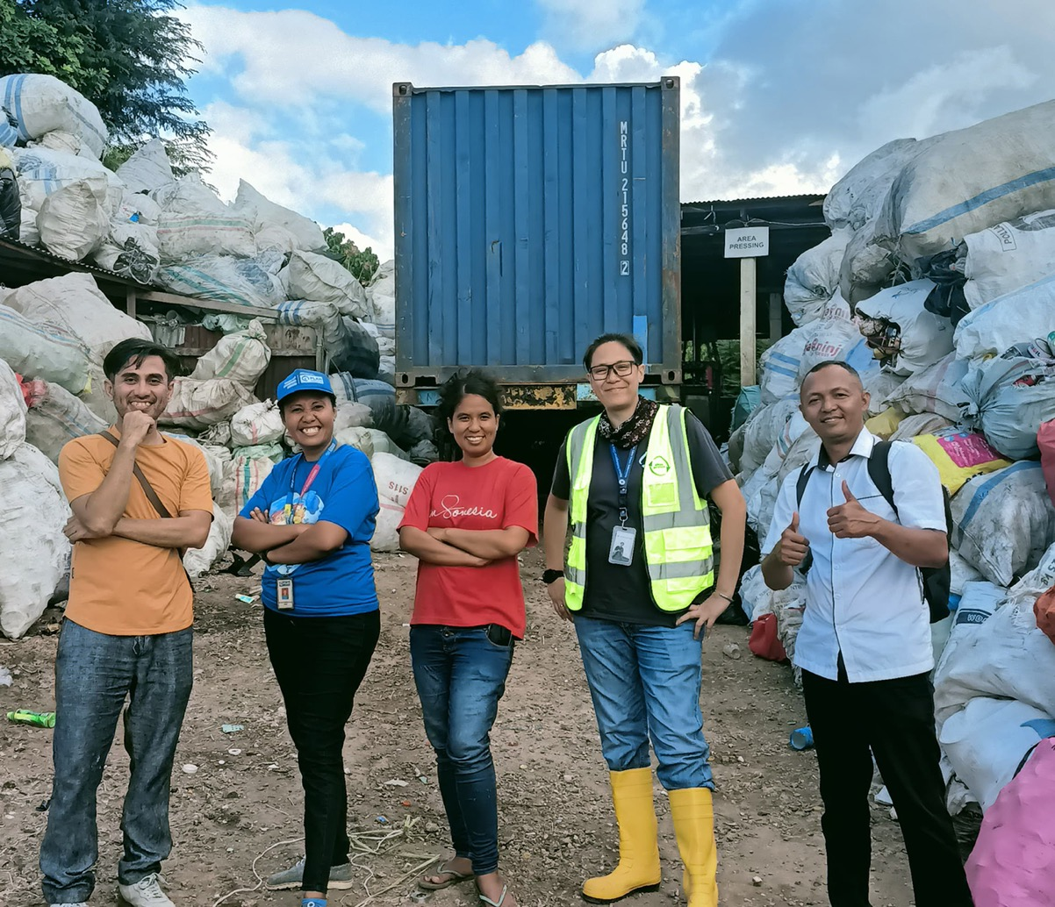
Recycling in Indonesia
Where: Kupang City, Indonesia
Challenge: Waste was being dumped in the streets and was making the water dirty in nearby rivers and dams.
Solution: A community program showed people how to sort their waste and take plastic to a waste bank for recycling and safe disposal.
Results: Plastic is now recycled into useful things and the streets, rivers and dams are cleaner.
Notes:
Image credit: © Plan International Indonesia

Slide 30
Imagining sustainable solutions for water challenges in the Indo-Pacific
Lesson 4
Notes:
Image credit: Michel Royon via Wikimedia Commons, public domain

Slide 31
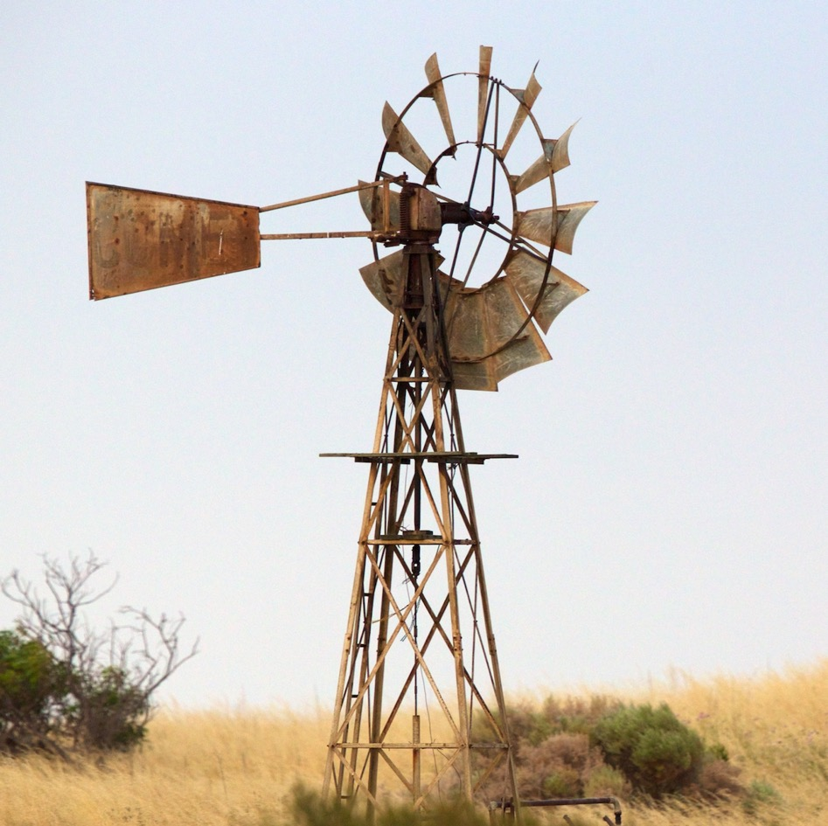
Learning intention: Lesson 4
To imagine a sustainable and reliable solution for a water challenge in an Indo-Pacific community.
Notes:
Image credit: julie burgher via Flickr, CC BY-NC-SA 2.0

Slide 32
Sustaining water graphic organiser
Location | Challenge
Possible solutions | Possible result

