Slide 1
How is global human development financed?
Lesson 1
Notes:
Image credit: © Aileen Dimatatac / Australian Government Department of Foreign Affairs and Trade, CC BY.

Slide 2
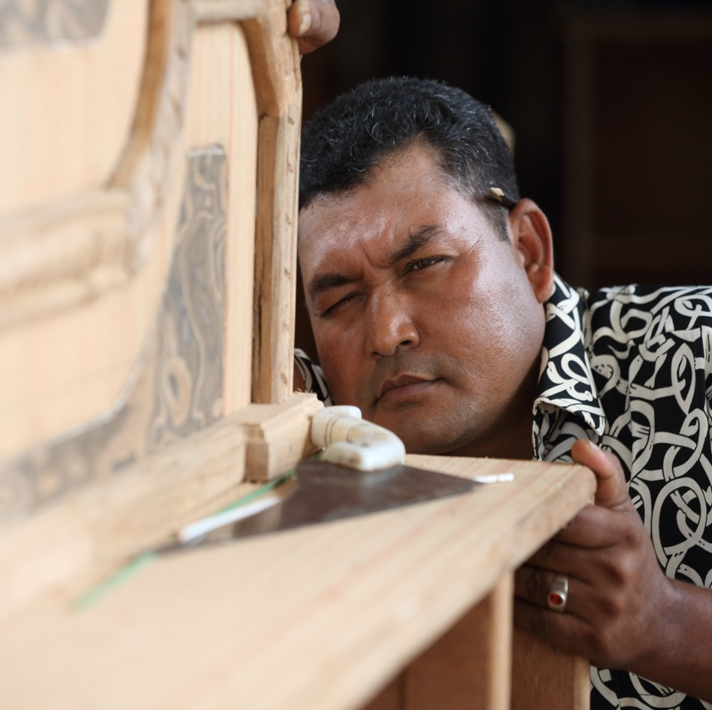

Learning intentions: Lesson 1
To identify the United Nations (UN) Sustainable Development Goals.
To compare the role of both macro- and microeconomics in financing global human development.
Notes:
Image credit: © Jim Holmes / Australian Government Department of Foreign Affairs and Trade, CC BY.

Slide 3
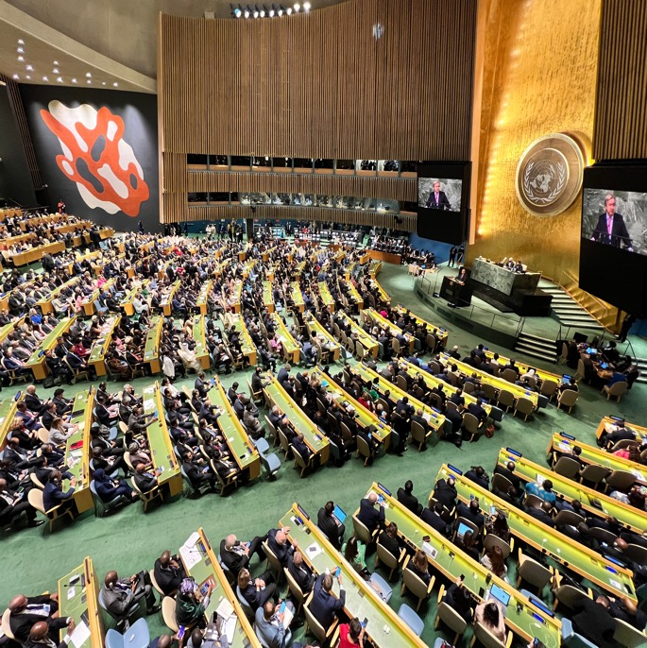
The role of the UN
The United Nations is the largest international organisation in the world, with 193 member countries.
The UN promotes peace, security, human rights and sustainable development.
Global human development aims to improve people’s wellbeing, expand their choices and opportunities, and enhance their overall quality of life to ensure everyone can live with dignity and freedom.
Notes:
Image credit: © Nathan Fulton / Australian Government Department of Foreign Affairs and Trade, CC BY.

Slide 4
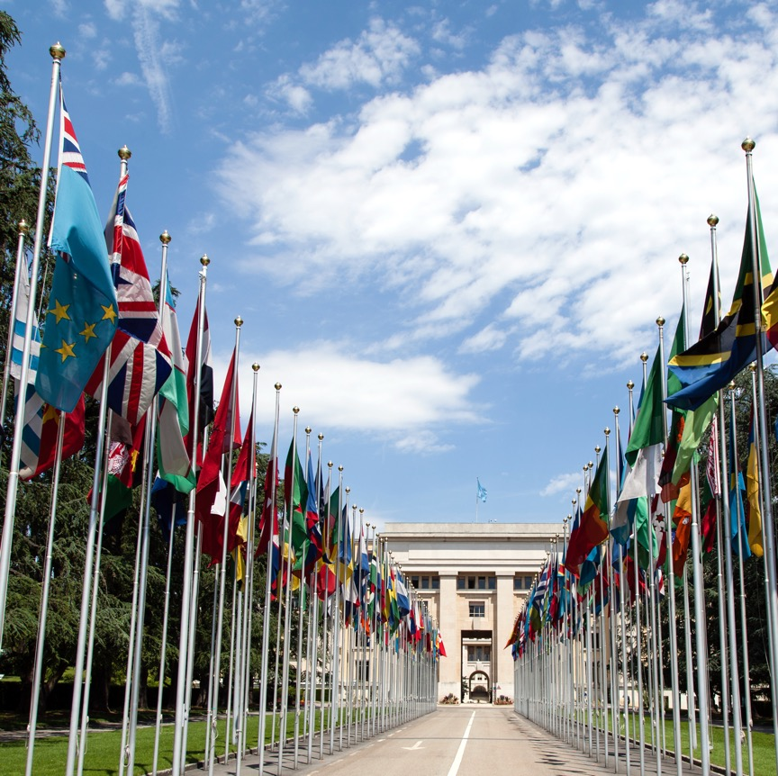
Sustainable Development Goals
In 2015, UN member states adopted the 2030 Agenda and the 17 Sustainable Development Goals.
The UN wants to achieve these goals by 2030.
Notes:
Image credit: © Tom Page via Wikimedia Commons, CC BY-SA 2.0

Slide 5



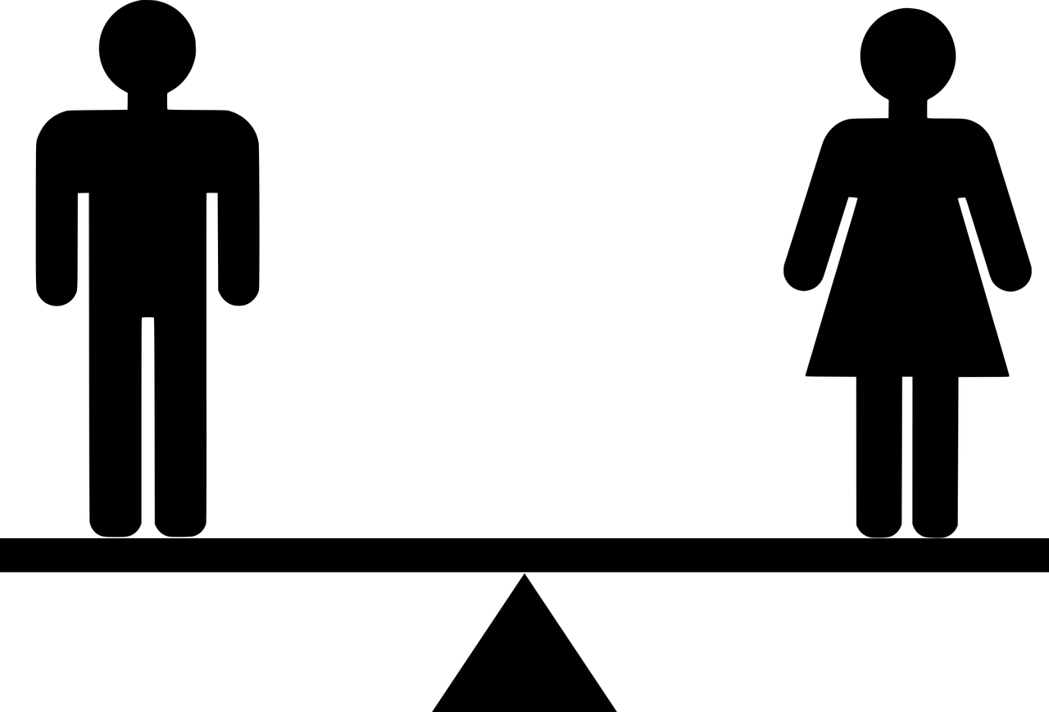




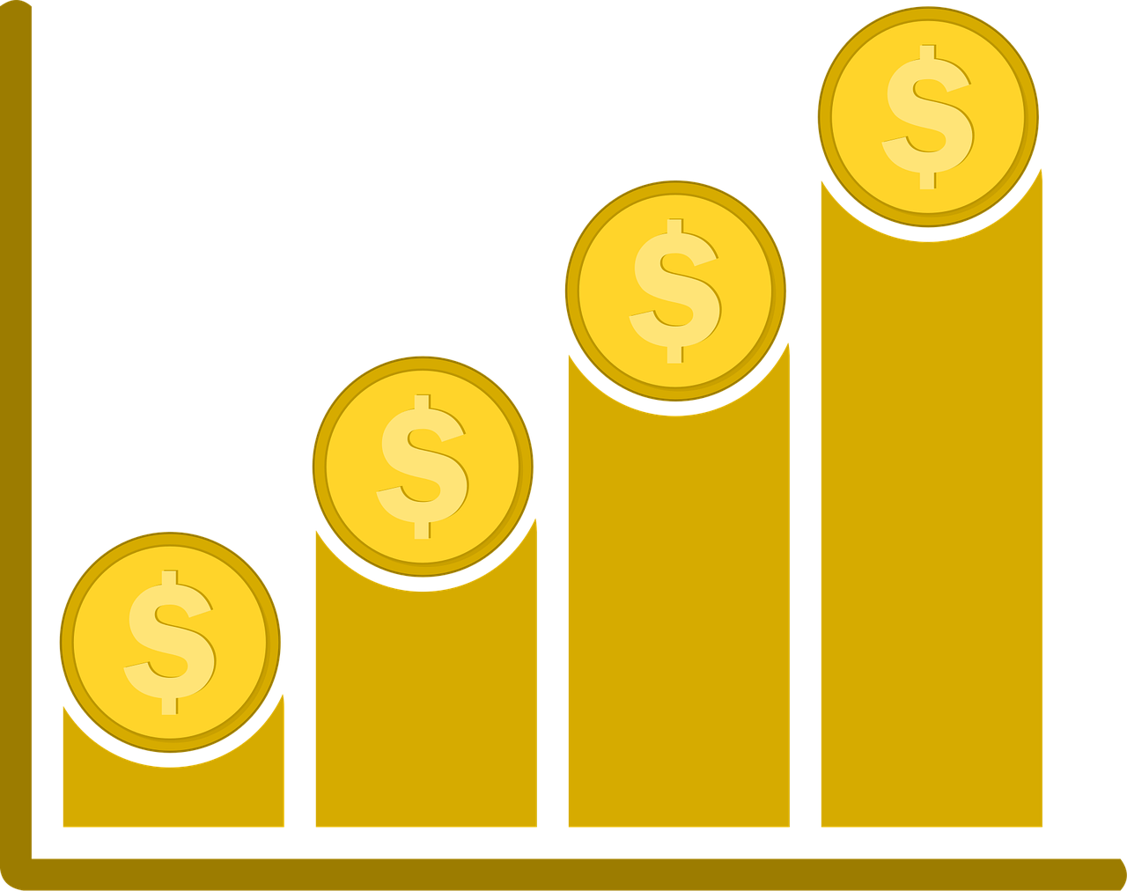



What might these icons represent in terms of global human development?
Notes:
Icon credits (left to right from top): GDJ; Mohamed_hassan; MissKaLem; Stampf; Projekt_Kaffeebart; Clker-Free-Vector-Images; meesgroothuis; OpenClipart-Vectors; MissKaLem; Cheerfully_lost; OpenClipart-Vectors; geralt. All via Pixabay.

Slide 6
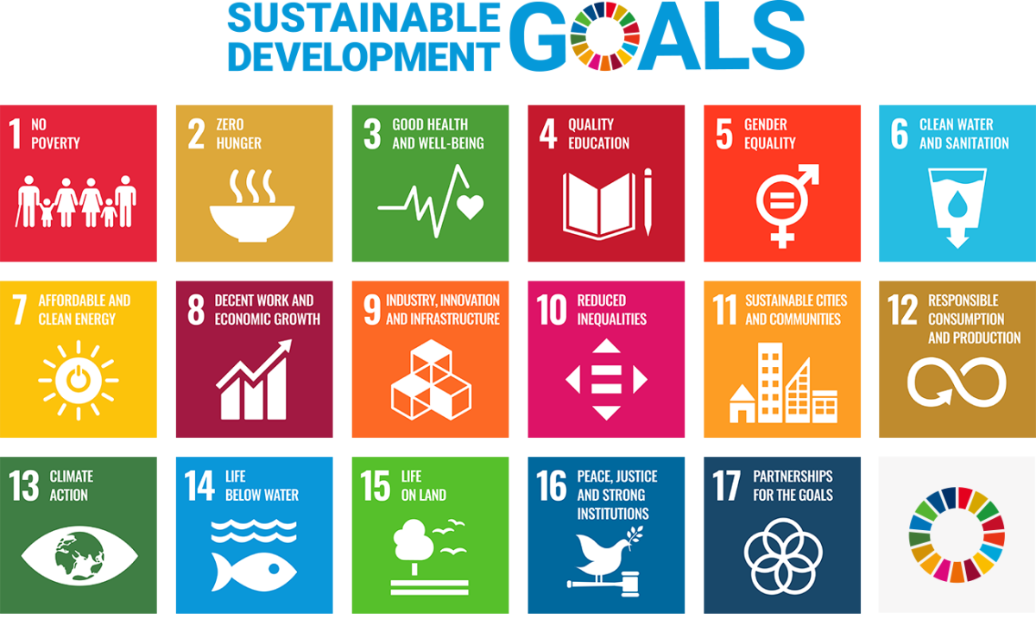
UN Sustainable Development Goals
Notes:
© United Nations Sustainable Development Goals https://www.un.org/sustainabledevelopment
The content of this publication has not been approved by the United Nations and does not reflect the views of the United Nations or its officials or Member States.

Slide 7
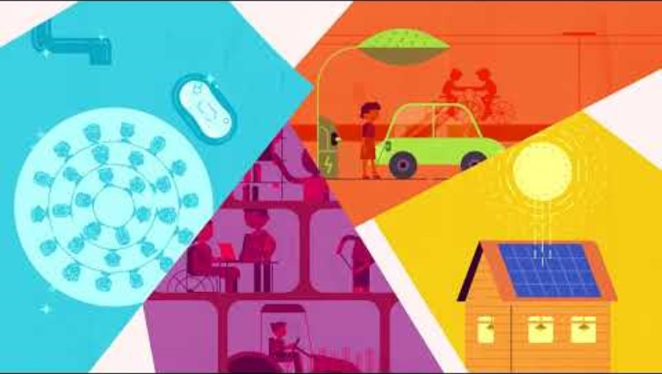

Slide 7: Video link

Slide 8
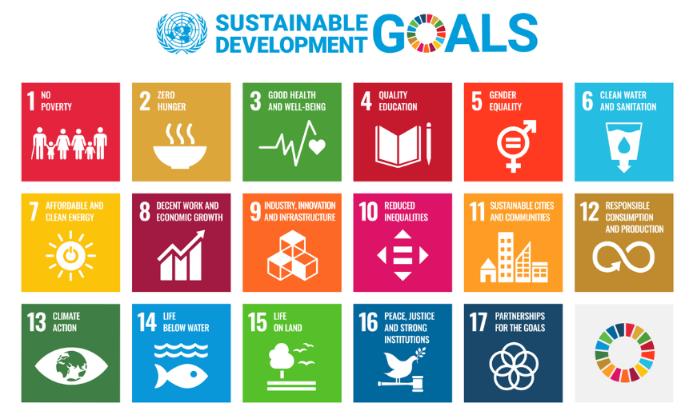
Sustainable Development Goals (SDGs)
Classified under five Ps: people, planet, prosperity, peace and partnership.
Prosperity and partnership are the focus of these lessons.
Key questions to consider:
What is meant by prosperity?
How do partnerships help global human development?
Notes:
Image credit: © United Nations Sustainable Development Goals https://www.un.org/sustainabledevelopment
The content of this publication has not been approved by the United Nations and does not reflect the views of the United Nations or its officials or Member States.

Slide 9
How does blended finance help large development projects?
Lesson 2
Notes:
Image credit: © Australian Government Department of Foreign Affairs and Trade.

Slide 10
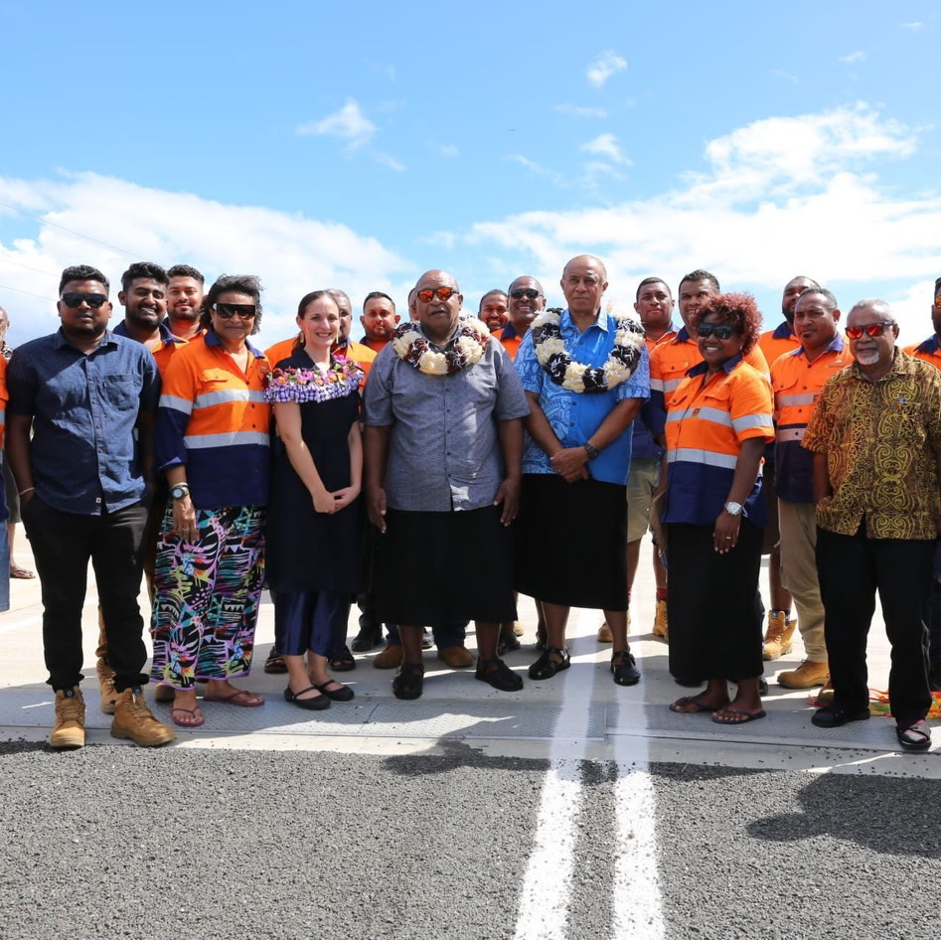
Learning intentions: Lesson 2
To explain how blended finance relies on economic partnerships to lower risk.
To describe the types of projects blended finance can support within the Indo-Pacific region.
Notes:
Image credit: © Australian Government Department of Foreign Affairs and Trade

Slide 11

Insurance and risk
Insurance is a contractual agreement (guarantee) between a financial institution and a user that they will be financially protected against specified risks.
The level of risk influences the price a user will pay for this guarantee. This price is called an insurance premium.
Risk
Premium
As risk increases, the premium increases

Slide 12

Loans and risk
A loan involves borrowing a sum of money that is expected to be paid back over time with interest (an extra charge from the lender).
Who is faced with a potential risk?
The borrower?
The lender?
What is the risk?
Risk
Money
As risk increases, the loan decreases

Slide 13
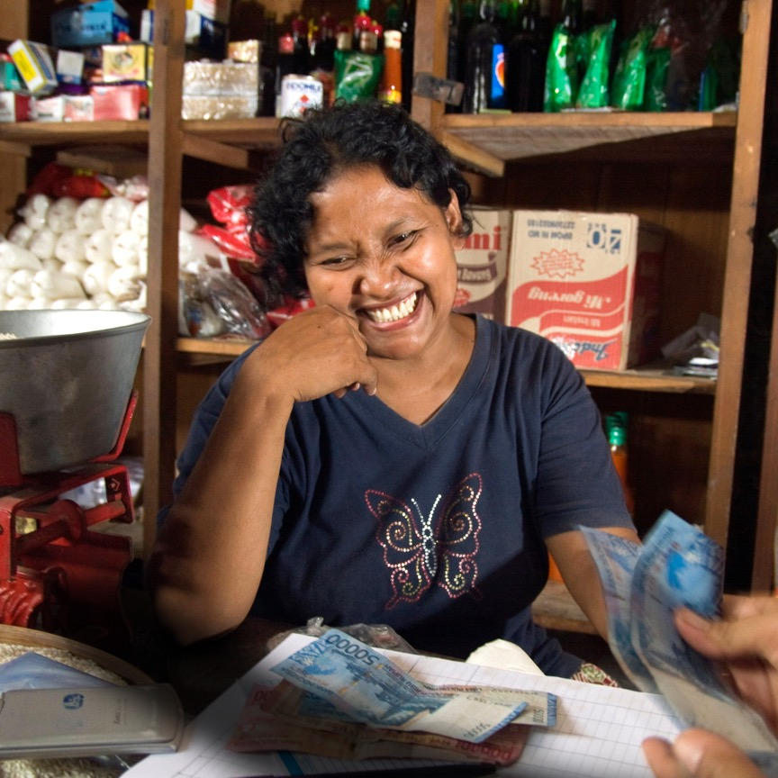
Loans and risk
How do you think the level of risk might affect a bank’s decision to provide a loan to the following two individuals:
Eva has a full-time job and $50,000 in savings.
Noah has a casual job and $20,000 in savings.
Notes:
Image credit: © Ahmad 'deNy' Salman / Australian Government Department of Foreign Affairs and Trade, CC BY.

Slide 14
Financing development
Why would low-income countries present a higher investment risk for financial institutions?
How could this impact the possible loans they would need for major development projects?
How would this risk affect insurance premiums?

Slide 15
Blended finance
A partnership between various financial stakeholders that helps to lower the risk of kickstarting large-scale development projects in low-income countries, boosting local employment.
Projects could include:
telecommunication network infrastructure
modern energy installations
healthcare companies
new technology startups.
Investment from private financial institutions
Attracts
Government funding from other countries
Philanthropic donations (NGOs, charities)
Blended finance

Slide 16
Who’s involved?
Philanthropic organisations (charities, NGOs) provide donations to a low-income country.
Countries, such as Australia, provide funding and loans to low-income neighbouring countries with lower rates of interest or delayed repayments. This lowers the financial risk for the lender.
Private companies and businesses are attracted to consider new development projects for low-income countries because the risk is lower.
Investment from private financial institutions
Attracts
Government funding from other countries
Philanthropic donations (NGOs, charities)
Blended finance

Slide 17
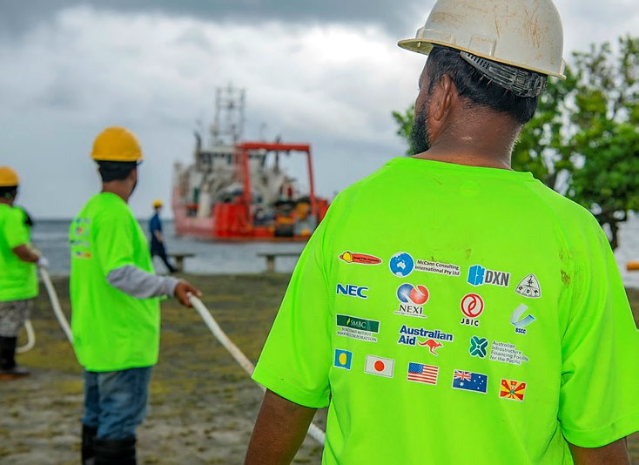
Slide 17: Example partnerships
Look at the back of this person’s top.
It displays the blended finance partnership of many stakeholders – including countries, technology companies and financial institutions – all helping Palau to lay submarine cables for connectivity.
You may be interested to find out who they all are.
Notes:
Image credit: © Australian Government Department of Foreign Affairs and Trade.

Slide 18
How is microfinance promoting local economic growth?
Lesson 3
Notes:
Image credit: © Australian Government Department of Foreign Affairs and Trade.

Slide 19
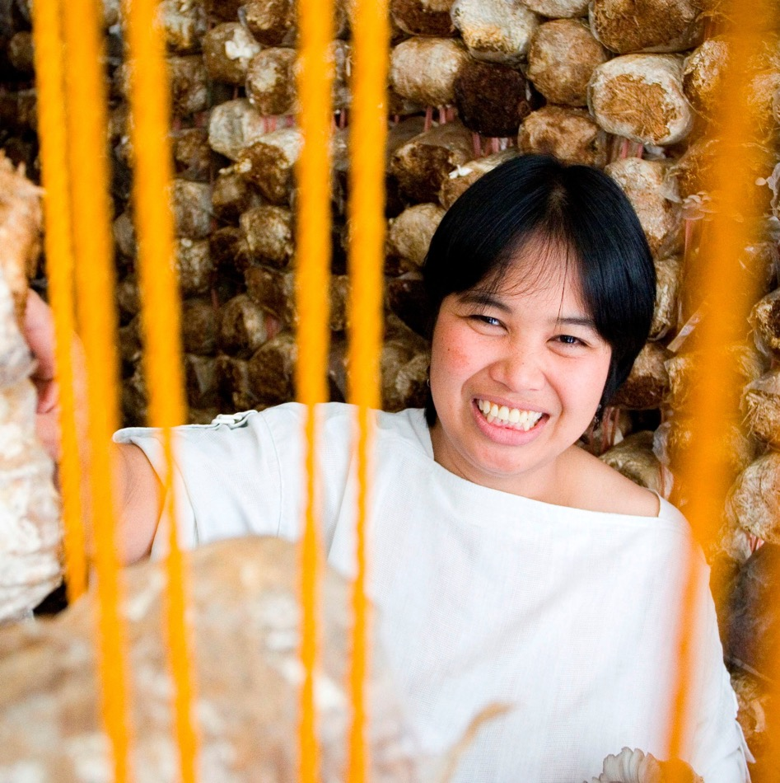
Learning intentions
To explain how microfinance can support female entrepreneurs and prosperity.
To outline how microfinance partnerships contribute towards achieving the Sustainable Development Goals.
Notes:
Image credit: © Opportunity International / Australian Government Department of Foreign Affairs and Trade.

Slide 20
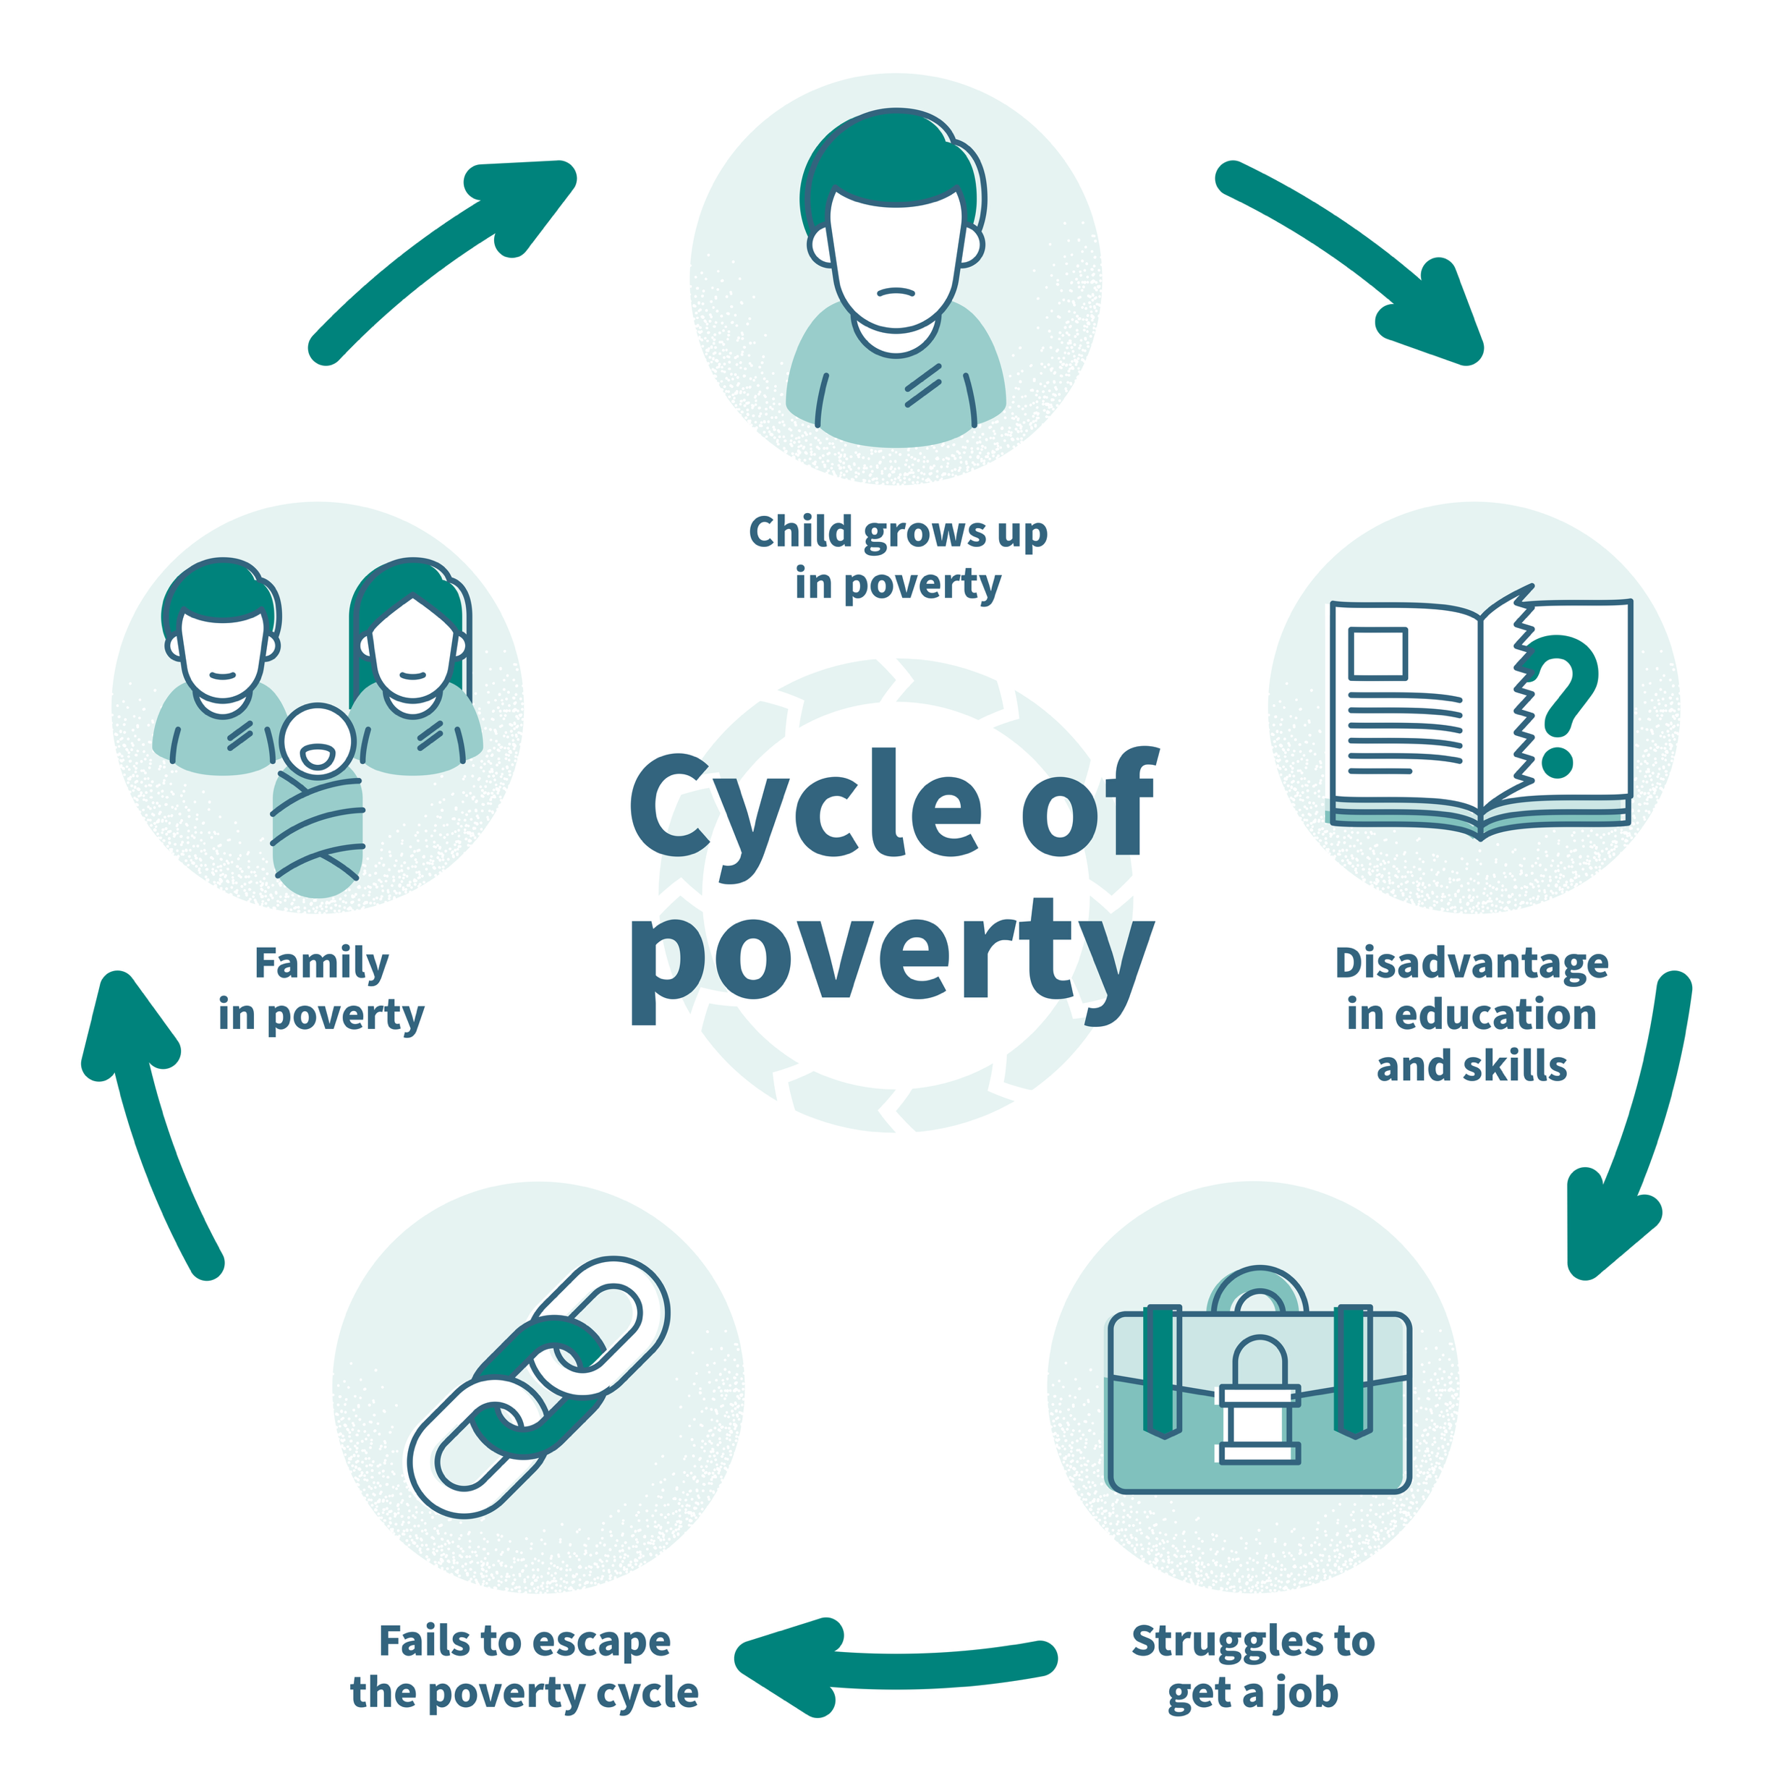
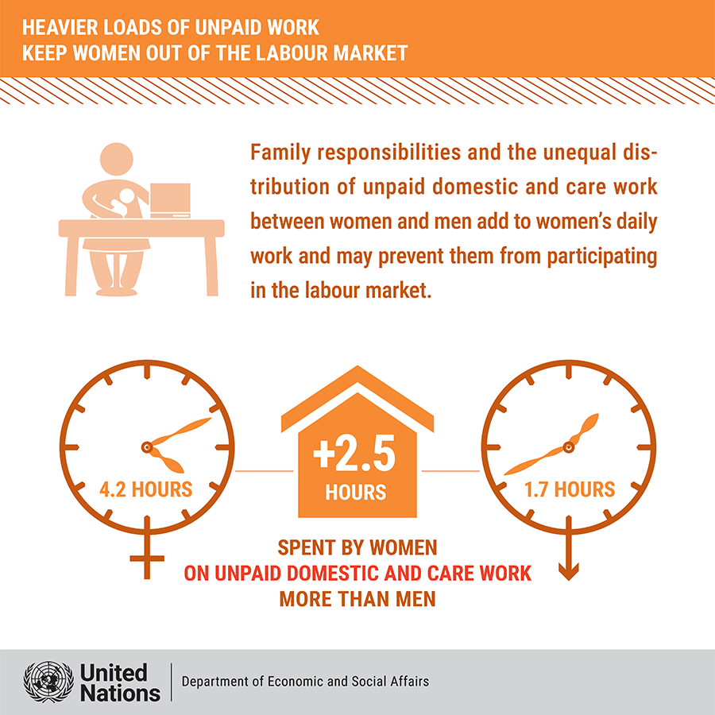
Poverty and inequality
Notes:
Infographic credits: VectorMine/Shutterstock; United Nations Department of Economic and Social Affairs, The World's Women 2020: Trends and Statistics https://unstats.un.org/unsd/demographic-social/products/worldswomen/.

