Slide 1
What makes the Asia-Pacific region so diverse?
Lesson 1
Notes:
Image credit: © Australian Humanitarian Partnership (AHP) Bangladesh / Australian Government Department of Foreign Affairs and Trade, CC BY

Slide 2
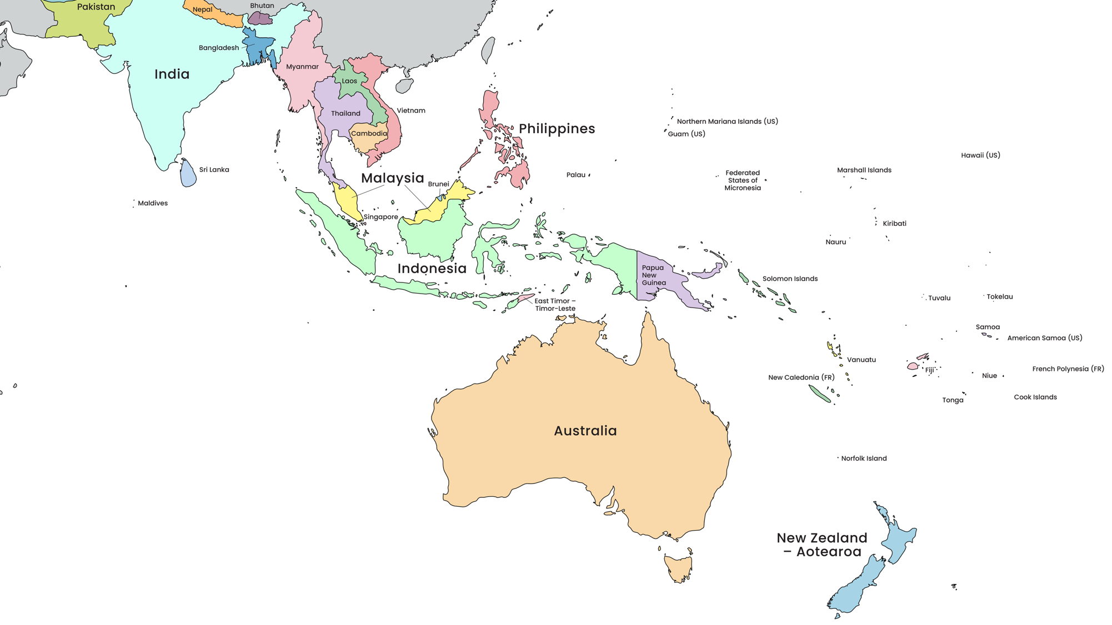
Map of countries of the Asia-Pacific region
Click to zoom into the Pacific
The Asia-Pacific Region
Australia’s closest neighbours
Notes:
Adapted from: © VectorStock.
View the map in full screen mode to use the zoom in feature to zero in on our Pacific neighbours.

Slide 3
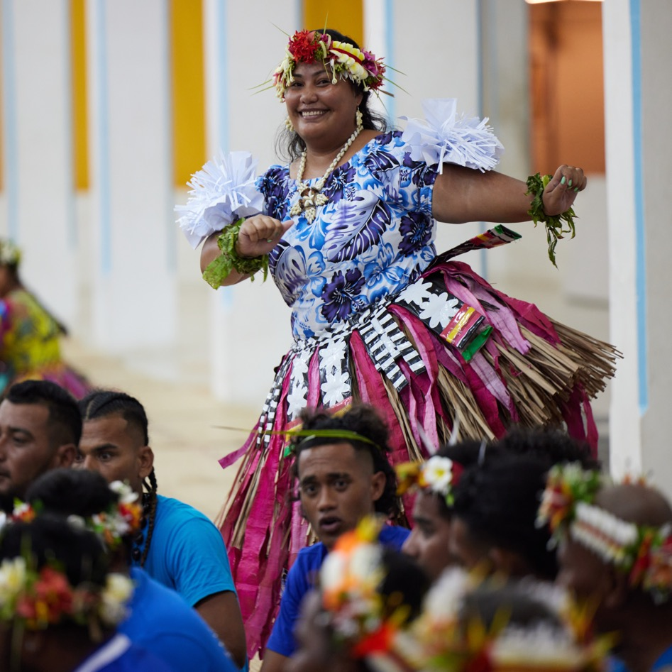

Learning intentions: Lesson 1
To describe the natural features and location of the Asia-Pacific region.
To compare the diversity of various countries within the Asia-Pacific region.
Notes:
Image credit: © Samuel Phelps / Australian Government Department of Foreign Affairs and Trade

Slide 4
How does Australia work in partnership with the Asia-Pacific region?
Lesson 2
Notes:
Image credit: © Australian Government Department of Foreign Affairs and Trade

Slide 5
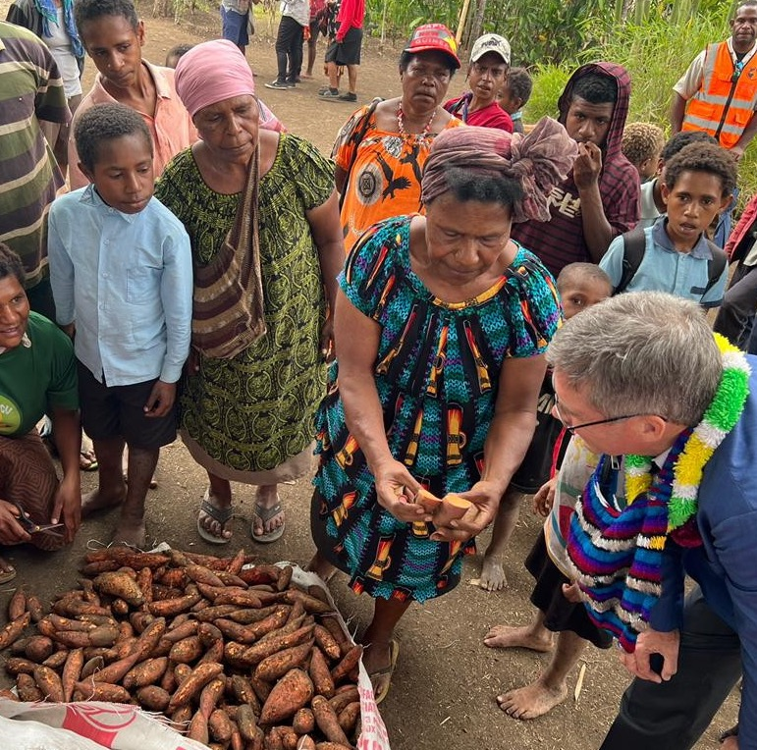
Learning intentions: Lesson 2
To explain how Official Development Assistance supports sustainable development.
To interpret data presented in a pie chart.
Notes:
Image credit: © Australian Government Department of Foreign Affairs and Trade

Slide 6
Australia’s Official Development Assistance:
is aimed at reducing poverty and promoting sustainable development
has supported countries within the Asia-Pacific region for more than 40 years
ensures resources are allocated where they are needed most
supports the United Nations Sustainable Development Goals.
Glossary
Poverty: the state of being extremely poor

Slide 7
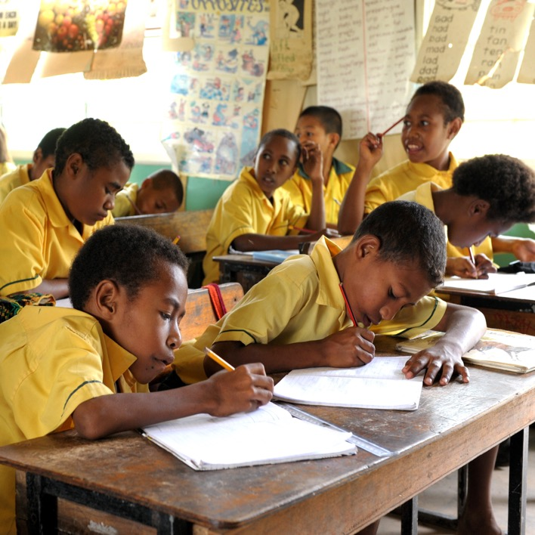
Key priorities
Australia works alongside Asia-Pacific countries to:
  build strong economies
  take climate action
  improve health and education
  emphasise equality for all people
  offer humanitarian support.
Glossary
Humanitarian support: short-term assistance following a crisis, conflict or disaster to reduce suffering and provide basic needs such as food, water and shelter
Notes:
Image credit: © Rocky Roe / Australian Government Department of Foreign Affairs and Trade

Slide 8
How does Australia decide who gets what?
Each year a budget is formed for each country that requires Official Development Assistance.
The Australian Government allocates funds across the various categories based on need.
The budget is represented in a pie chart.
Glossary
Budget: a plan for how to spend and save money
Funds: a sum of money made available for a particular purpose

Slide 9
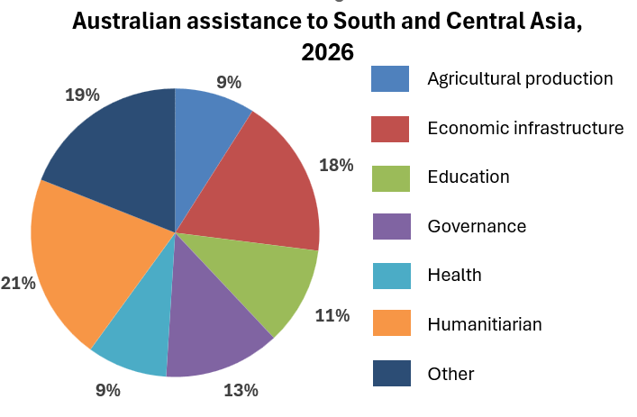
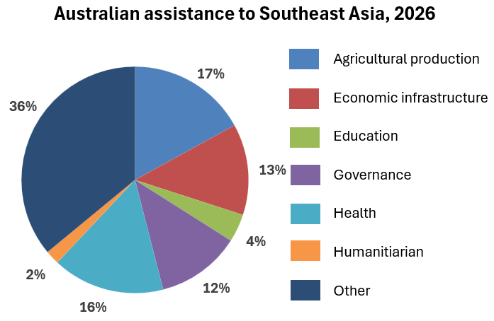
Pie chart budgets
Pie charts show the proportion (percentage) of funding provided to each development sector.
A pie chart as a whole will add up to 100%.
Each colour represents a development sector that Australia is supporting in a particular country or region.
Notes:
Pie charts adapted from: Development cooperation fact sheets, Department of Foreign Affairs and Trade, https://www.dfat.gov.au/about-us/publications/development-cooperation-fact-sheets-for-country-regional-and-sector-thematic-programs, CC BY 4.0.

Slide 10
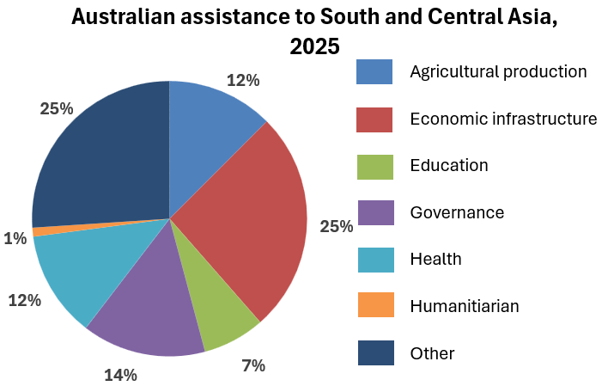
Compare these two charts
Consider which sector receives the most and least funding in each chart.
‘Other’ usually refers to the administration (planning and organising) of development funding.
What has changed between 2025 and 2026?
Notes:
Adapted from: Development cooperation fact sheets, Department of Foreign Affairs and Trade, https://www.dfat.gov.au/about-us/publications/development-cooperation-fact-sheets-for-country-regional-and-sector-thematic-programs, CC BY 4.0.

Slide 11
Why are decisions about development resources carefully planned?
Lesson 3
Notes:
This photo shows a diversity choir established between Australia and Vietnam as part of the Australia Awards. The Australia Awards build economic prosperity and people-to-people links for the region. The awards provide an opportunity for emerging leaders from our near neighbours (in this case, Vietnam) for study, research and professional development and then return home and contribute to their nations’ development, prosperity and resilience.
Image credit: © Australian Government Department of Foreign Affairs and Trade

Slide 12
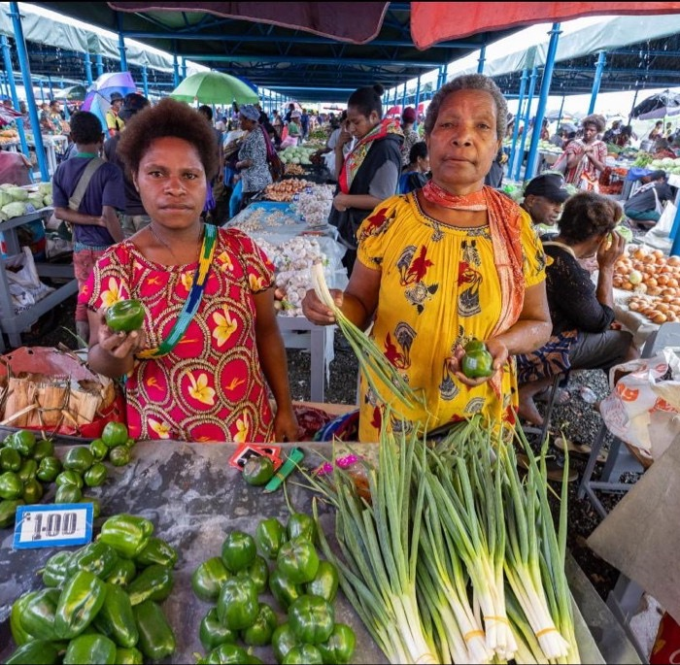
Learning intentions: Lesson 3
To make informed financial decisions about Australia’s allocation of Official Development Assistance to
its neighbours.
To interpret, compare and describe data presented in
a table and chart format.
Notes:
Image credit: © Australian Government Department of Foreign Affairs and Trade

Slide 13
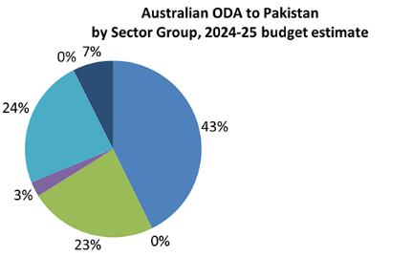
Example description of a pie chart
Almost half of Pakistan’s Official Development Assistance (ODA) from Australia in 2025 was allocated to farming or production of natural resources. Another half was equally shared between two major human resources – education and health.
A negligible amount was provided
to government services.
Australian ODA to Pakistan, 2025
Agriculture and other
production
Economic infrastructure
and services
Education
Governance
Health
Humanitarian
Other
Notes:
Adapted from: Development cooperation fact sheets, Department of Foreign Affairs and Trade, https://www.dfat.gov.au/about-us/publications/development-cooperation-fact-sheets-for-country-regional-and-sector-thematic-programs, CC BY 4.0.

Slide 14
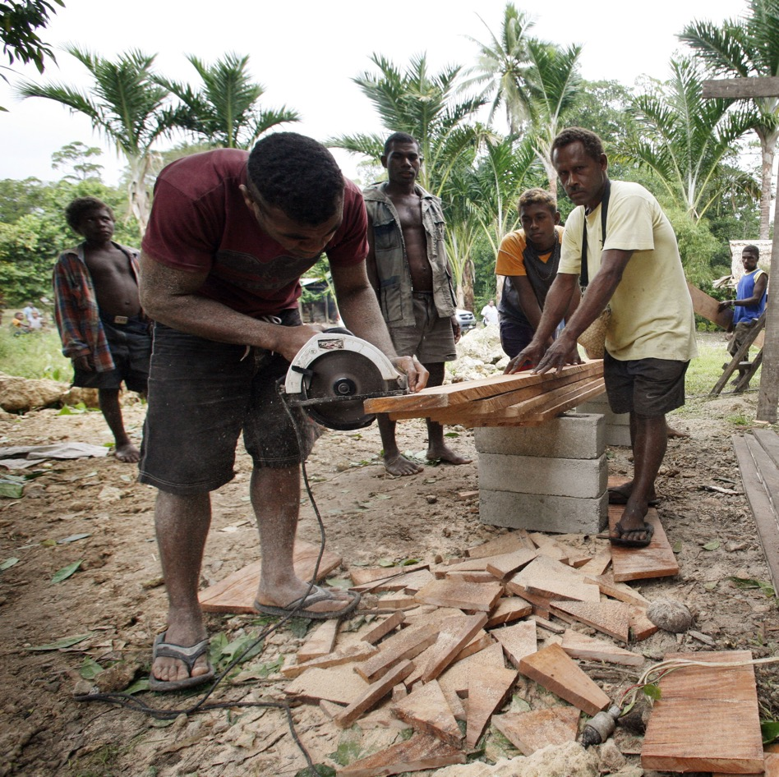
Extension question
How will the partnership established through Official Development Assistance change a place?
Notes:
Image credit: © Rob Maccoll / Australian Government Department of Foreign Affairs and Trade

