Slide 1
How are global partnerships improving agricultural productivity?
Lesson 1
Notes:
Image credit: © Australian Government Department of Foreign Affairs and Trade

Slide 2
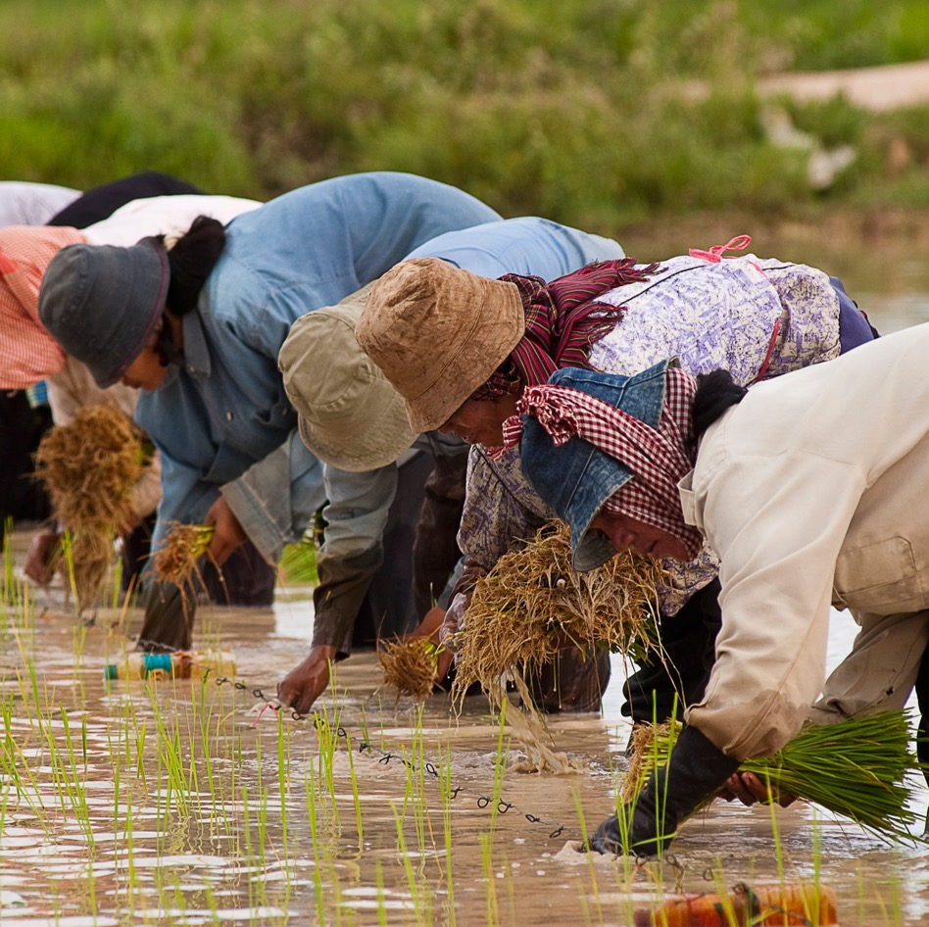

Learning intentions
To identify the global goals and targets aimed at sustaining agriculture and feeding populations.
To investigate how partnerships can support innovative and sustainable solutions.
Notes:
Image credit: © Brad Collis / Australian Government Department of Foreign Affairs and Trade

Slide 3

Global goal to end hunger
United Nations has 17 Sustainable Development Goals.
Goals established in 2015.
Aim is to reach targets by 2030.
Goal 2: end hunger, achieve food security and improved nutrition and promote sustainable agriculture.
Notes:
Icon credit: Sustainable Development Goals: https://www.un.org/sustainabledevelopment
The content of this publication has not been approved by the United Nations and does not reflect the views of the United Nations or its officials or Member States.

Slide 4
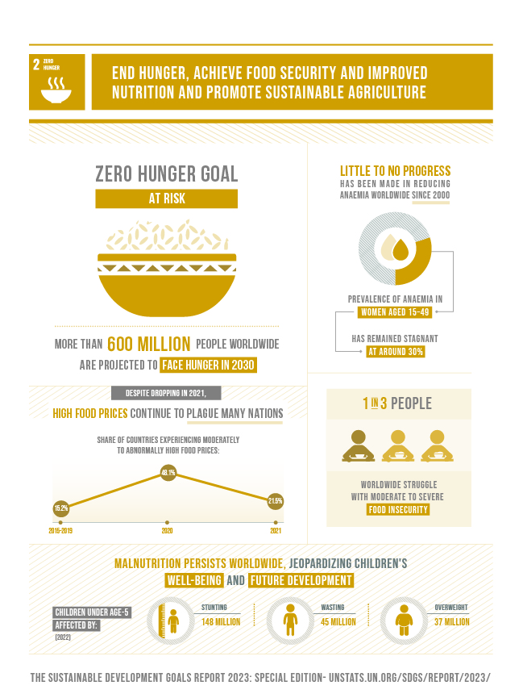
Zero Hunger Challenge
Zero stunted children under the age of two
100% access to adequate food all year round
All food systems sustainable
100% increase in smallholder productivity and income
Zero loss or waste of food
Notes:
Infographic credit: The Sustainable Development Goals Report 2023: Special Edition © 2023 United Nations

Slide 5
UN Targets covered in this module
Target 2.3 – double the output and income of local farmers, especially women, indigenous peoples and families
Target 2.4 – sustainable farming that is climate resilient and ensures land quality
Target 2a – global cooperation and funding into agricultural research and innovation
Notes:
Icon credit: Sustainable Development Goals: https://www.un.org/sustainabledevelopment
The content of this publication has not been approved by the United Nations and does not reflect the views of the United Nations or its officials or Member States.

Slide 6
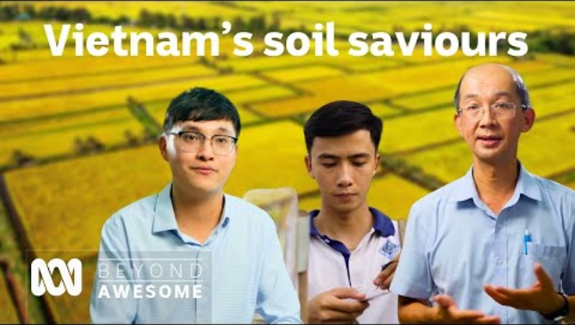
Vietnam’s soil saviours video
Notes:
Link: Meet the scientists saving fields in Vietnam’s Mekong Delta Region | Beyond Awesome

Slide 7
How is modern technology assisting sustainable food production?
Lessons 3–5
Notes:
Image credit: © Ness Kerton / Australian Government Department of Foreign Affairs and Trade

Slide 8
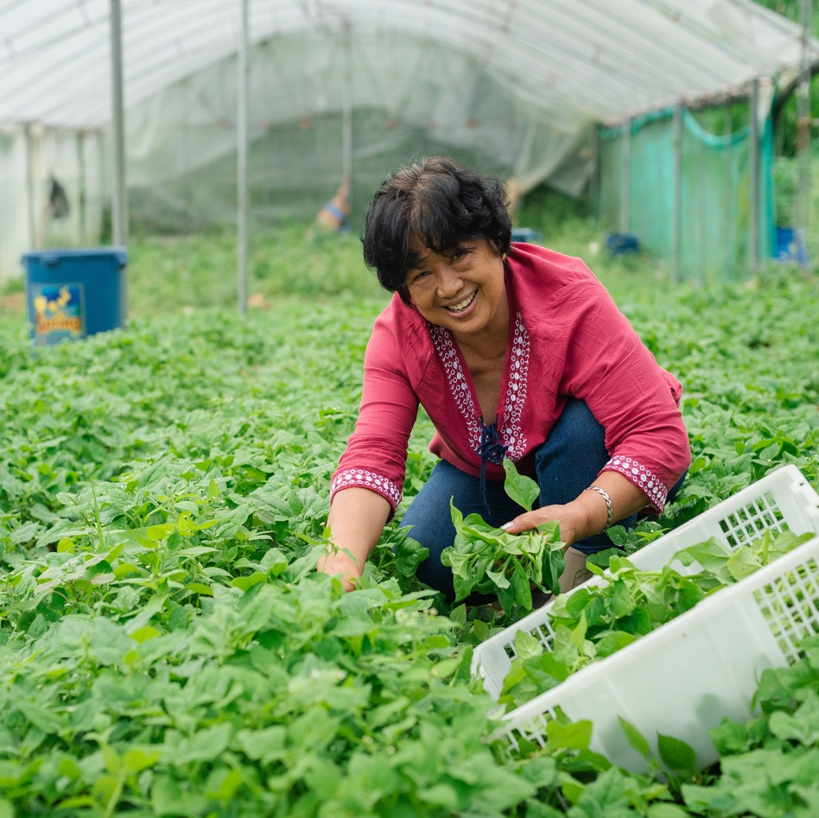
Learning intentions
To describe the technological innovations that are making food production more sustainable.
To propose how the use of a modern technology could assist countries to reach food security.
Notes:
Image credit: © Flordeliz Ranola / Australian Government Department of Foreign Affairs and Trade

Slide 9
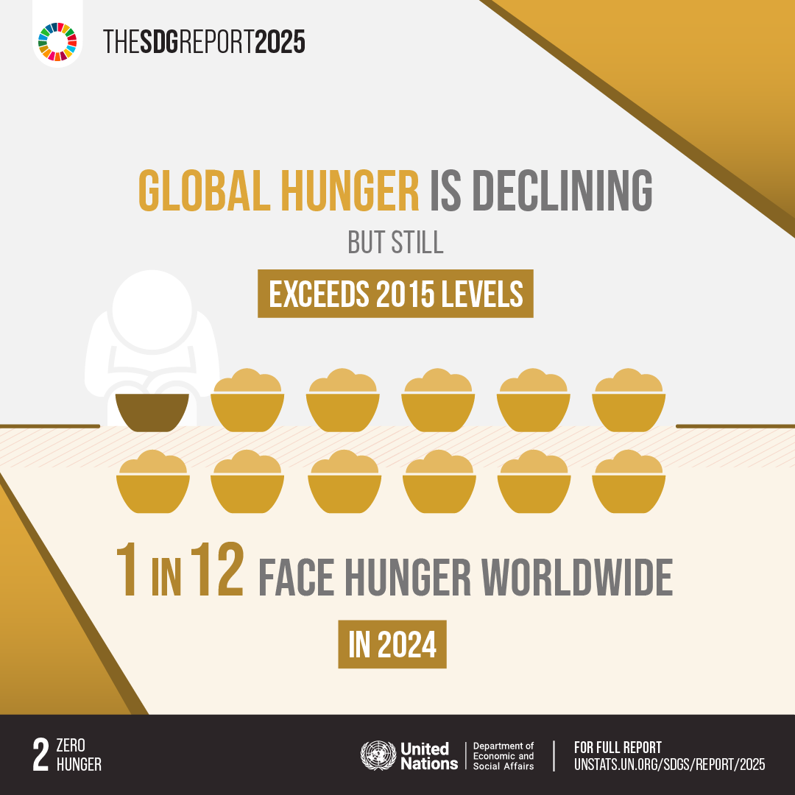
SDG Goal reports infographics
Notes:
Infographic credits (left to right): The Sustainable Development Goals Report 2025 © 2025 United Nations; The Sustainable Development Goals Report 2023: Special Edition © 2023 United Nations

Slide 10
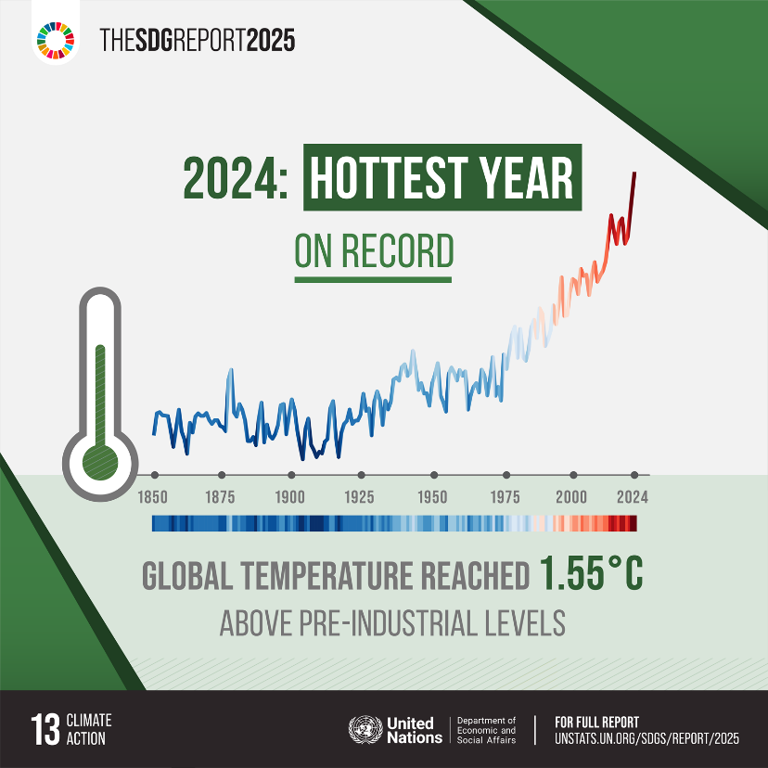

Take urgent action to combat climate change and its impacts
Notes:
Infographic credits (left to right): Sustainable Development Goals: https://www.un.org/sustainabledevelopment; The Sustainable Development Goals Report 2025 © 2025 United Nations
The content of this publication has not been approved by the United Nations and does not reflect the views of the United Nations or its officials or Member States.

Slide 11
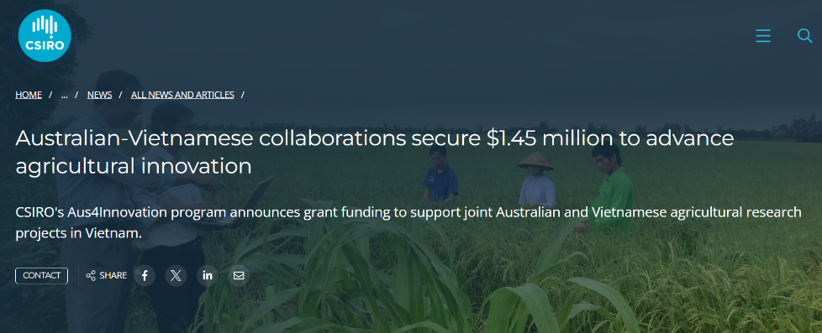
Innovation partnerships
Australia works with various stakeholders across the Asia-Pacific region to develop agricultural partnerships. Stakeholders include:
country governments
local businesses or farms
universities
scientific organisations
technology companies.
Read the article to discover the many stakeholders partnering in the Aus4Innovation funded project

Slide 12
Modern farming technology proposal
Scenario
The Australian Government wishes to partner with a country in the Asia-Pacific region to conduct research on the use and effectiveness of modern technological innovations for local agricultural practices.
This partnership could involve government departments, technology experts or scientists, entrepreneurs (such as yourself) or universities, and most importantly it must include local communities and agricultural businesses.

Slide 13

Pitching an agricultural solution

Slide 14
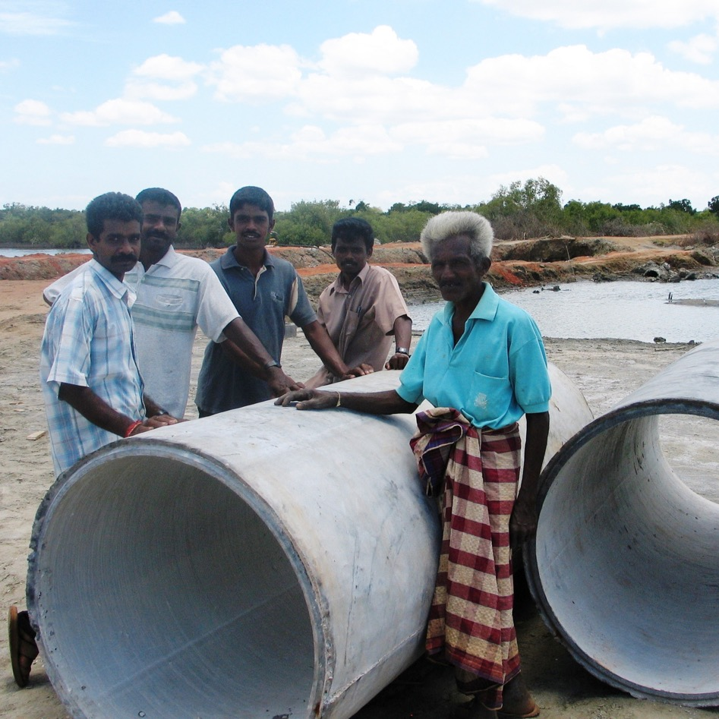
Module review
What skills underpin an entrepreneurial mindset? How would you rate yourself on these?
What tasks did you enjoy and/or consider challenging during the design thinking process?
What social skills are your strengths and what could you develop further?
Notes:
Image credit: © Australian Government Department of Foreign Affairs and Trade

Slide 15
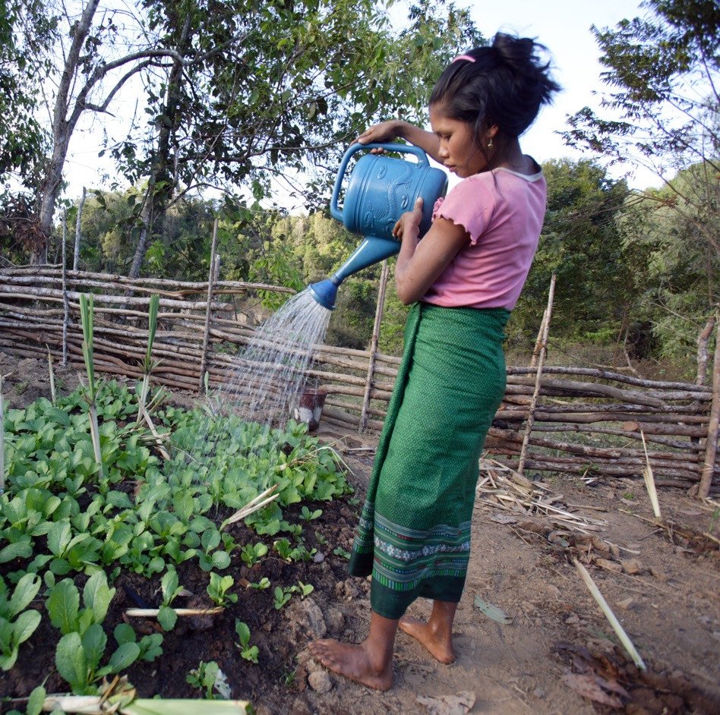
Module review
Do you believe the Asia-Pacific region could reach zero hunger by 2030?
Which agricultural innovation, strategy, technology or combination will be most influential in achieving food security by 2030?
Notes:
Image credit: © Jim Holmes / Australian Government Department of Foreign Affairs and Trade, CC BY

