Slide 1
Our Indo-Pacific community
Notes:
© ChildFund Kiribati/Department of Foreign Affairs and Trade, CC BY

Slide 2
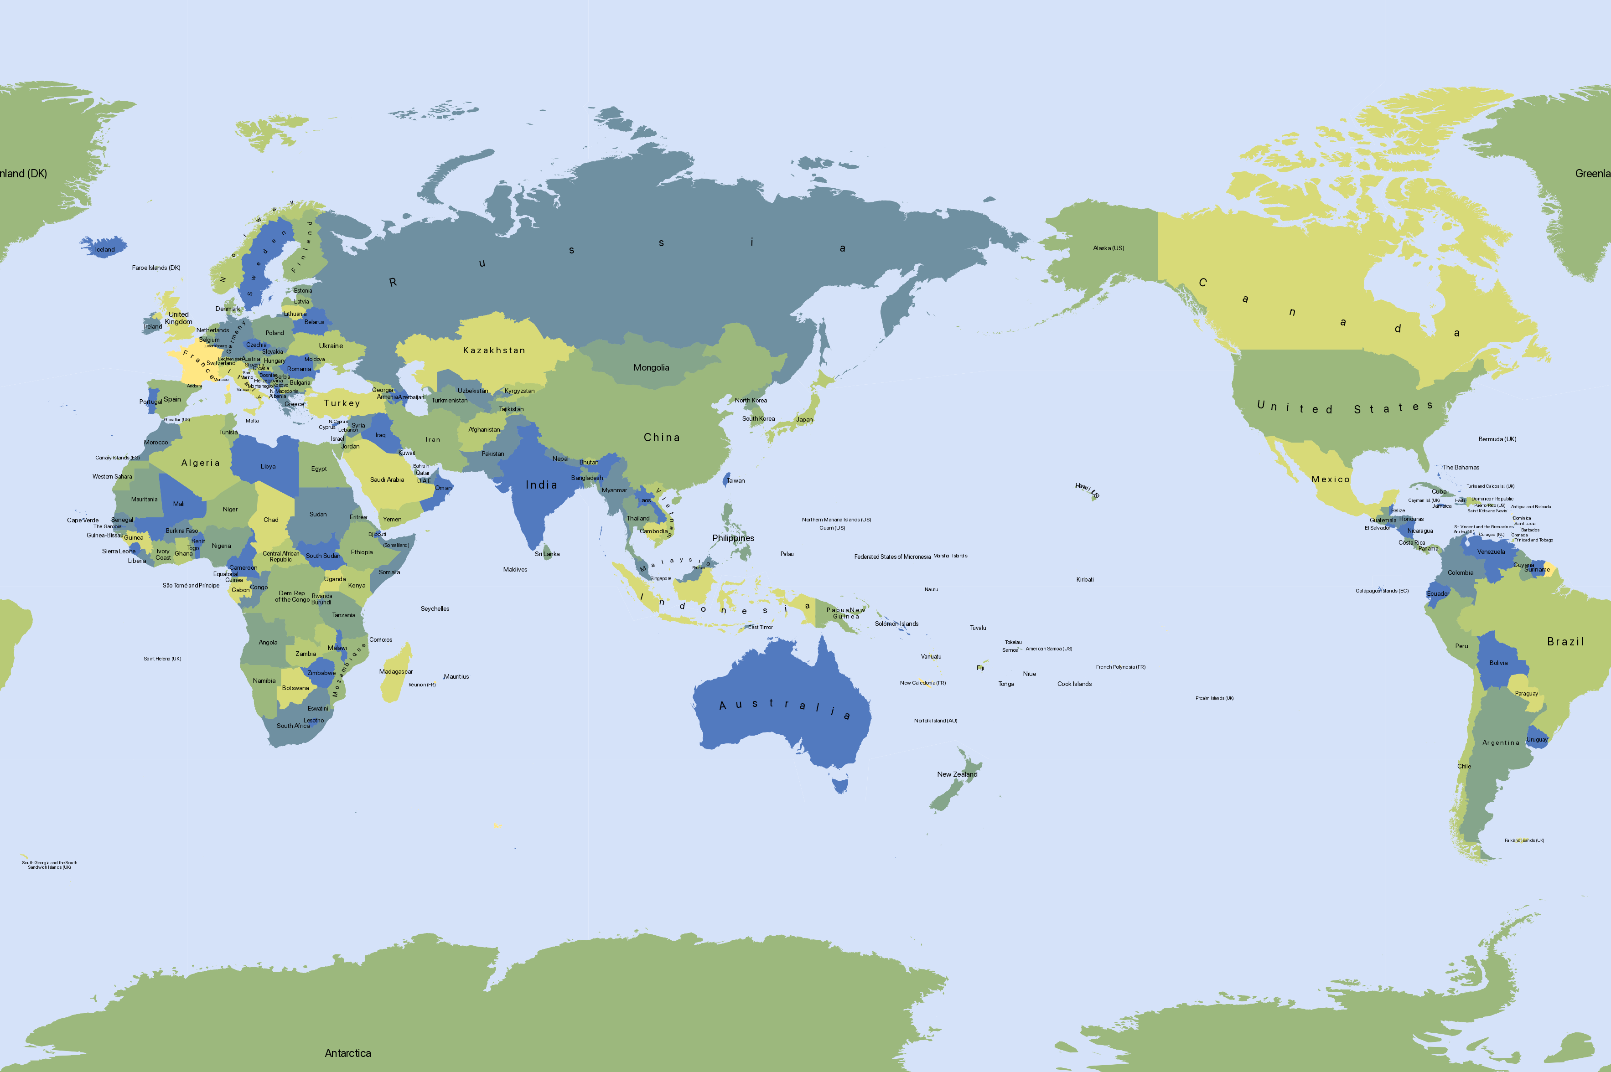
Slide 2: Map of the Indo-Pacific region
Notes:
© Mapswire, CC BY 4.0

Slide 3
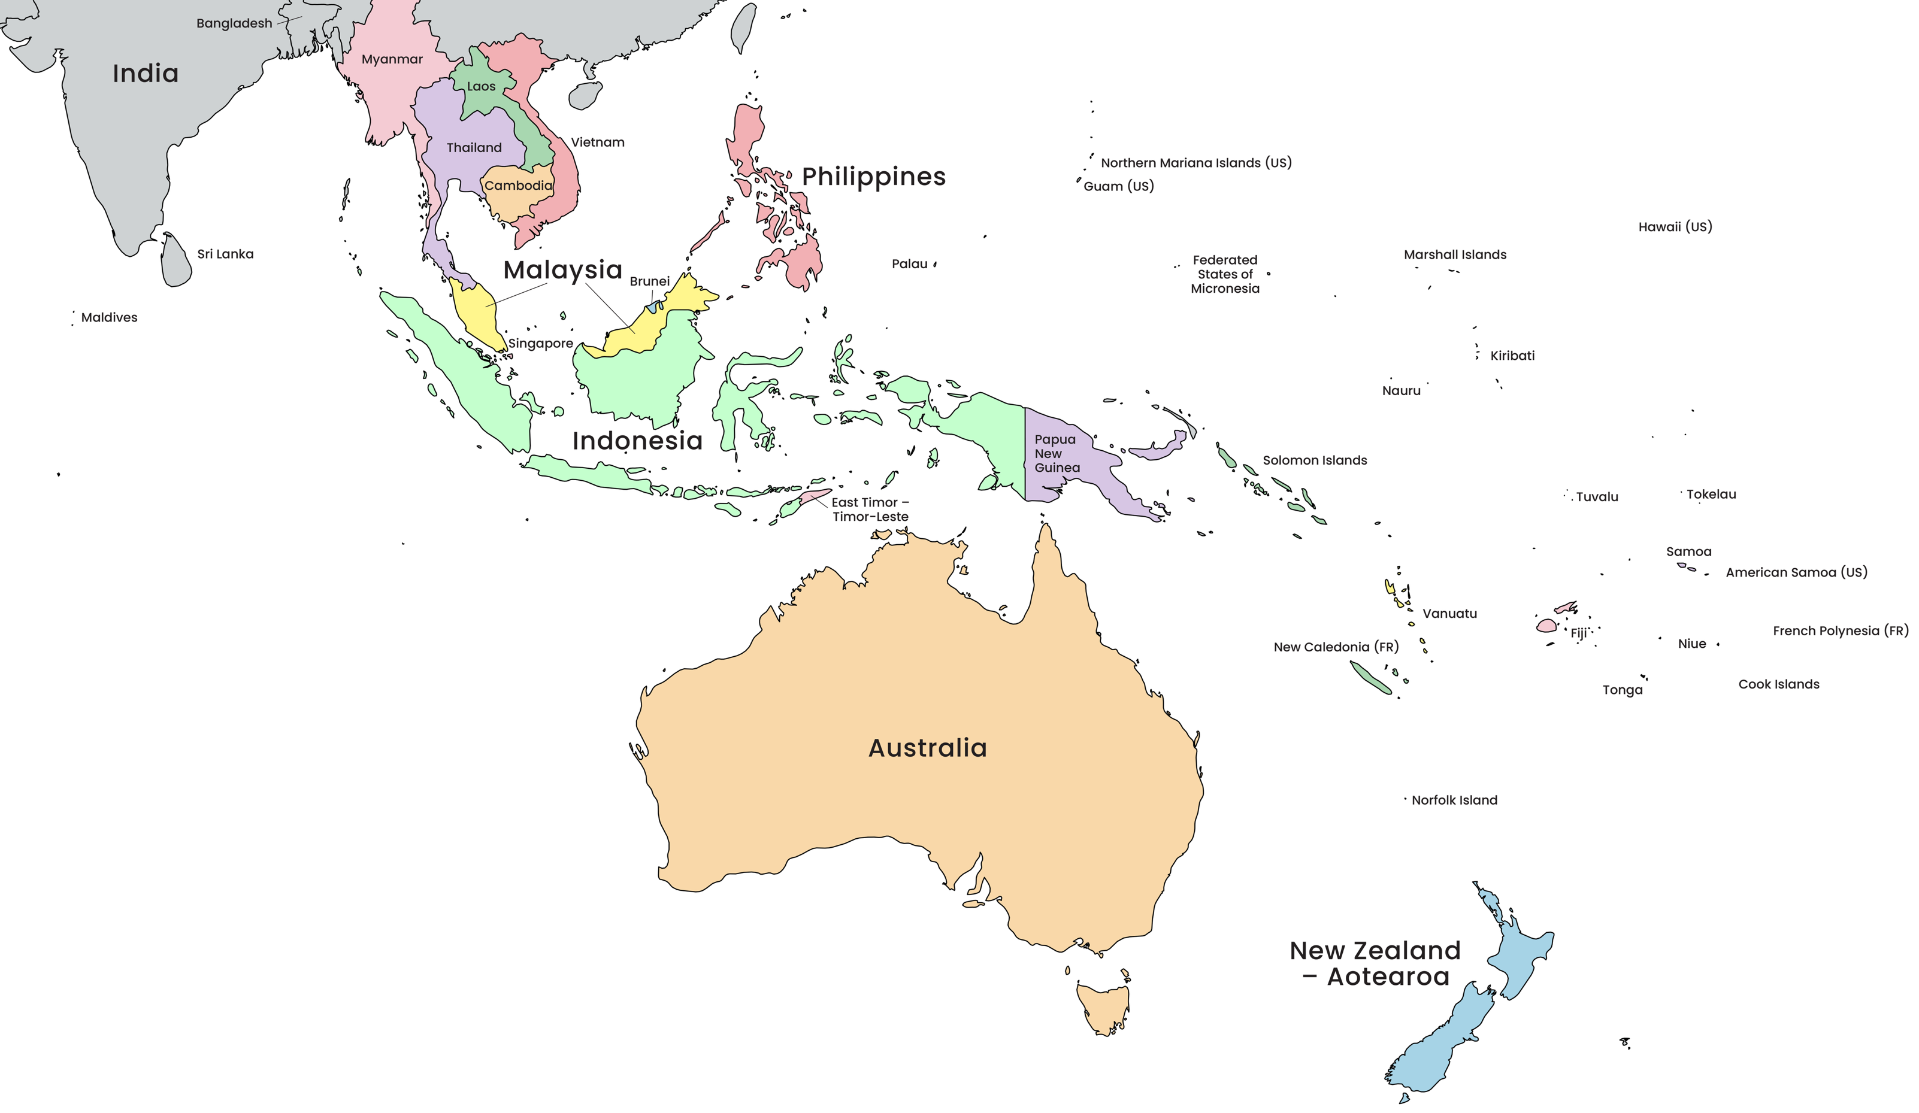
Slide 3: Map of our Indo-Pacific region’s countries
Notes:
Adapted from: © VectorStock

