Slide 1
How does Australia uphold its global responsibilities?
Lesson 1
Notes:
© Nathan Fulton / Australian Department of Foreign Affairs and Trade, CC BY

Slide 2
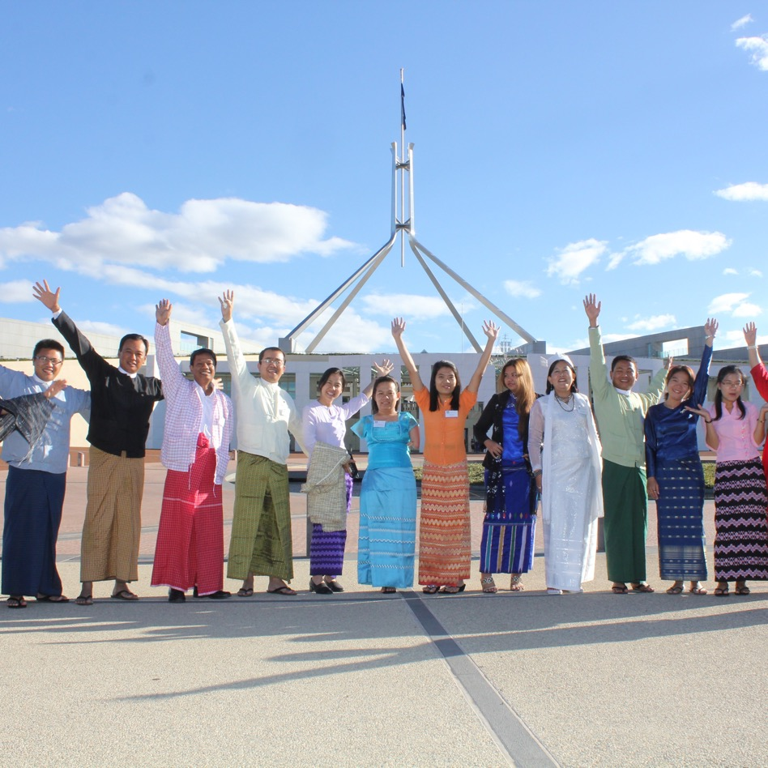

Learning intention
To understand how Australia works cooperatively with other countries and organisations to fulfill its legal and global responsibilities.
Notes:
© Angus Braithwaite, Australian Department of Foreign Affairs and Trade

Slide 3
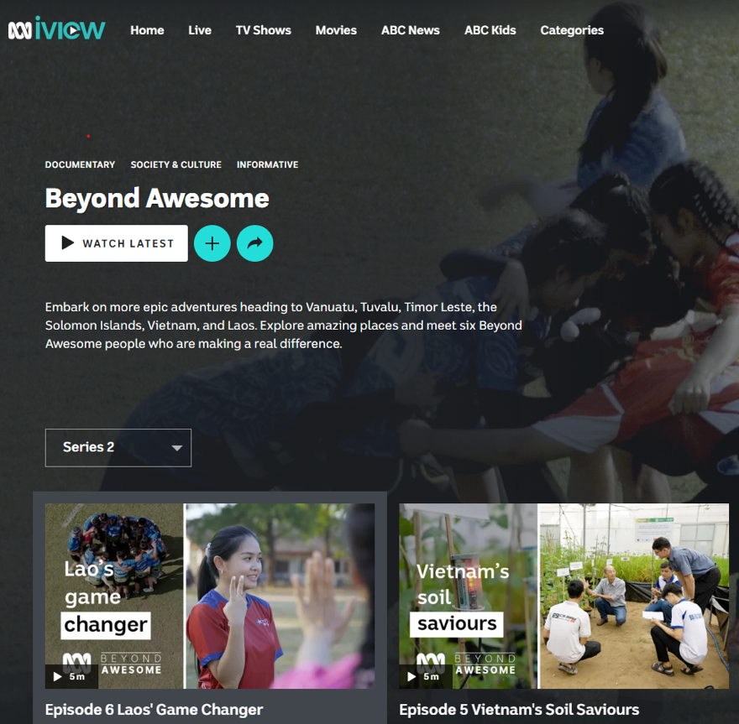
Global development – the diplomatic work of DFAT
Choose a topic to research:
Environment and sea law
Child protection and rights
Gender equality
Education and workforce
Climate change
Rights of Indigenous peoples
or people with a disability

Slide 4
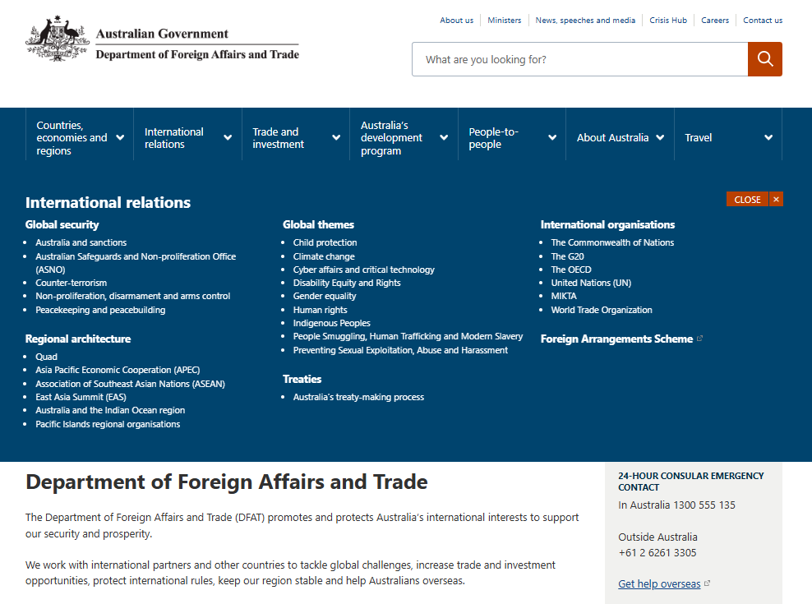
Accessing the DFAT website
Go to www.dfat.gov.au and
select the drop-down menu ‘International relations’.
Then select one of the relevant topic links.
OR
Go to dfat.gov.au/international-relations

Slide 5
Worked example (questions 1 and 2)
Area of global development: Child protection and rights of people with a disability
Identify any international treaties or multilateral agreements signed by Australia to do with
the topic you chose.
United Nations Convention on the Rights of the Child (UNCRC)
Provide examples of how these agreements are reflected in Australian legal policies and commitments.
Australia was first to implement a policy to protect children from exploitation and abuse.
The Australian Government has a zero-tolerance approach.
Following the UNCRC, the Australian Government upholds that the primary consideration
should always be what is in the best interests of the child.
In Australia, the National Framework for Protecting Australia’s Children was endorsed in 2009.
It outlines the standards for protecting and supporting children as agreed to in the UNCRC.
The framework makes clear that ‘protecting children is everyone’s business’.

Slide 6
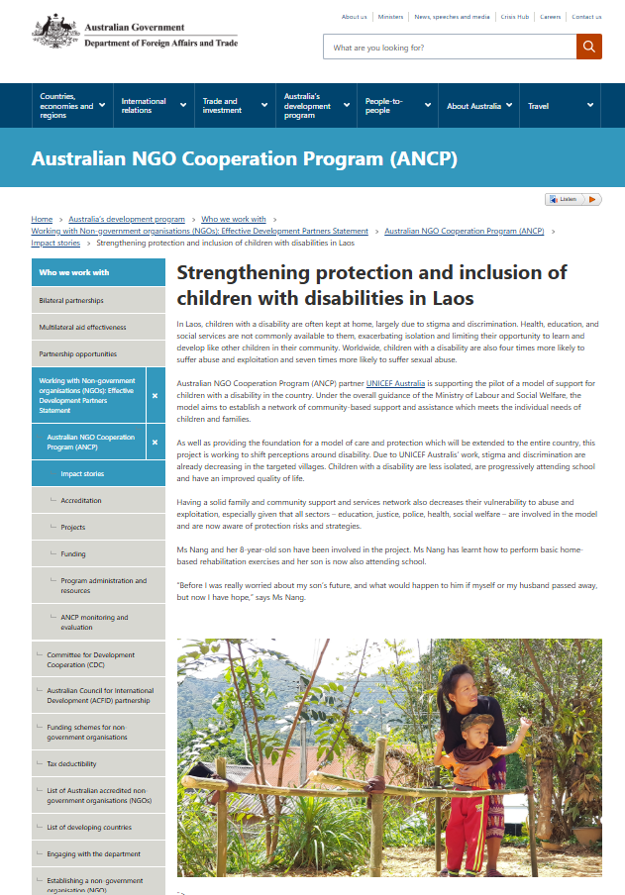
Worked example (question 3)
Outline an Australian Government development program or project.
This example summarises information from an article found through a DFAT website search: Strengthening protection and inclusion of children with disabilities in Laos.
‘Globally, children with a disability are more likely to suffer abuse and exploitation. In Laos, social stigma and a lack of specialised health services mean that most children with a disability are kept at home. The Australian Government is working with the Lao Government and supported by the
non-government organisation, UNICEF Australia to develop a model of care for these children. It is currently aimed at certain villages to reduce isolation and discrimination and to assist families with health services such as rehabilitation exercises to improve quality of life and encourage their inclusion into a school. This is an example of a multilateral agreement between the Australian Government, Lao Government and non-government organisation UNICEF Australia.’

Slide 7
Worked example (question 4)
What are some of the challenges and risks for Australia?
‘The exploitation or abuse of children undermines a child’s right to grow
up safely. When experiencing abuse, there is a risk that children may be traumatised and suffer long-term mental health issues. The Australian Government works to minimise exploitation and abuse by managing any risks that may be linked to its international development programs. They also ensure that responsibility of their zero-tolerance policy is shared with all partner organisations. DFAT provides guidance on how to immediately report concerns.
The growing challenge of online predatory or suspicious behaviour towards children has meant that Australia is part of a Virtual Global Taskforce. This is a multilateral agreement between 15 law enforcement agencies. Online criminal activity and child sexual abuse is borderless, making it impossible for any one country to combat it alone. The taskforce also works with other organisations to protect children online, across the globe.’

Slide 8
Worked example (question 5)
Extension: How does global connectedness both hinder and enhance the ability to manage your chosen topic?
‘Diplomacy between governments and the formation of legal agreements ensures there is universal acceptance regarding the rights and treatment of children, which then becomes more widely known
to people throughout the world. This hopefully filters through into national and organisational standards.
However, technology has enabled such connectedness that it is difficult to control or keep track of what methods are being used to abuse children. Furthermore, with large companies often spreading the production of goods and services across the globe, it allows avenues for child labour and exploitation to arise, often discreetly.’

