Slide 1
RFS Operational Technology.
Matthew White, Operational Platforms

Slide 2
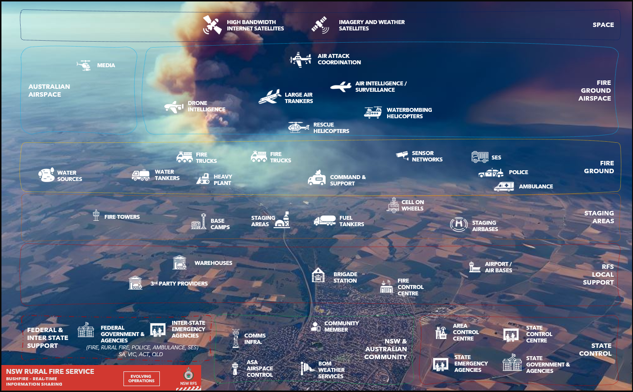
Notes:
- Leverage diagram to reference complexity of RFS situation
- Sheer number of people and assets that need to coordinate in real-time to be effective.

Slide 3
Athena

Slide 4
Cloud Hosted Fire Modelling
Risk Visualiser
Social Intel
Ensemble Phoenix RapidFire Predictions
CSIRO Spark Predictions
Burn Probability, Flame Height and Ember Density Outputs
Side-by-Side Comparison Tool
FBAn Prediction Upload
Red Map Upload
Incident Prioritisation
Potential Impacts
Map Annotations
Multi-Incident Predictions
Access to 80+ Spatial Layers
Aerial Imagery Overlay
Live Resource Tracking
ML-Based Image Recognition Model
Word Classification Engine
Map Social Clustering
Configurable Data Streams
Incident Social Streams
Dynamic Coverage
Aviation Safety
Risk Response Engine
Red, Amber, Green Coverage Gap Ratings
Gap Analysis by Brigade and District Boundaries
Aligned with FDR Stand-Up Protocol
Filters by Resource Type and Capabilities
Incident-Specific Safety Reports based on weather variables over fireground
Safety Assessment of 19 Common Airframes
ARENA System Integration
Updated every 15 minutes
CAD System Integration
ARENA Heavy Plant Integration
Dynamic Suppression Strategies Incorporating Appliances, Aircraft, and Heavy Plant
Dispatch Instructions via CAD
ML Model in Training
COP Replacement
Watch Zones
Integrated Help Centre
Access to 75,000 Users
Support for 2,000+ Concurrent Users
Integration with FireMapper
Share Endorsed Predictions with Volunteers and Partner Agencies
Define Area of Operation
Set Area of Interest
Customise Notifications and Frequency
Email and SMS Alerts
In-Platform Step-by-Step Feature Tutorials
Business Rules and System Logic Documentation
Instructional Tutorial Videos

Slide 5
Intelligence Generation Process
The Athena Platform
Risk Response Engine
Suggest response strategies
TRIAL
Aviation Risk Assessment
Notify SAD operators
TRIAL
Incident Reported
ICON shares with Athena
Incident created in Athena
Firestory Incident Log
Logs first Sitrep & Alert Level
Incident Log
Social Intel Analysis
ML model searches bushfire
& Smoke
Generates Point Prediction
Ensemble Phoenix Prediction
Single Spark Prediction
(2 - 5 minutes)
Updated Polygon Prediction or Weather Forecast
Ensemble Phoenix Prediction
Single Spark Prediction
Queries for Resource Gaps
Notifies IC of Gaps
FireMapper Integration
Verified Incident Field Mapping

Slide 6
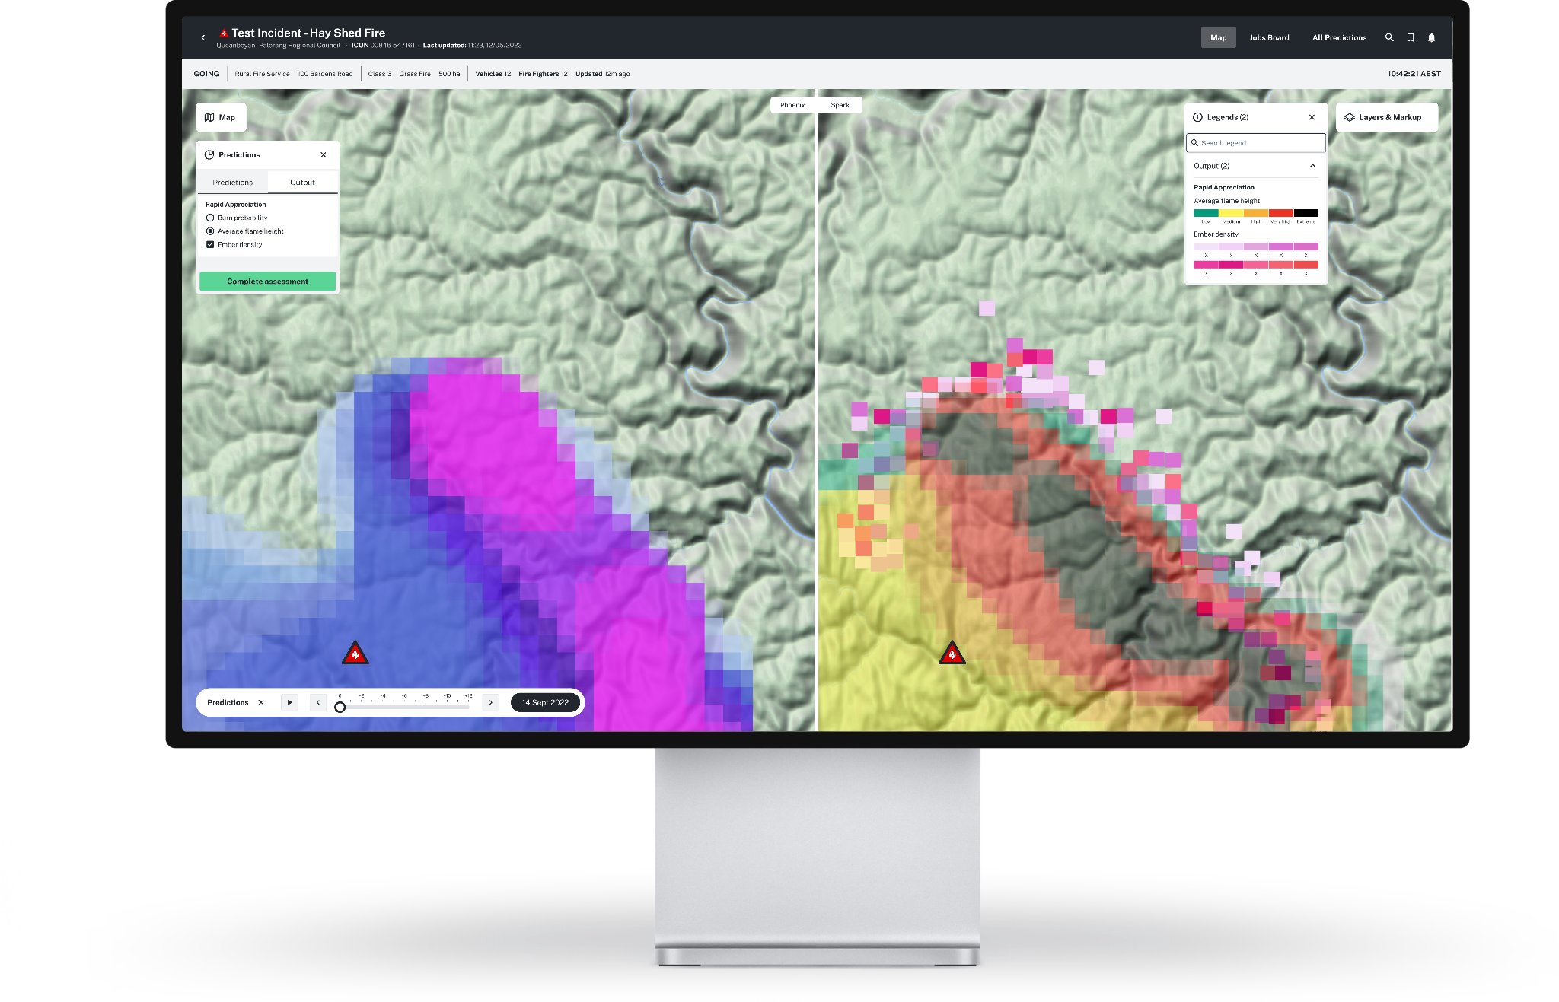
Multi-Model Fire Predictions
First ensemble cloud implementation of Phoenix RapidFire.
First operational implementation of CSIRO Spark
Running both models in parallel in the cloud, reducing run time from hours to minutes.
Multi-Incident Predictions
Ensemble Ignition (Point) Predictions
Ensemble Established (Shape) Predictions
Upload 4-Day Forecasts
Human/Manual Prediction Upload
Fire Scientist Supervisor Page

Slide 7
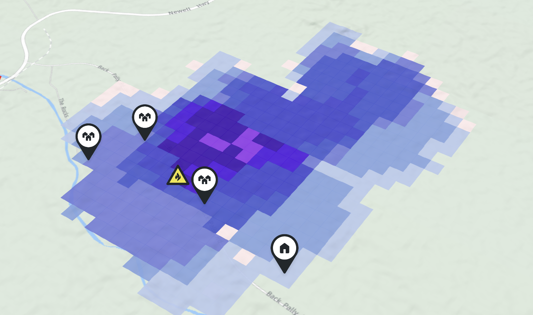
Prediction Outputs
Burn Probability
Flame Height
Ember Density
Maps the predicted fire path and depicts how it might interact with the both the built and natural environment.
When ensembled, this product is shown as a percentage. Each grid is 180 metres².
Provides a modelled forecast of flame height and the likelihood of it reaching canopy fuels or crowning.
Models areas around the fire that are susceptible to spotting and likely to jump fire breaks and/ or create spot fires.

Slide 8
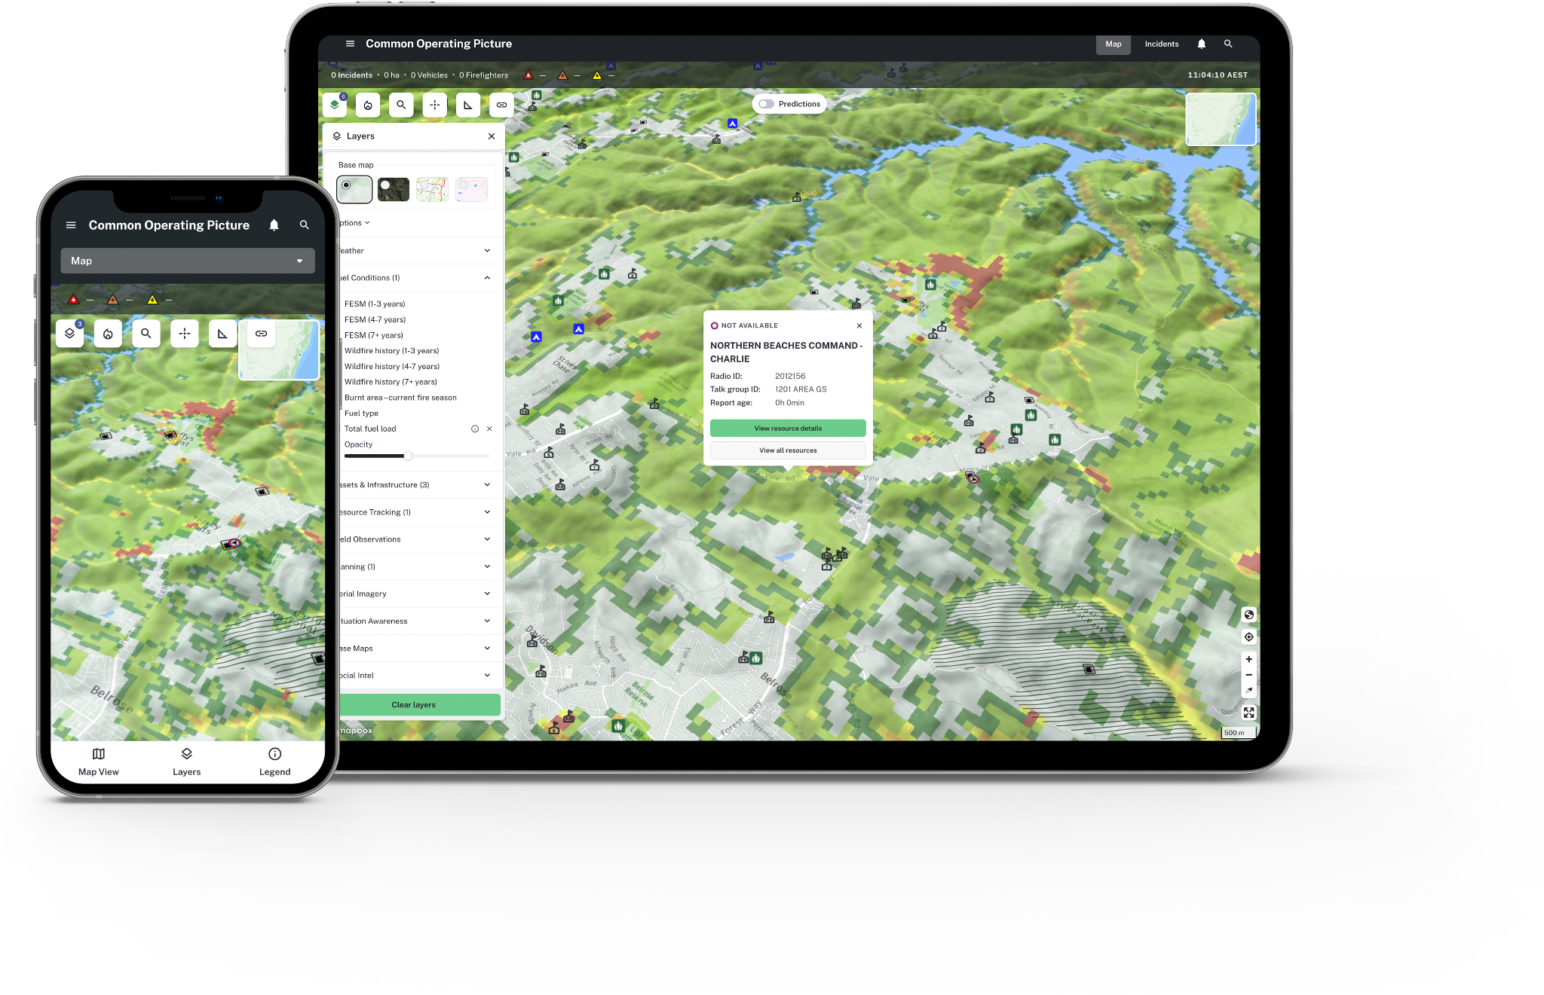
Common Operating Picture
3D Tiled Spatial Map
Mapping Enhancements
Layer Opacity
Updated Layer Groupings
Enhanced Search Functionality
Share Endorsed Fire Spread Predictions with Fireground Commanders
Download Lightning data
Feature Parity with the Existing RFS COP
4 Day RART Forecast

Slide 9
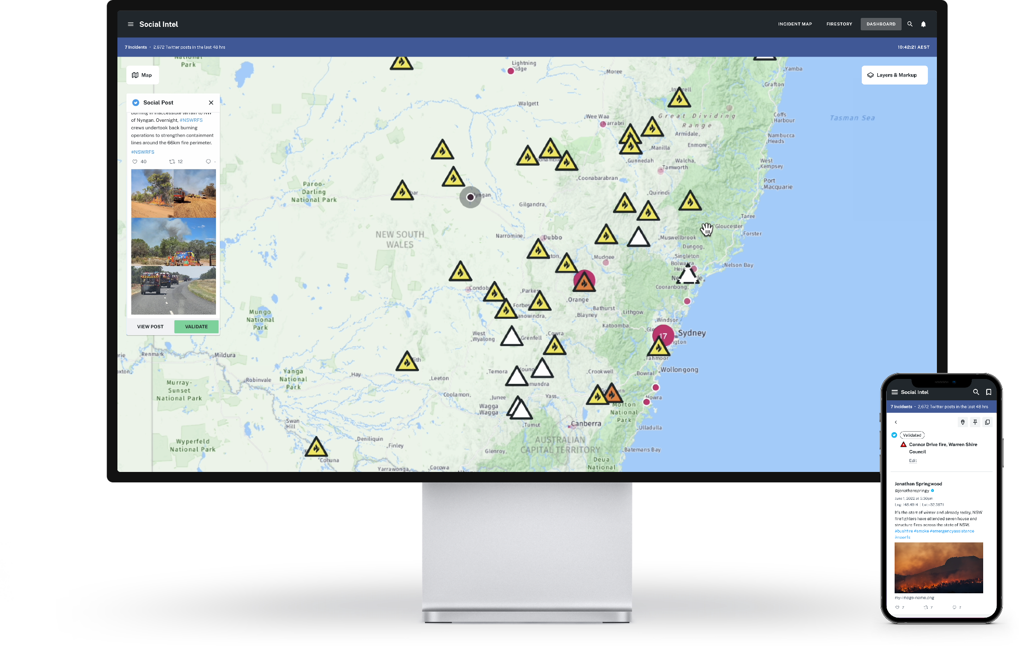
Social Intelligence
Powered by an image recognition Machine Learning Model
Automatically surfaces wildfire related social media to the platforms map
‘Social Clusters’ layer surfaces areas of concentrated wildfire related social activity
Direct integration with Twitter’s ‘Fire Hose’
Individual Incident Streams and incident filters
Mobile compatibility

Slide 10
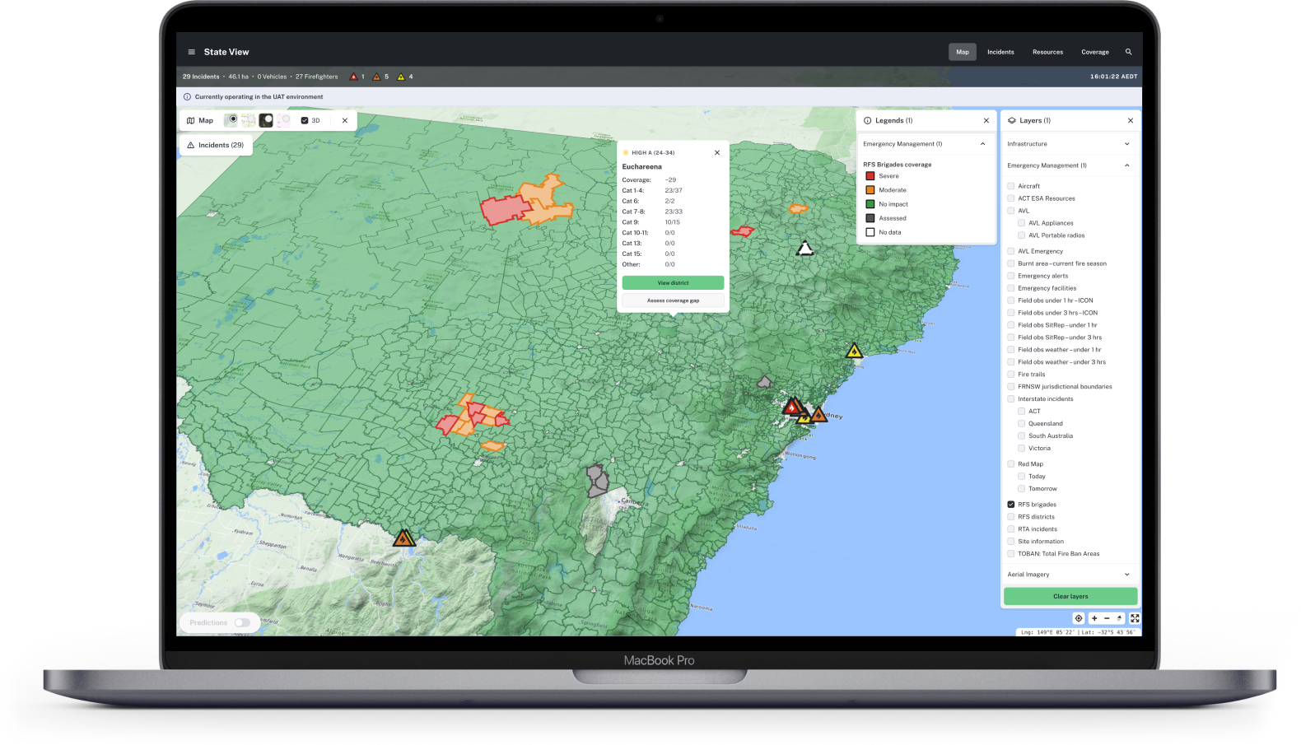
Dynamic Coverage
Automated state, district, and brigade Appliance coverage gap analysis
Automated state Aircraft coverage gap analysis
Considers operational readiness and activation procedures based on district FDR
Manual overwrite if additional resources are available that Athena can’t access (National Parks, Forestry etc.)

Slide 11
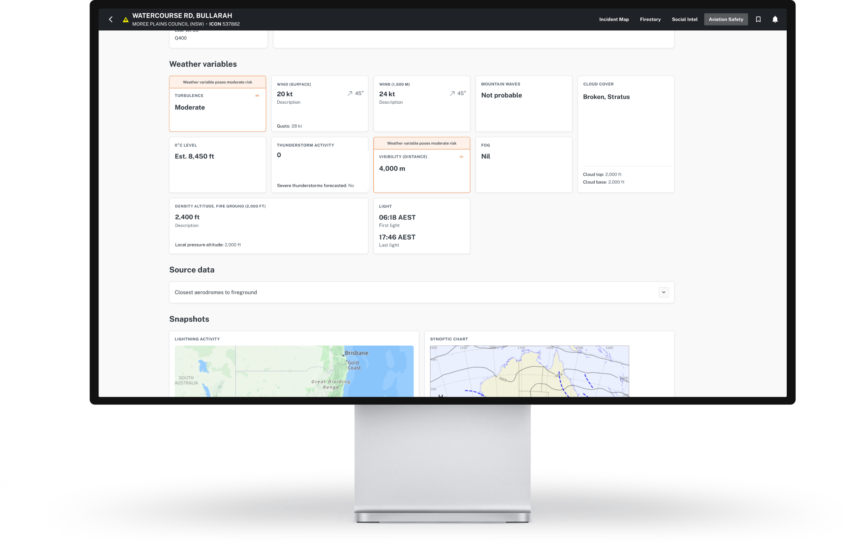
Aviation Safety
Incident specific Aviation Risk Assessments (Based on weather only)
Automated analysis of forecasted weather conditions over a fireground
Considers the risk to 17 commonly used waterbombing airframes - both rotary and fixed-wing aircraft.
State Red, Amber, Green (RAG) map
SMS notifications

Slide 12
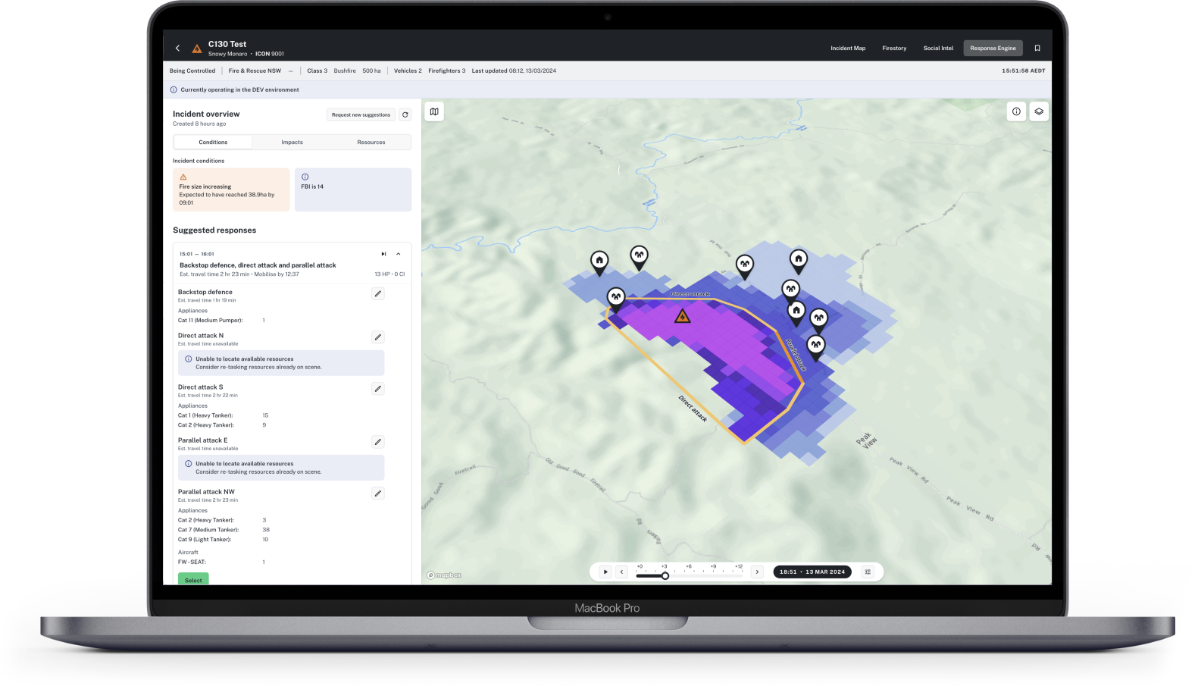
PROJECT ATHENA
Risk Response Engine
TRIAL
Target of containing fires within 10 hectares
Automated generation of recommended response strategies and resources required
Considers Appliances, Aircraft, and Heavy Plant in response strategies
Considers potential coverage gaps and Aviation Risk Assessments in response strategies
Currently a heuristic model, but a Machine Learning model is being trained

Slide 13
Vehicle as a Node (VaaN)

Slide 14
Our challenge – Oct 2023
Operational effectiveness was being challenged by communications limitations
Fires at radio towers
Radio coverage is limited in parts of Western NSW
4G communications networks are strained during large scale emergencies
LOADING…

Slide 15
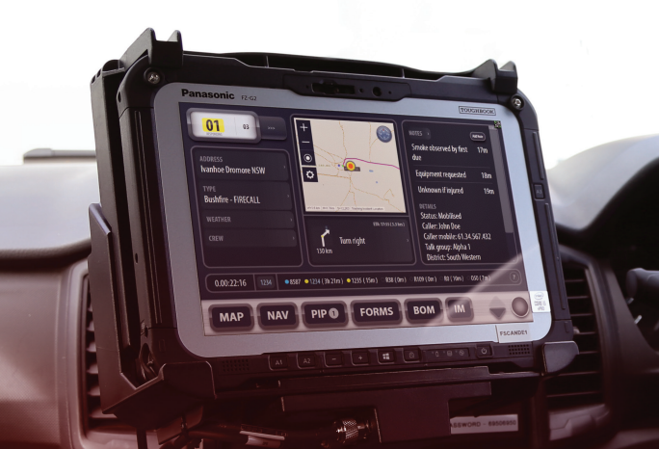
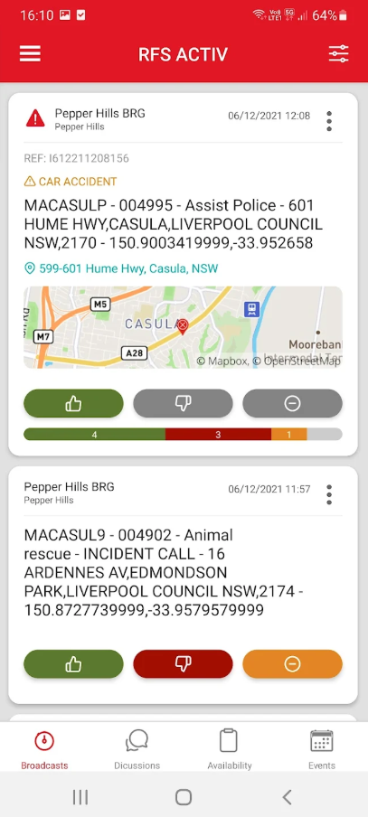
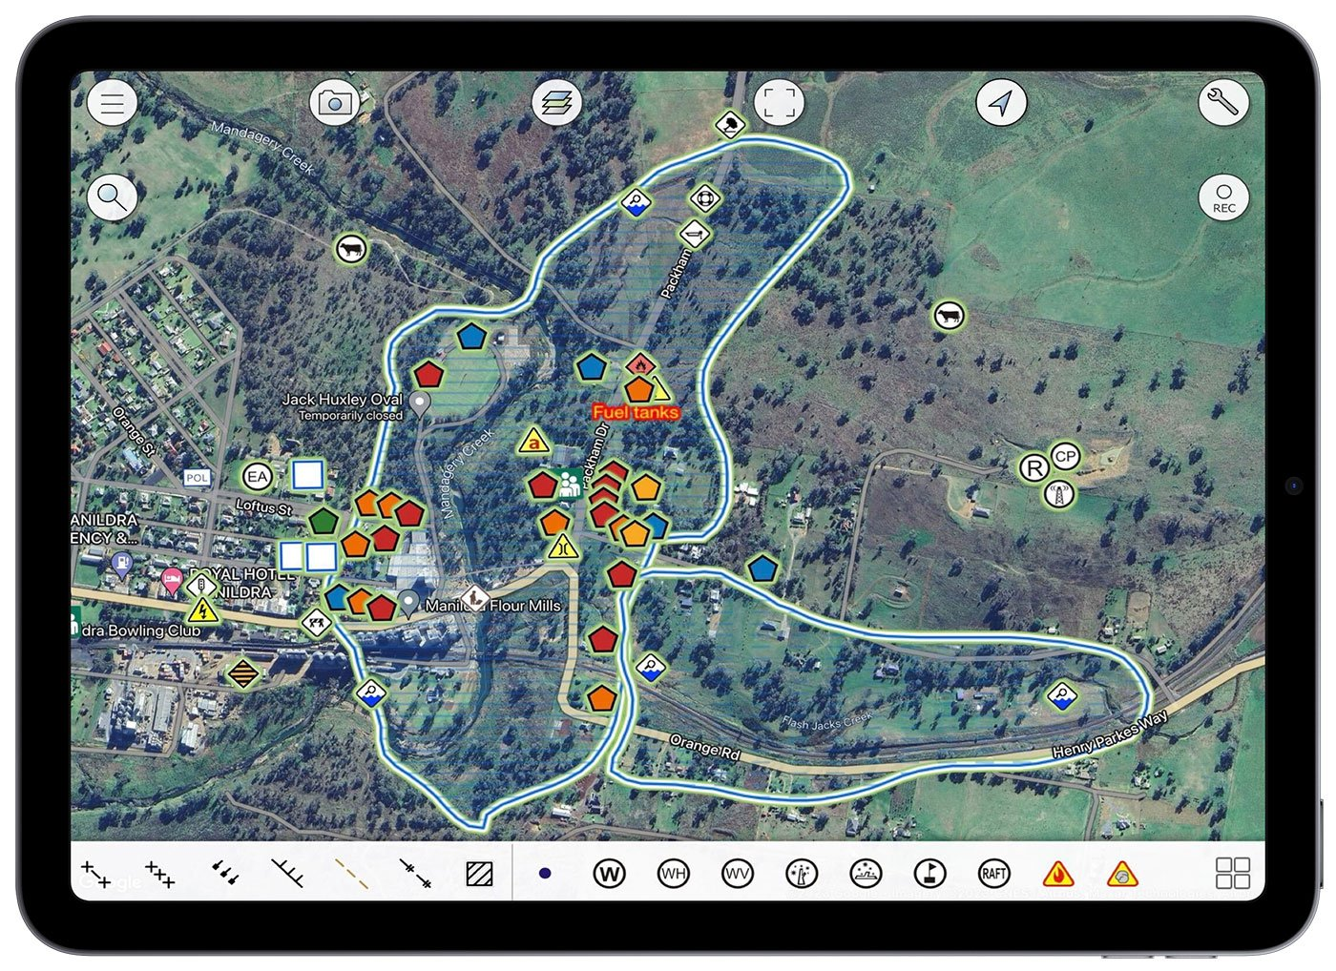
Making key investments accessible in the field

Slide 16
VaaN Design approach
Design Principals
Minimise the number of designs: The contract allows for design across the 12 categories of appliances, split into major and minor designs. Minimising the variation in physical designs will expedite the manufacturing process and ensure a flexible rollout approach.
Prioritise installation efficiency: focus on minimising the amount complexity of installs to deliver a efficient install time to support the rollout period
Accommodate variable power systems: the solution need to support the RFS fleet, and the various ages, design approach's and power systems
Simplified Product Range: Limit the use of complex or proprietary components.
Ease of Support: Common hardware assembly simplifies support processes for RFS.
Heavy Fleet
Medium Fleet
Light Fleet
Category 1
Category 7
Category 16
Dual Cab
Category 9
Single Cab
Notes:
Commercial comparison Hypha retail the device at 15000 the RFS buy rate as an outcome of the work is 9k (6000 Diff)

Slide 17
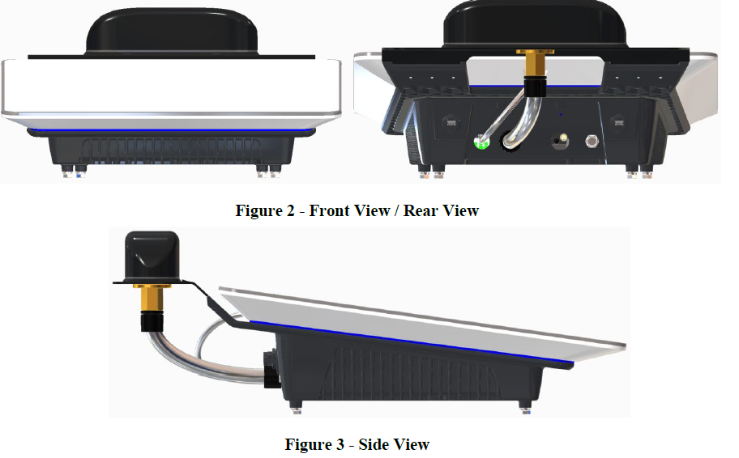
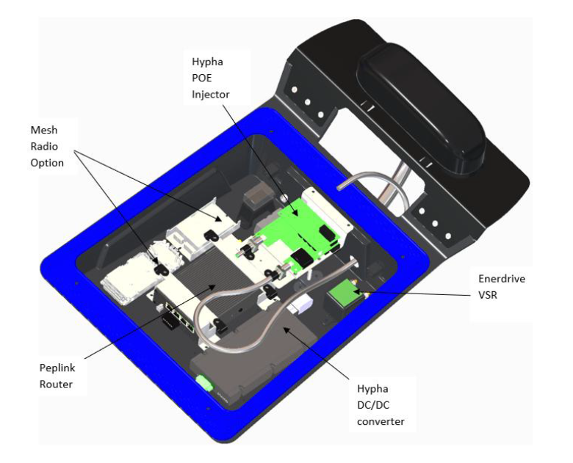
Hypha One

Slide 18
Wi-Fi

Slide 19
Firemapper

Slide 20
In-Field Mapping | Introduction to FireMapper
Project Background
RFS is implementing and integrating a service-wide Field Mapping Solution to streamline data collection in the field, in both operational and non-operational settings. Quality field mapping would greatly enhance RFS’s situational awareness capabilities, fire spread predictions and warnings and inform operational decisions.
What are the Key Benefits of FireMapper?
All Hazard Symbology
Real-Time Information
Operational Focus
System Compatibility
Specialised hazard and emergency symbology covering a range of incident scenarios including wildfire, storm damage etc.
Interactive maps are synced in real-time across user devices, empowering collaboration in the field.
Improved accuracy and timeliness of information between the field, FCC and HQ to support better decisions and incident response.
Ability to integrate with agency IT and GIS systems such as CAD and COP to enable a cohesive workflow.
July – September 2023
In-person and virtual briefing sessions delivered across brigades
End September 2023
Standalone FireMapper licences provisioned to all brigades
Mid November 2023
Enhanced FireMapper solution and integration design approved
Present: End February 2024
Enhanced FireMapper solution and integration build in progress
Project Go-Live: End April 2024
Enhanced FireMapper solution released to users with supporting training materials, communications & media announcements
How is FireMapper being customised to meet the needs of the RFS?
Real-Time Streaming of Mapping Data
Direct Integration with RFS Databases, Platforms & Applications
Customised Symbology
AVL, Base Maps & Feature Layers
Organisation-wide Single-Sign On

Slide 21
Mobile Data Terminal

Slide 22
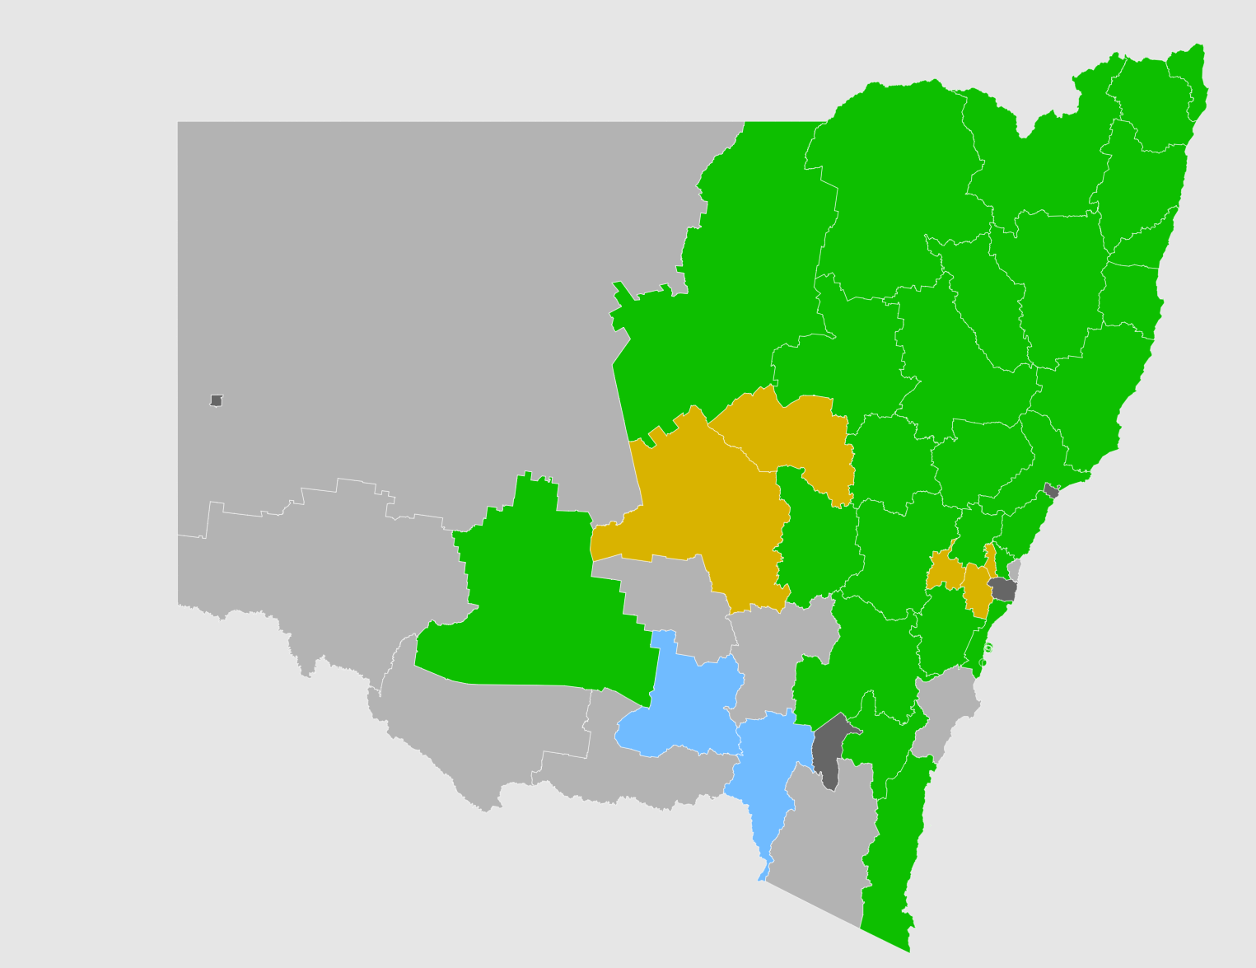
MDT Project Background
The introduction of MDTs is a significant opportunity to enhance incident management and situational awareness. The program is continuing with MDT installations and rollout, with all districts planned to be fully operational by Q1 2026.
34
5
Districts are live operationally
Districts are in the process of rollout
MDT Project Background
Prior to MDTs, communication between Incident Management Teams (IMT) and firefighters on the field were radio-based.
Following the 2019-2020 bush fire season and the outcomes of the Keelty Report, the RFS prioritised key tech opportunities to ensure that they are best equipped to serve our community into the future.
What is an MDT?
A Mobile Data Terminal (MDT) is a Panasonic Toughpad tablet device that is being installed in all RFS appliances.
The MDT project enables RFS to leverage technology to improve the response capability and accuracy of dispatch of available assets to any incident as well as provide resources up-to-date information driven from the RFS Operational Control Centre (OCC).
4
3259+
Districts are in planning
Appliances installed

Slide 23
Connected Operational System

Slide 24
RFS Key Applications with integrations
Emergency
Alerts
AFDRS*
RFS Public
Website
Legend
Deputy
Weather Stations**
Community
Centric
Operational
Point to Point
Hazard Near Me
Point to Point (RIP)
Noggin
(Guardian)
Membership
Enabling
O
Multipoint (RIP) Domain Service*
BoM
Fire risk data
Fire Weather
Non-RFS
System
Operational Emerging
Multipoint (GIS)
GIS API
O
Multi-Point API Generic
O
Direct OKTA integration
BPED
ServiceNow
(Guardian)
ICON
Indirect SSO (Auth0, AD)
O
O
O
Feed RFS Data Platform
Manual User Action
D
D
DAST
BIP
Other
NSW CADs
D
RMP
Units
O
Assets
Incidents
Telemetry
Procurement
Incident
Dispatch
Organisation
Fire Risks
CAD
FR NSW
ESCAD
Taleo
ServiceNow
(eMembership)
New
Recruits
SAP HCM
D
O
O
RIP Domain Services
Data Platform
D
Adashi C&C +
First Responder
Fuel
SAP EAM
O
O
Solv & DoneSafe
O
O
D
Assets / Events
ACTIV
Arena Aviation & Arena HP
O
Emerging
OneRFS
O
O
Invoices
VaaN
Next Gen Fleet Sensors#
Athena/ Casandra/COP
Firemapper
SAP FICO
Payments
COUPA
O
O
LIDAR***
O
O
D
Purchase requests
Internal Order
IMT
Catalogue
Satellite****
PRAS
ServiceNow
(ELS)
SAP Warehouse
O
O
O
D
Routing
Map Desk ArcGIS Pro
GIS (ESRI/FME)
HereMaps
Office 365
O
*AFDRS link to RFS Public website is being removed, to go direct via RIP to ServiceNow (due Jan 2025)
**Weather station capability into RIP (due Jan 2025)
***LIDAR – capability increasing from Feb 2025 through to 2026,2027.
****Satellite – initial capability due Oct 2025.
# Next Gen Fleet Sensor capabilities – initial capability from Feb 2025 through June 2025.

