Slide 1
RFS State Operations Briefing February 2025

Slide 2
RFS – Who we are
First Brigade formed in 1900 which were all managed by individual Local Governments however a central State agency created in 1997.
Responsible for all fires in rural fire districts, and the prevention, preparation and response to bush & grass fires across the State.
Now the world's largest volunteer firefighting organisation with over 71,000 members and 2,100 Brigades across the State.
Members also perform other functions such as road crash rescue, fire investigation, aviation operations and assist with other natural disasters such as storm & flood.
Notes:
More than 280,000 firefighter deployments (NSW)
Around 6,000 interstate personnel from every jurisdiction
Support from the United States, Canada and New Zealand including:
82 from US
84 from Canada
224 from NZ

Slide 3
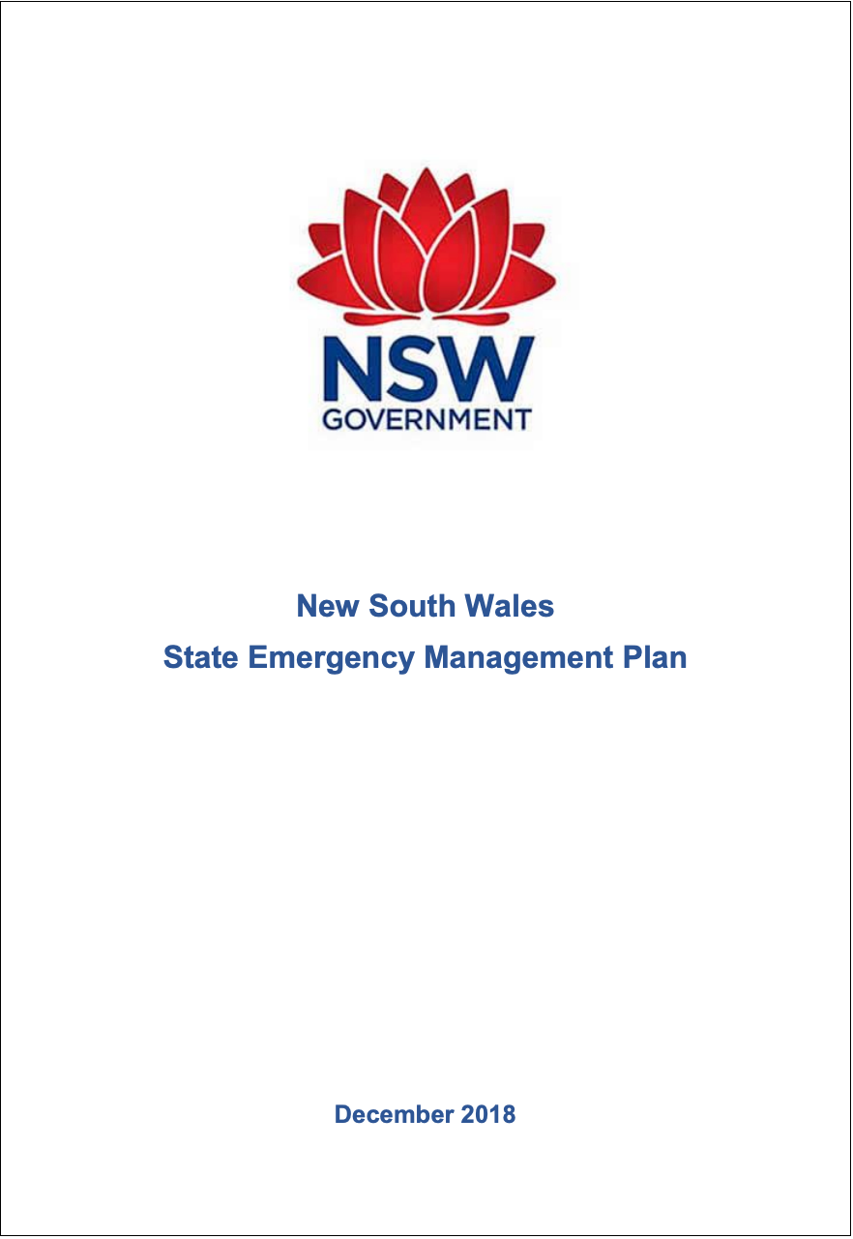
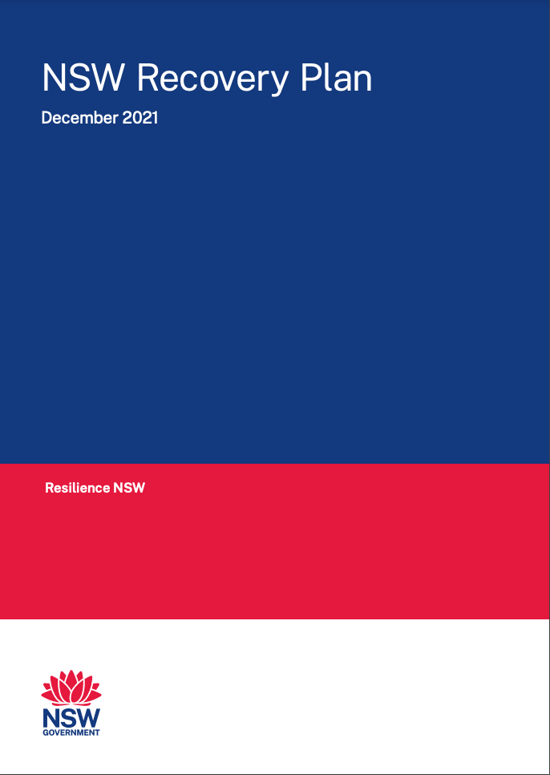
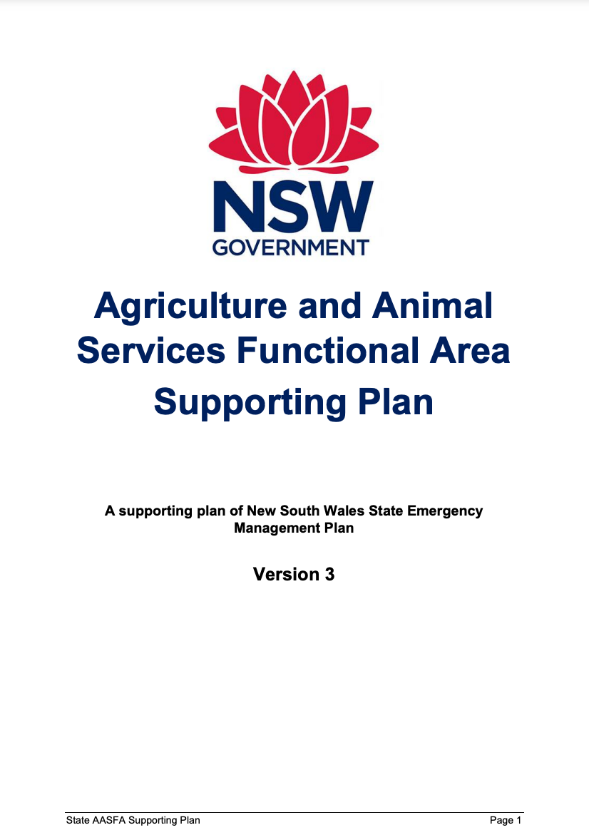
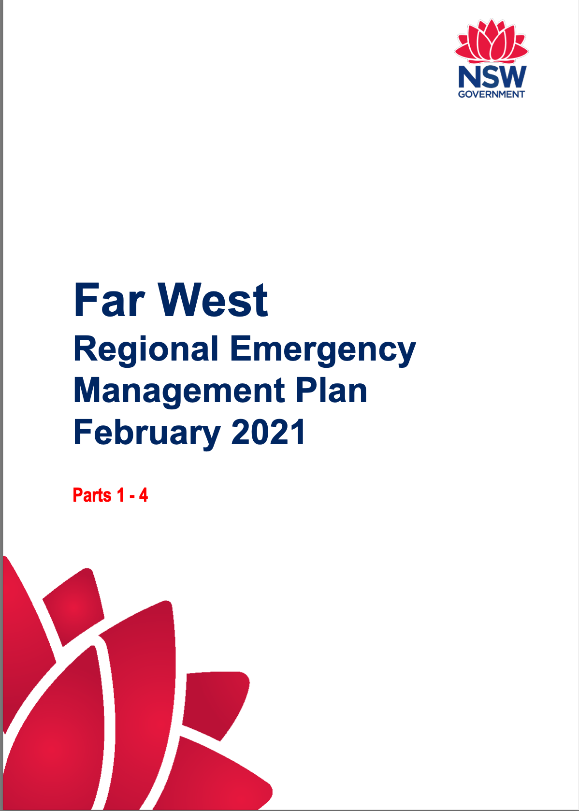
Emergency Management
The State Emergency and Rescue Management Act 1989 (SERM Act) establishes 4 phases of emergency management:
PREVENTION | PREPARATION | RESPONSE | RECOVERY
Other legislation provides hazard specific powers (e.g. Rural Fires Act 1997) or (e.g. Public Health Act 2010)
Plans
Emergency Management Plan (EMPLAN)
Allocates responsibilities
Identifies lead agencies for hazards and support functions
Ensures a coordinated response to emergencies.
Sub and Supporting Plans
Sub plans deal with specific hazards – e.g. bush fire
Supporting plans deal with supporting functions
Regional Plans

Slide 4
Emergency Management
Prevention & Preparation
State Emergency Management Committee
Response
Recovery
State Emergency Recovery Controller (SERCON)
Functional and hazard specific committees
Regional and Local Emergency Management Committees
Regional Recovery Coordinator
State, Regional and Local Recovery Committees
Specific responsibility for a hazard, controls the response when an emergency occurs.
Combat Agency
State Emergency Operations Controller (SEOCON)
Regional and Local Emergency Operations Controllers
Controls recovery operations when there is no other identified recovery agency.
Coordinate functions under sub and supporting plans
Roles and functions of SEMC translated at regional and local level
Controls operations when there is no combat agency, or when requested.
Supported by other Combat Agencies and Functional Area Coordinators at each level
Public face of recovery providing leadership and coordination
Coordinate activities to rebuild, restore and rehabilitate
Oversees State EMPLAN and sub and supporting plans.

Slide 5
Combat Agencies
Fire (Within Rural Fire District) & Major Bush Fires Emergencies NSW Rural Fire Service
Fire (Within A Fire District) Fire and Rescue NSW
Major Structure Collapse Fire and Rescue NSW
Hazardous Material Fire and Rescue NSW
Flood NSW State Emergency Service
Tsunami NSW State Emergency Service
Storm NSW State Emergency Service
Terrorist Act NSW Police Force
Food Industry NSW Department of Primary Industries
Marine Oil & Chemical Spills NSW Maritime
Law Enforcement During A Declaration NSW Police Force
Animal, Plant Disease, Rodent Or Insect Plague NSW Department of Primary Industries
Search And Rescue NSW Police Force
Pandemic NSW Health
SEOCON
Lead for:
Earthquake
Heatwave
Aviation emergencies
Any other unallocated emergency

Slide 6
Functional Areas
Agriculture and Animal Services
Department of Primary Industries
Energy and Utility Services
NSW Office of Energy and Climate Change, NSW Treasury
Engineering Services
NSW Public Works, Department of Regional NSW
Environmental Services
Department of Planning and Environment
Health Services
NSW Health
Public Information Services
NSW Police Force
Telecommunication Services
NSW Telco Authority
Transport Services
Transport for NSW
Welfare Services
Department of Communities and Justice

Slide 7
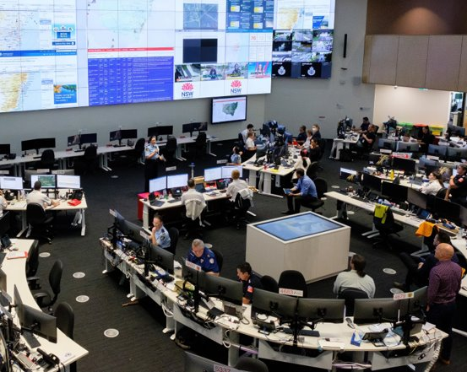
State Emergency Operations Centre
Co-located with the RFS State Operations Centre
Redundancy remains in place
Representation as requested including:
Combat agencies / Functional Areas
Australian Defence Force, Bureau of Meteorology
National Emergency Management Agency
Recovery-related agencies (NSW Reconstruction Authority, Regional NSW, Service NSW)
Supporting agencies including Department of Education, Multicultural NSW, Aboriginal Affairs NSW, and others

Slide 8
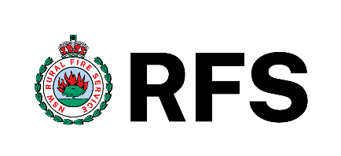
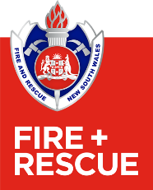
Agency Fire Fighting Capabilities
 | 71,017 members 700 Remote Area Fire Fighters and 40 Aviation Rescue Crew 3,883 appliances (bush fire tankers and pumpers) and 350 approved heavy plant contractors, with more than 2,700 registered plant 11 NSW RFS aircraft (1 Large Air Tanker, 3 fixed wing, 6 rotary, and 1 CH-47 Chinook helicopter) and more than 200 contracted aircraft available (including 2 Large Air Tankers)
 | 1,267 fire fighters (including over 700 remote area fire fighters) 377 appliances and 189 heavy plant 3 owned aircraft (rotary) and 3 leased aircraft (2 rotary and 1 fixed wing) 1 additional contracted rotary aircraft to support NPWS rapid aerial response teams (RART) during the bush fire season
 | 6,776 Fire Fighters (3,564 permanent and 3,212 retained) 574 bush fire tankers/pumpers and 53 bush fire appliances 97 Remote Aerial Piloted Systems (RPAS) 512 Community Fire Units with 4,657 members
 | 556 Fire Fighters 453 appliances and 35 heavy plant 4 contracted aircraft 110 Remote Aerial Piloted Systems (RPAS)

Slide 9
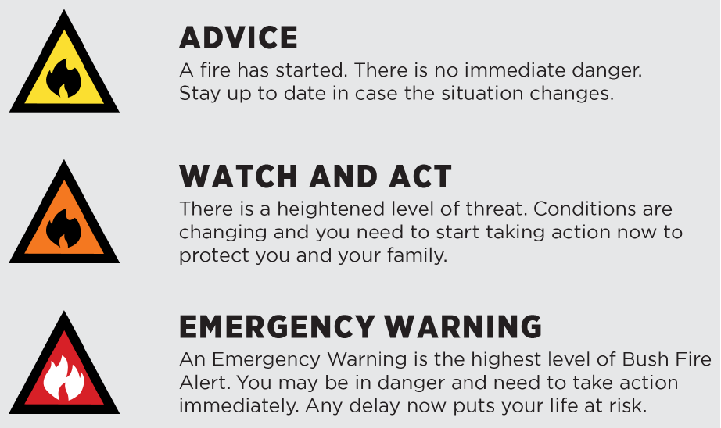
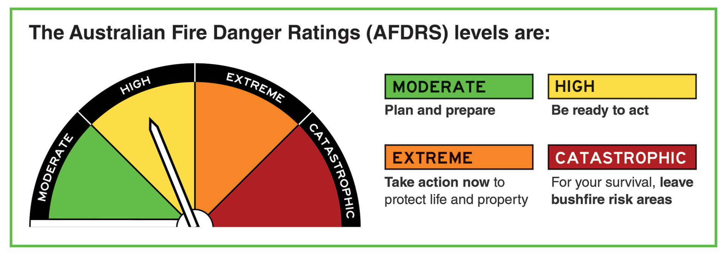
Public Information & Warnings
RFS is the lead agency for the issuing of public information and warnings relating to bush fires and bush fire threats.
RFS has responsibility for the provision of information and associated public messaging and warnings through channels including.

Slide 10
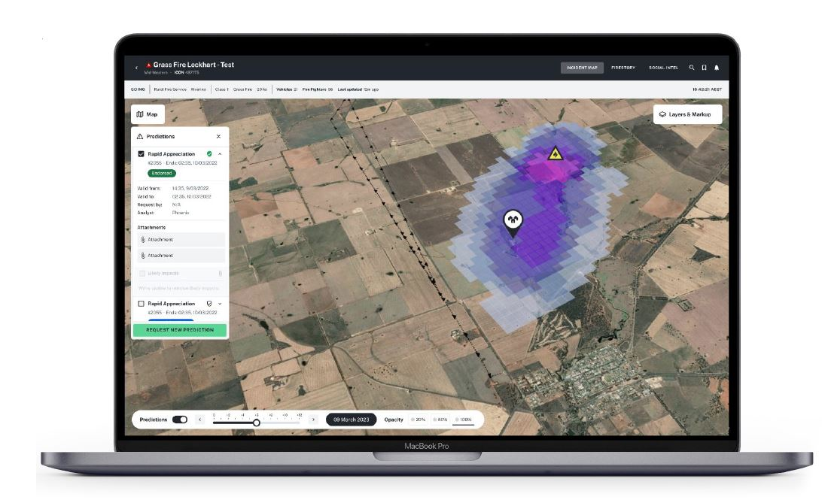
Athena Bush Fire Intelligence
The Athena Bush Fire Intelligence System uses Government and external sources to enhance situational awareness and decision making.
Athena leverages artificial intelligence, automation and cloud computing to provide the right information to the right people at the right time. The system is recognised as a first and state of the art technology for fire agencies nationally and internationally.
Athena Phase 1 was launched in November 2022 which included three modules: Social Media Intelligence, Risk Visualisation and Predictive Modelling.
Athena Phase 2 is currently in progress to develop an additional three modules: Dynamic Coverage, Aviation Safety and Risk Response Engine.

Slide 11
Aviation
RFS owns 11 aircraft including the recently purchased CH-47 Chinook helicopter which has already been deployed operationally across NSW.
NSW engages exclusive contract aircraft and can access Call When Needed aircraft throughout the Bush Fire Danger Period.
Issues continue to be experienced with contract aircraft availability due to the extended North America, Europe and Asian fire seasons.
The RFS and NSW State Emergency Service (SES) now jointly manages the State Air Desk (SAD) following recommendations contained within the State Flood Inquiry report.
The SAD supports various Government agencies including Corrective Services, Department of Primary Industries, NSW Telco Authority and Surf Lifesaving NSW.
RFS has implemented various aviation safety initiatives following the Large Air Tanker crash during the 2019/20 season.

Slide 12
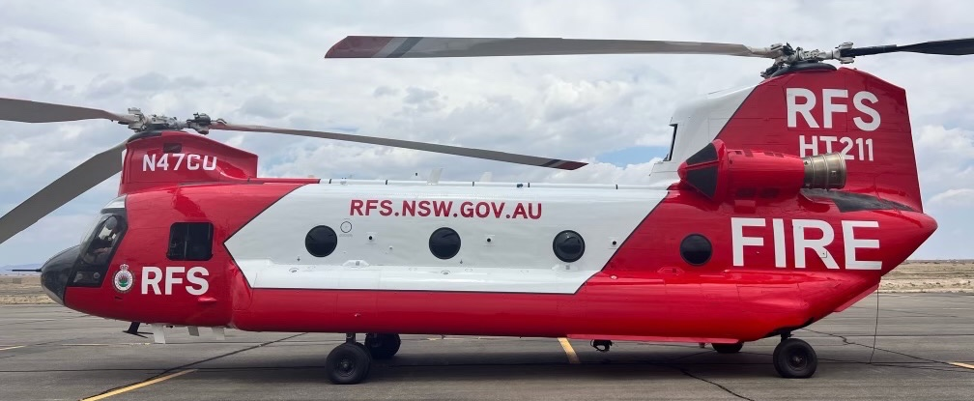
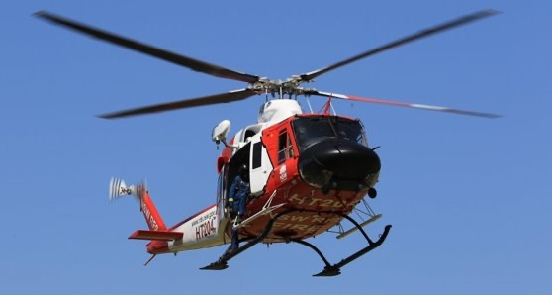
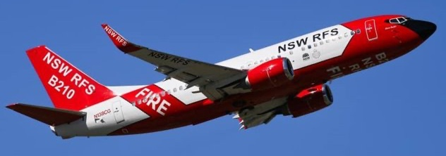
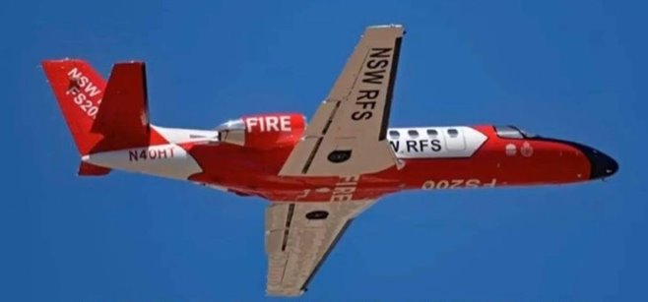
RFS Owned Aircraft

Slide 13
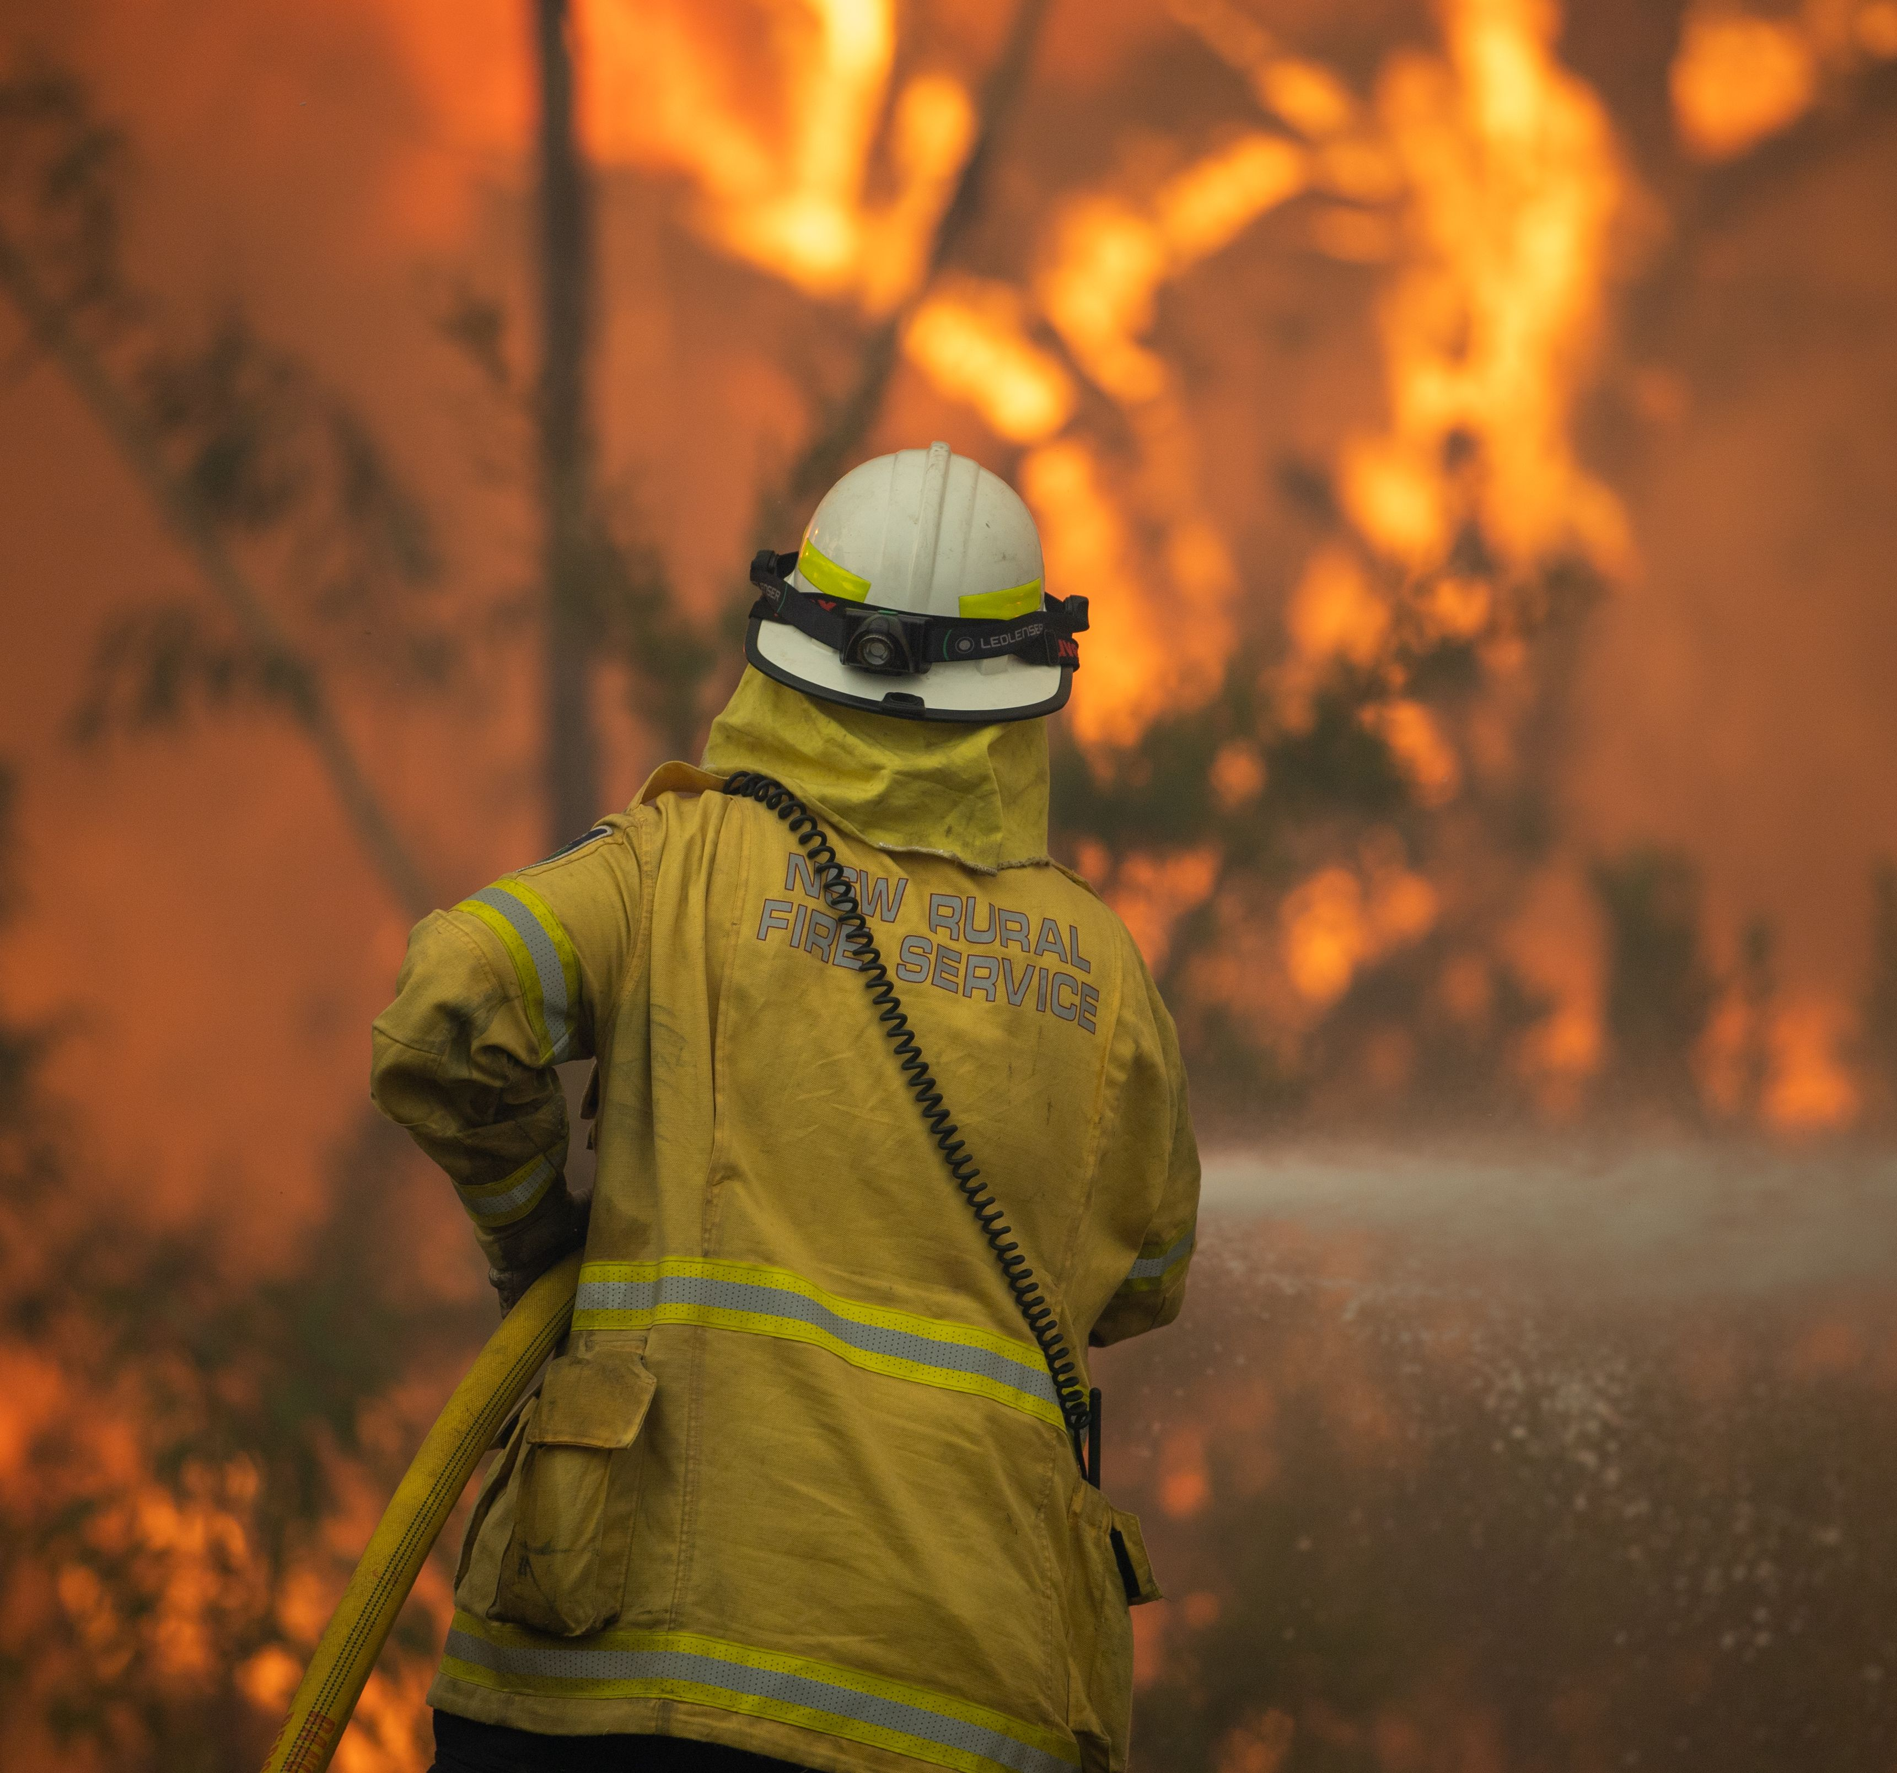
2019/20 Season at a Glance
More than 160 days of continuous major operations in State Operations Centre
Over 11,000 bush and grass fires
5.5 million hectares burnt – approximately 7% of the State
Three State of Emergency declarations
More than 40 Section 44 declarations (Bush Fire Emergencies)
59 days of Total Fire Ban (including 11 days of statewide bans)
More than 2,400 homes destroyed
Sadly 26 lives lost
Nearly 15,000 homes saved in the direct area of fire impact

Slide 14
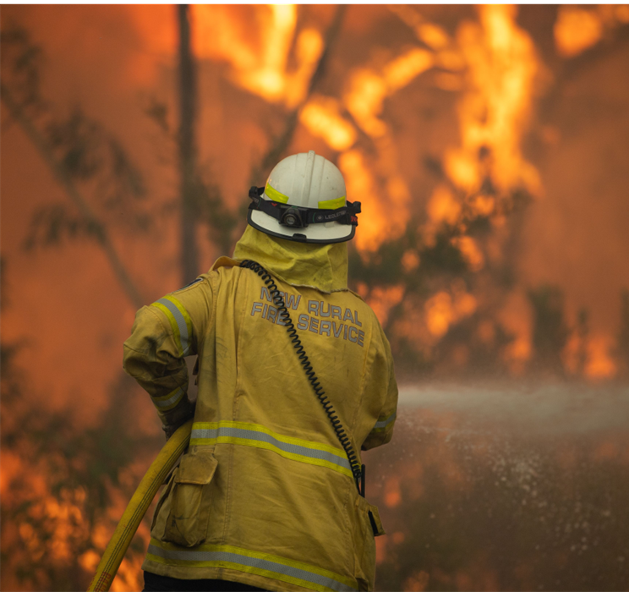
2019/20 Season at a Glance
NSW RFS Public Website
Users (July 2019 – February 2020) | 42.98 million
Page views (July 2019 – February 2020) | 109.65 million
NSW RFS Fires Near Me
New Downloads (July 2019 – February 2020) | 2.74 million
Social Media
Twitter engagements | 609,951
Facebook engagements | 6.45 million

Slide 15
Notes:
The 2019-20 Bush Fire Season at a Glance
This short clip shows the daily fire progression from 3rd July 2019 to 14th March 2020.
The orange is the active fire: The grey is the burnt area remaining
More than 160 days of continuous major operations in SOC,
more than 200 consecutive days of Section 44​ activity
Over 11,000 bush and grass fires
5.5 million hectares burnt – approximately 7% of NSW
Three State of Emergency declarations
More than 40 Section 44 declarations
59 days of total fire ban
11 days of statewide total fire ban
More than 2,400 homes destroyed
Nearly 15,000 homes saved in the direct area of fire impact

Slide 16
Thank you

