Slide 1
AUSTRALIA’S NEW INTERNATIONAL DEVELOPMENT POLICY

Slide 2
Key parameters for the new International Development Policy
New policy will seek to reinforce the foundations of a peaceful, stable and prosperous Indo-Pacific.
Focus areas:
Building effective, accountable states
Enhancing state and community resilience
Connecting partners with Australia and regional architecture
Generating collective action on global
challenges
New policy will:
Be whole-of-government
Consider priorities
Outline the use of ODA and non-ODA
Consider Australia’s national strengths
Set out delivery, performance and accountability systems

Slide 3
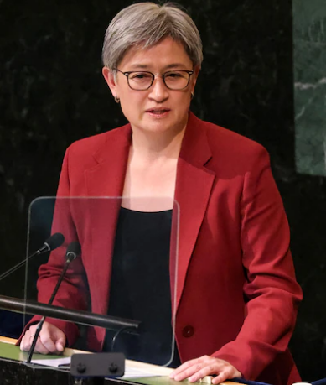
Our region is grappling with intense, overlapping crises
COVID-19 will have lasting social, economic and health impacts – with setbacks in poverty reduction, gender equality, education & achieving the SDGs.
Demand for humanitarian assistance is growing. Around 274 million people need emergency help in 2022.
Our region is on the frontline of climate change. More than 130 million people could be pushed into poverty over the next decade.
‘Over the coming months, we are designing a new development policy, outlining how we will play our part in a world in an era of crisis.’
~ Foreign Minister Penny Wong at UNGA, September 2022
Shifts in economic and political power are creating an uncertain future – marked by disrupted global trade, geopolitical tensions and potential conflict.

Slide 4
Australia’s ODA is increasing – but there are competing calls on our resources
ADDITIONAL $1.4 BILLION ODA OVER 4 YEARS
2022-23 ODA BUDGET
$900 MILLION
$4.65 Billion Total ODA
Pacific
$383.2 million
for South/West Asia
$470 MILLION
$1.2 billion
for Southeast Asia
Southeast Asia
$987.8 million
for global and other
$30 MILLION
$1.9 billion
for the Pacific
ANCP

Slide 5
A principled approach – drawing on Australia’s strengths
Building stronger partnerships in our region, founded on mutual trust and respect, shared values of fairness and equality.
Listening to and working with our regional partners.
Leveraging our institutions, cultures, expertise, economy and regional ties.
Australia’s strength
Ambitious climate action, poverty reduction, human rights, gender equality, disability and social inclusion.
Guided by a First Nations approach to foreign policy.
Working together to maximise impact with multilateral institutions, civil society, the private sector and other donors.
Committed to quality, accountability and transparency.

Slide 6
Consultation and thematic issues
Consultation is critical to developing the new policy
Seeking views from a wide range of stakeholders
Committed to listening to our regional partners
‘It’s vital that we hear from as many experts and partners as possible.’
~ Minister for International Development and the Pacific, Pat Conroy, at ACFID conference, October 2022
Consider carefully how to address thematic issues
An External Advisory Group will provide contestability

Slide 7
An updated performance and delivery system
Current Performance and Delivery System
What performance type?
What is performance measured against?
How is performance reported?
Indo-Pacific development context
Australia’s contribution to development
Organisational effectiveness and efficiency
Annual Ministerial Statement
DFAT’s Annual Report
WHOLE OF PROGRAM
PROGRAMS
Country and Regional
Global
COVID-19 Development Response Plans
Country/Regional Progress Reports
Multilateral Performance Reports
Strategic partnerships with multilaterals
Investment M&E Frameworks
Partnership Performance
Annual Investment Monitoring Reports
Independent Evaluations
Annual Partner Assessments
INDIVIDUAL INVESTMENTS

Slide 8
Indicative timeline for policy process
Minster Wong announces new development policy
at UN General Assembly
23 September
Establishment of the External Advisory Group (EAG)
Consultations on the new policy
Release policy in first half of 2023
Synthesis and drafting
Finalisation
2022
2023
SEP
OCT
NOV
DEC
JAN
FEB
MAR
APR
MAY
Ministers Wong and Conroy issue joint media release inviting public submissions 14 October
DFAT releases Terms of Reference and calls for submissions for the new policy 14 October
Minister Conroy speech to ACFID 27 October
Minister Conroy speech to Australasian Aid Conference 29 November

Slide 9
Discussion Questions
DFAT is eager to hear your perspectives. We propose four guiding questions for today:
In light of key trends and challenges, what are the top three priorities Australia’s development program should seek to advance?
How can Australia ensure the new policy demonstrates a commitment to building stronger and more meaningful partnerships in our region?
How can Australia best utilise its national strengths to enhance the impact of our development program? What capabilities do we need?
How should performance and delivery systems be designed to promote transparency, accountability, effectiveness and learning in Australia's development assistance?

Slide 10
Discussion Question 1
In light of key trends and challenges, what are the top three priorities Australia’s development program should seek to advance?

Slide 11
Discussion Question 2
How can Australia ensure the new policy demonstrates a commitment to building stronger and more meaningful partnerships in our region?

Slide 12
Discussion Question 3
How can Australia best utilise its national strengths to enhance the impact of our development program? What capabilities do we need?

Slide 13
Discussion Question 4
How should performance and delivery systems be designed to promote transparency, accountability, effectiveness and learning in Australia's development assistance?

