Slide 1



Nabilan 6 monthly progress briefing
January – June 2018

Slide 3
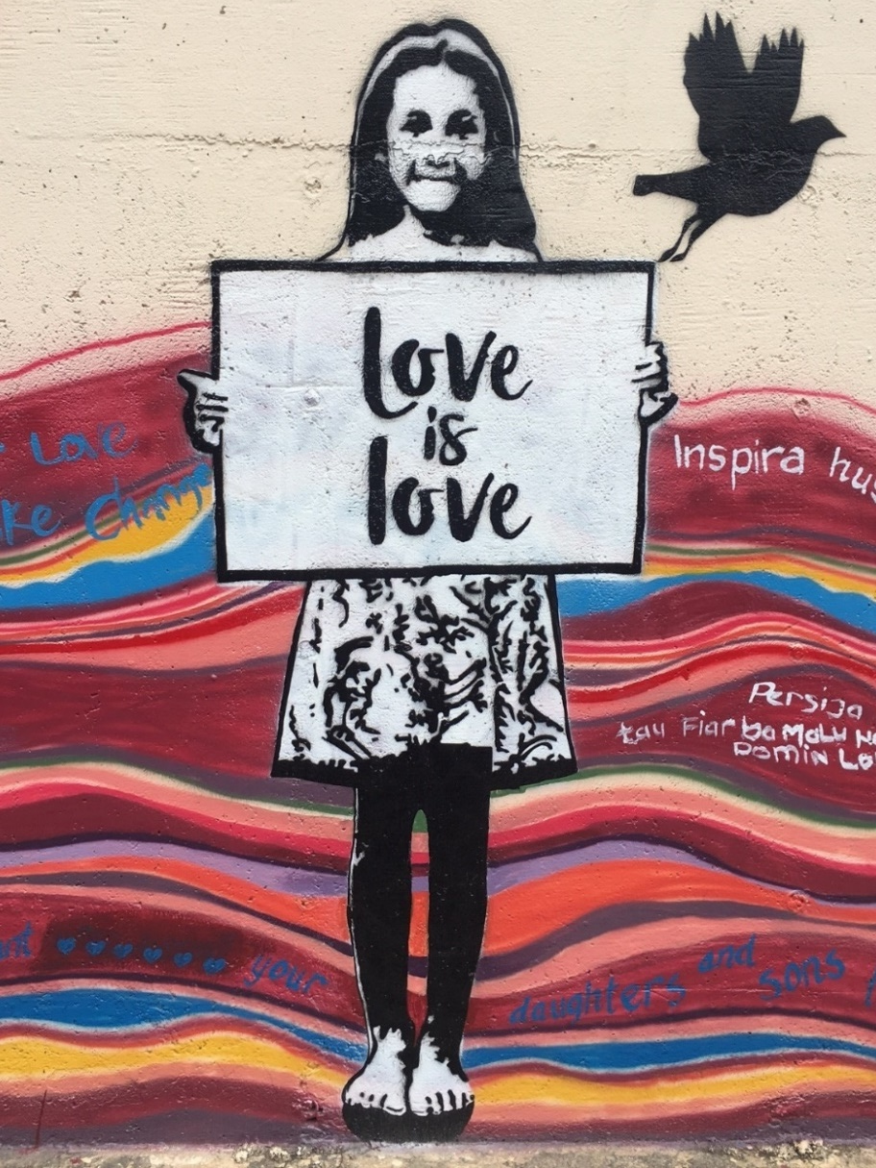
CONTEXT UPDATE
Nabilan Phase 2 commenced. MELF & MELP updated.
New Government.
Governments unable to pass budget – services partners received intermittent support from MSS.
Increasing conversations/awareness about social norms change approach in violence prevention.

Slide 4
Our Key Evaluation Questions
KEQ1 How effective was the Nabilan program in ensuring women and children who experience violence have access to adequate and responsive services?
EOPO1: Women and children who experience violence have access to quality and inclusive services
KEQ 2 To what extent are individuals, communities and institutions taking action to reduce violence against women?
EOPO2: Individuals, communities and institutions take action to reduce violence against women and children
KEQ 3 What key factors will contribute to the sustainability of the Nabilan program outcomes beyond the end of the program? (Mid-term review)
Sustainability
KEQ 4 Are there indications that the Nabilan programming model has contributed, or could contribute, to changing social norms relating to VAWC in Timor-Leste?
(Mid-term review)
Appropriateness

Slide 5
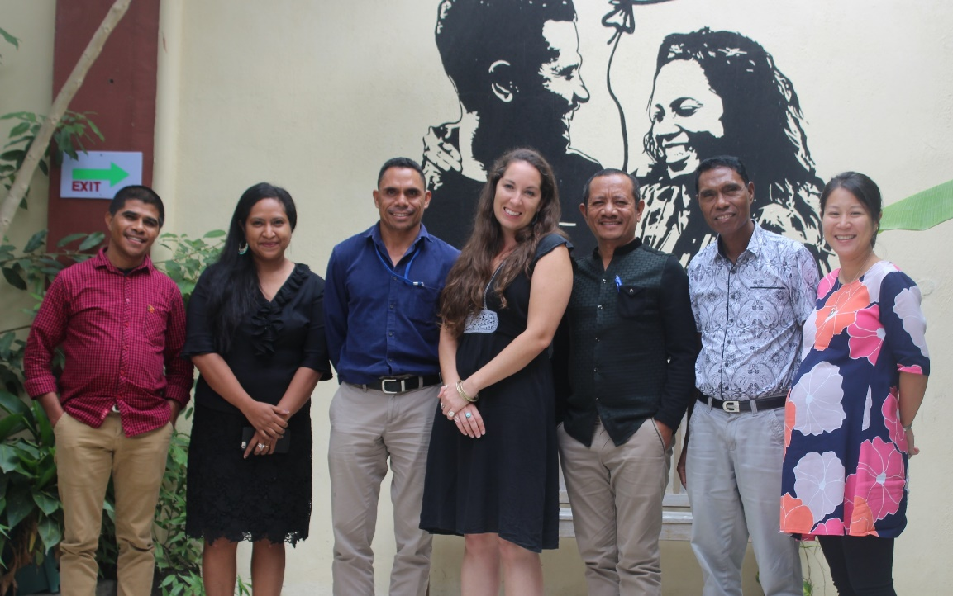
KEQ1, EOPO 1 (services): What did we do?
How effective was the Nabilan program in ensuring women and children who experience violence have access to adequate and responsive services?
Provided funding (USD $513,750) & TA to five partners: ALFeLa (legal aid), PRADET (crisis shelter, medical forensic examination, medical treatment and counselling), Casa Vida (shelter for children) and UMS (shelter for women and children); and JSMP (court monitoring and advocacy).
Finalised 2nd round of Certificate III in Social Services. Completed evaluation of the first two rounds, and updating course materials.
Supported case management, and links with DPOs and LGBTI groups.

Slide 6
KEQ1, EOPO 1 (services): What DID WE achieve?
Nabilan Services partners supported 561 new clients (530 F, 31 M), compared with 556 new clients in previous reporting period.
Total of 4,298 services provided, compared with 3,945 in the previous reporting period.
13 students graduated with their Certificate III in Social Services on 25 May 2018. Nine students will do make-up sessions in August-Nov 2018 to graduate.
PRADET ran 4R training: in Suai 76 participants (49 F, 27 M); in Dili 13 participants (8 F, 5 M).
On track against indicator 1: No. of new clients steady compared with 2017 levels.
On track against indicator 2: No. of services provided steady compared with 2017 levels.
On track against indicators 3 & 4: 20 participants completing Cert III by end 2018, 30 participants completing 4R training by end 2018; at least 50% of participants in each training demonstrate improved knowledge/skills at end of training.

Slide 7
Total 20 PWD (4%) were supported (19 F, 1 M). Compared with last reporting period where 3% of new F clients had disability.
On track against indicator 8: Maintain or increase in proportion of clients with disabilities (and other vulnerable clients) compared with 2014 baseline of 5 new clients with a disability.

Slide 8
Nabilan Partners’ locations
Bobonaro-Maliana (PRADET FH)
Covalima-Suai (ALFeLa, PRADET FH, UMS)
Baucau (ALFeLa, PRADET FH)
Oecusse (ALFeLa, PRADET-FH)
Dili (ALFeLa, PRADET FH, Casa Vida)

Slide 10
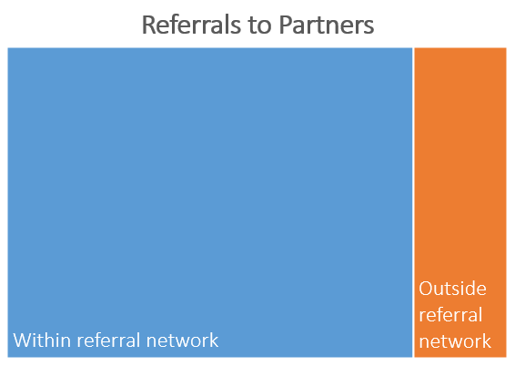
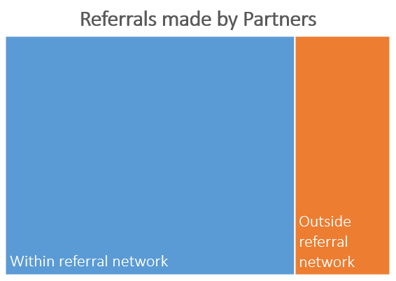
Partners received 561 new clients/referrals.
Baseline for Indicator 9 (5% increase in referrals from outside the referral network by 2020).
Partners made total of 526 referrals.
Baseline for Indicator 9 (10% increase in number of referrals made between service providers).

Slide 11
JSMP monitored 515 cases. On track against indicator 11 (No. of cases monitored holding steady against 2017).
380 DV cases were monitored: 249 were charged as simple assault DV; 23 were charged as mistreatment of a spouse (compared with 13 in the last reporting period). On track against indicator 10: increase in number of DV cases being charged as serious assault or mistreatment of a spouse.
271 DV decisions were monitored: 51 resulted in a fine (compared with 12 in the last reporting period). Not on track against indicator 10: decrease in number of DV cases resulting in a fine.

Slide 12
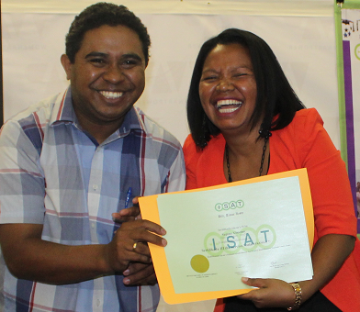
KEQ1, EOPO 1 (services): FINDINGS
EOPO 1 is rated green – on track.
Nabilan has national coverage, reaching all municipalities and a large number of women and children. Service providers have increased number of new clients compared with last reporting period – but there is a sustainability & quality ceiling.
Funding is being utilised well, and we are supporting partners to strengthen their institutional capacity.
Nabilan’s Cert III Course is contributing to quality training in the EVAW sector, with clear evidence of staff improving the way they support clients as a result (SSC). For example, partners are getting better at identifying clients with a disability.
There is high level of satisfaction with Cert III among students and employers.
“I no longer feel alone in doing this job. I have connections with others who can help my client better for certain issues.” (student from round 1 of Cert III course.

Slide 13
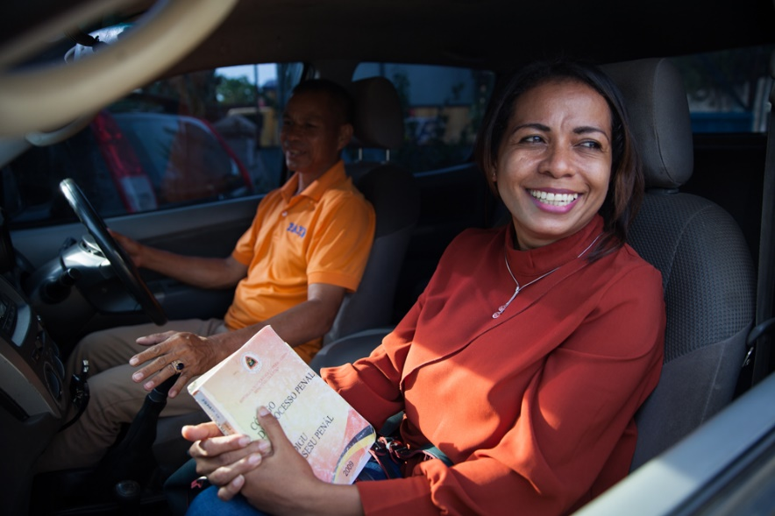
KEQ1, EOPO 1 (services): FINDINGS
Partners are following the correct referral pathway, however stronger links with non-referral network organisations required.
The increase in number of suspended sentences with monitoring obligations suggests there is a slow shift towards more sensitivity in justice sector responses to VAWC. It is likely that JSMP’s advocacy has contributed to this. However more work to be done to decrease use of fines in DV cases.
“During this reporting period, JSMP observed that Oecusse District Court started to apply rules of conduct in domestic violence cases. This is a positive result of JSMP’s advocacy … because in previous years other District Courts applied these rules but the Oecusse District did not.”

Slide 14
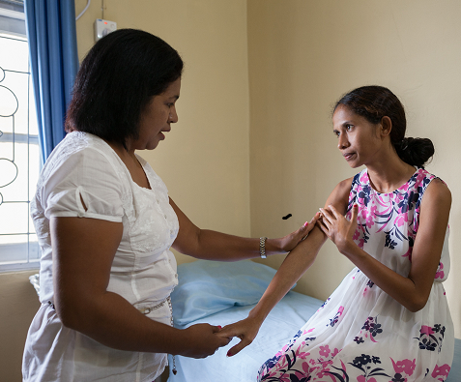
KEQ1, EOPO 1 (services): RECOMMENDATIONS
Consider how to deliver counselling training to partners in municipalities.
Refine & further develope post-training monitoring tools to better assess impact.
Strengthen referral pathways to partners, especially referrals from DPOs.
Strengthen Certificate III content about vulnerable groups, including the LGBTI community.

Slide 15
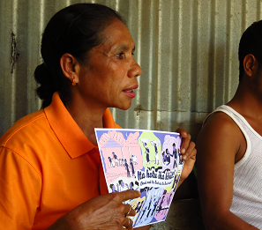
KEQ2, EOPO 2 (sNC): What did we do?
Continued Phase 1 of our community-based approach (CBA) to violence prevention in Suku Letefoho, Manufahi, using an adaptation of SASA!.
Conducted rapid assessment survey (RAS) & FGDs – this forms the CBA baseline.
Continued to support Change Ambassadors’ Network (CAN): 3 meetings held; network training package developed; initial consultations & surveys done with 14 CAN member organisations – forming CAN baseline.
Preparing new prevention partners (PRADET-PDC, FMDC, MHVF) for start of programming in January 2019.
Shared SNC approach & CBA materials with partners.
To what extent are individuals, communities and institutions taking action to reduce violence against women?

Slide 16
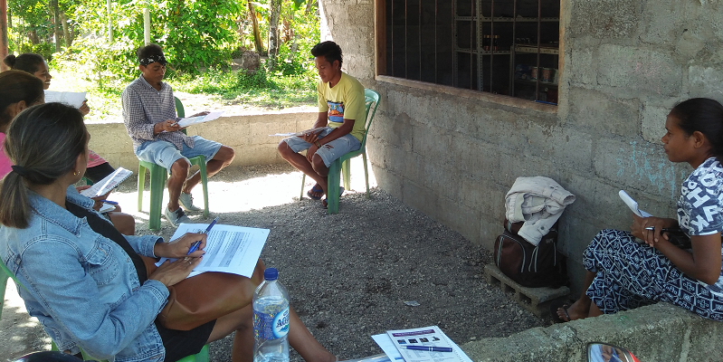
KEQ2, EOPO 2 (sNC): What DID WE achieve?
Completed Phase 1 (Start) and moving onto Phase 2 (Awareness) of CBA/SASA!.
Have baseline for CBA work.
11 community mobilisers in Suku Letefoho are taking action to prevent violence against women in their communities. 40+ activities conducted.
On target to complete Phase II (Awareness) between July 2018 – June 2019 – Indicator 23
Baseline collected for indicators 13 & 22 (CBA)/SASA!.
On target against indicator 24: No. of activities conducted by CMs.
“Men have to make all the decisions and their wives just have to accept it.” – male participant.

Slide 17
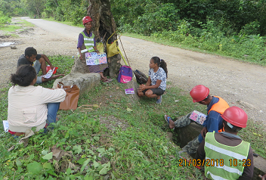
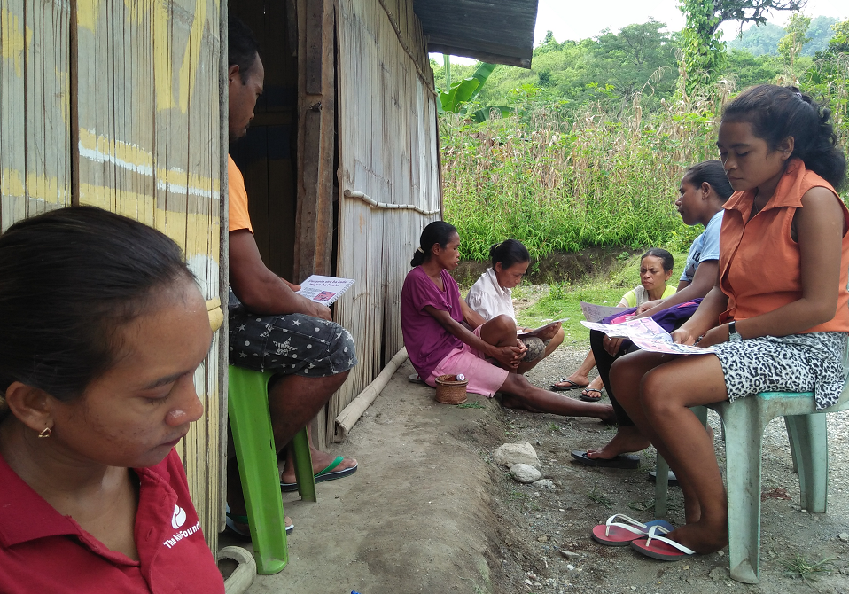
CBA Baseline
Nabilan conducted Rapid Assessment Surveys & FGDs in Suku Letefoho to understand the levels of knowledge, attitudes, skills and behavior in the community in relation to power and violence against women.
FGDs were carried out with six different groups – young women, young men, older women, older men, healthcare workers and religious leaders, with an overall total of 24 women and 19 men.
Rapid Assessment Surveys were carried out and included 42 women and 47 men.

Slide 18
40% of men and 50% of women consider VAW to be normal in relationships.
Over half of all respondents believe a man has a good reason to hit his wife if she does not do the house work satisfactorily, with women (74%) rating higher than men (43%).
Sexual violence was a common theme in the FGDs. However, there was limited knowledge, and a concerning ambiguity, around what constitutes rape. The Indonesian term for rape, ‘perkosa’ was used by some to describe rape, but used by others to describe infidelity.
55% of people have provided support to someone experiencing or using violence, and 69% have told someone violence is not OK in last 12 months. But the FGDs revealed that it is only the more serious cases of violence that get attention, and community response to violence against women sometimes results in punitive violent action towards the man.
“When you’ve been told three times [but you still don’t comply] have to be hit to be taught better, but it can’t draw blood.” – female participant.
“The woman is to blame because the man perkosa the woman when the woman has a family, but then why did the woman want it? – female participant
“The community surround the man and makes the woman slap the man.” – male participant

Slide 19
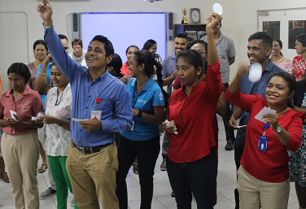
Have baseline for CAN to measure impact on integration of better violence prevention programming across DFAT investments.
Change ambassadors are participating in meetings. Received positive feedback from PNDS on the impact of the CAN training on their ambassadors, and example of how the ambassadors have integrated their learnings in their work.
Prevention grants on hold until January 2018 due to funding restrictions.
On hold against indicators 14, 15, 16, 22.
On track to achieving target against indicators 19, 20 & 21 on CAN.
“I am impressed with what [our change ambassadors] are learning through the network and how it is motivating them to lead change and dialogue with their peers..” – Team Leader

Slide 20
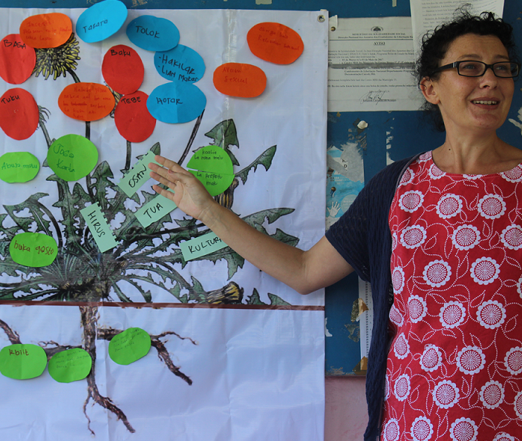
KEQ2, EOPO 2 (sNC): FINDINGS
EOPO 2 is rated orange – there are some delays and challenges but we expect to be on track in the next reporting period.
Work with prevention partners has been delayed. Partners still need intensive support to do good primary prevention work.
There has been positive feedback on the CAN – the challenge is to keep the momentum going.
CBA surveys found high tolerance & acceptance of violence, and low knowledge & helping skills in the community. This is not unexpected.
There has been significant delay in CBA but now back on track with support of new Nabilan staff in Letefoho.
Media monitoring shows pervasive victim-blaming and promotion of gender inequity in the media.

Slide 21
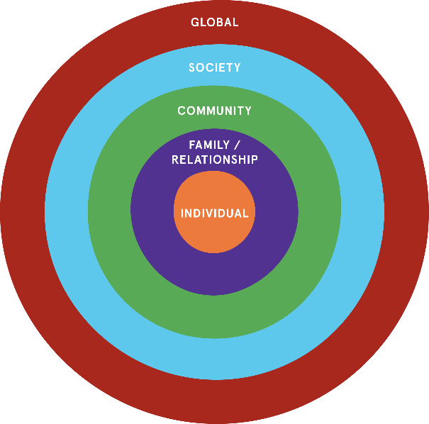
KEQ2, EOPO 2 (sNC): RECOMMENDATIONS
Work with the media to get accurate stories out on gender, HIV & domestic violence.
Look for opportunities to link independent feminist movement with established human rights defenders, such as FOKUPERS.
Develop a Whole of Government engagement strategy (applies also to EOPO 1).
Finish adaptations of the SASA! toolkit, and revise activities and tools based on findings related to sexual violence.
Remember – social norms change is a process. There is evidence of some positive changes, and we need to continue efforts at all levels of the ecological model.

Slide 22
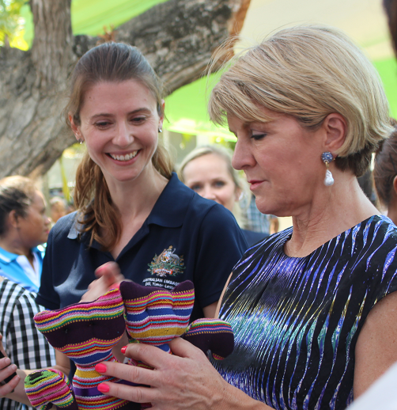
KEQ3: SUSTAINABILITY
Keq4: appropriateness
KEQ 3 What key factors will contribute to the sustainability of the Nabilan program outcomes beyond the end of the program? (Mid-term review)
KEQ 4 Are there indications that the Nabilan programming model has contributed, or could contribute, to changing social norms relating to VAWC in Timor-Leste? (Mid-term review)
New government on ‘hold’ and has not resourced prevention, and essential services have reduced funding. Funding submissions made by all partners to MSS, but not yet confirmed. Shelters are running out of food & borrowing money to feed clients.
Too soon to tell about evidence of change in community attitudes and practices – will be tracked through CBA and midterm review of Nabilan.

Slide 23
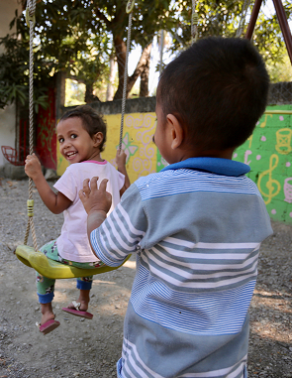
Looking forward
Develop strategy for PRADET FH Dili – continuing.
Drafting guidelines on Penal Code (Sep onwards).
Cert III make-up sessions (Sep).
CAN make-up sessions and baseline report (Sep).
Meetings with MSS, SEII, MoH, MoJ, CoA (Sep).
Media training with JSMP, SEII & SECOM (Oct).
Case management review of services partners (Nov).
Training for new medical forensic examiners (Sep – Nov).
16 Days (Nov): Positive reporting media kit; SASA! radio shows; voice-prompt referral service).
Counselling training, DV & suicide risk assessment tools (Nov – Dec).

