Slide 1
How does Australia support the Sustainable Development Goals?
Lessons 3–4
Notes:
Image credit: © Ness Kerton for AusAID / Australian Government Department of Foreign Affairs and Trade

Slide 2
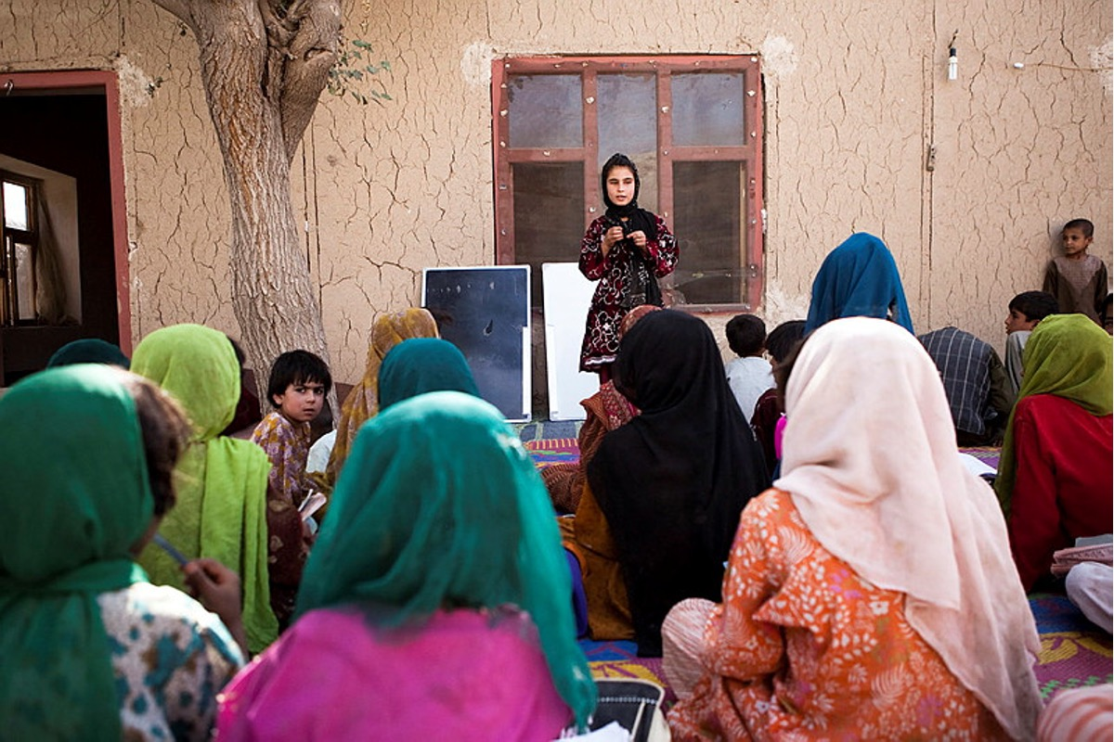

Learning intentions
To explain the different resources that satisfy human needs and wants.
To identify how Australia helps its Asia-Pacific neighbours to meet the UN Sustainable Development Goals.
Notes:
Image credit: © Elissa Bogos Mirzaei / Save the Children / Australian Government Department of Foreign Affairs and Trade

Slide 3
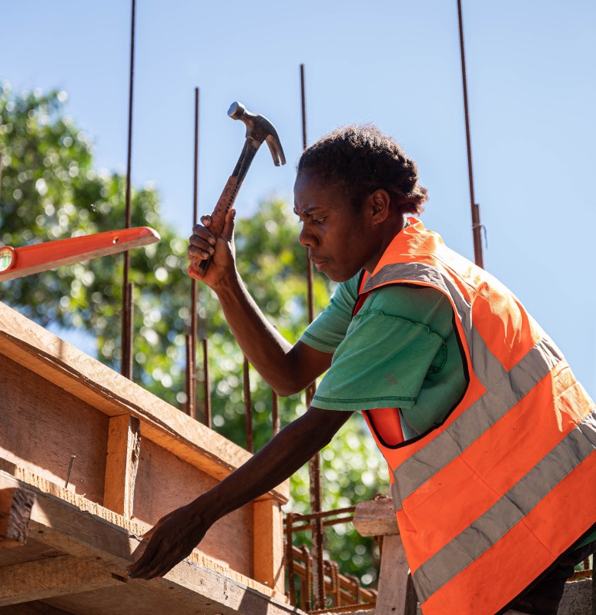
Australia’s role in meeting the SDGs
Australia provides resources (natural, human or capital) to other nations to help them reach the Sustainable Development Goals.
These resources satisfy both needs and wants, such as access to clean water or scholarships to study at a university.
Notes:
Image credit: © Australian Government Department of Foreign Affairs and Trade

Slide 4
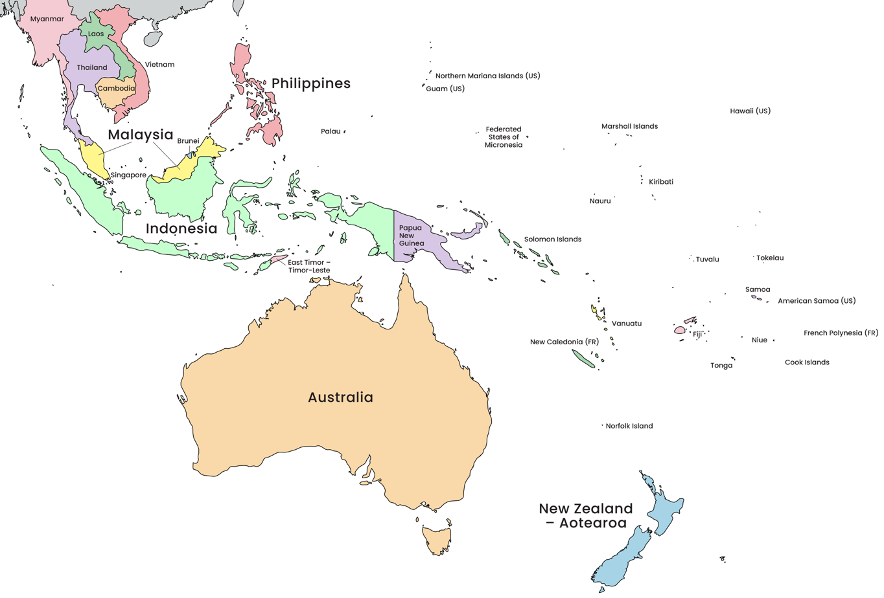
Countries of the Asia-Pacific region
Australia strongly focuses on its closest neighbours in the Asia-Pacific region.
This is our regional community.
Can you identify some of our neighbours?
Notes:
Adapted from: © VectorStock

Slide 5
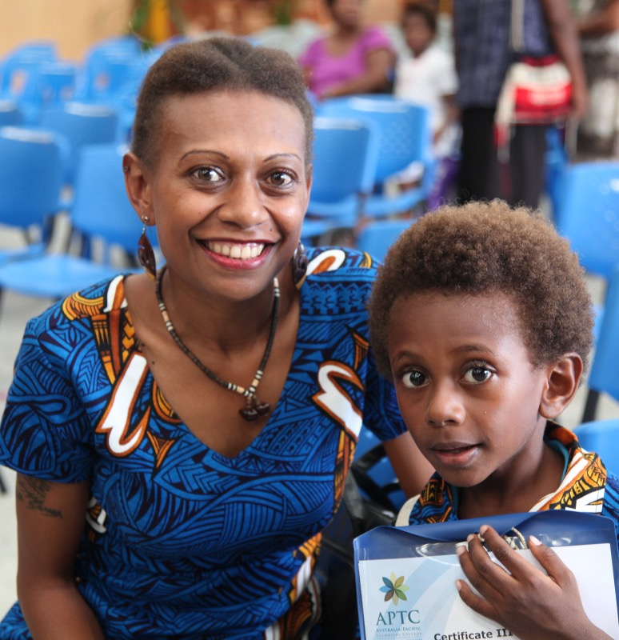
Official development assistance
Official development assistance
The resources that Australia gives to some countries is called official development assistance.
It is essential to the progress of the UN’s Sustainable Development Goals.
It is funded by governments, such as Australia, for those countries who need it.
It aims to meet the SDG’s objective to ‘leave no-one behind’.
Notes:
Image credit: © Jacqueline Smart for AusAID / Australian Government Department of Foreign Affairs and Trade

Slide 6
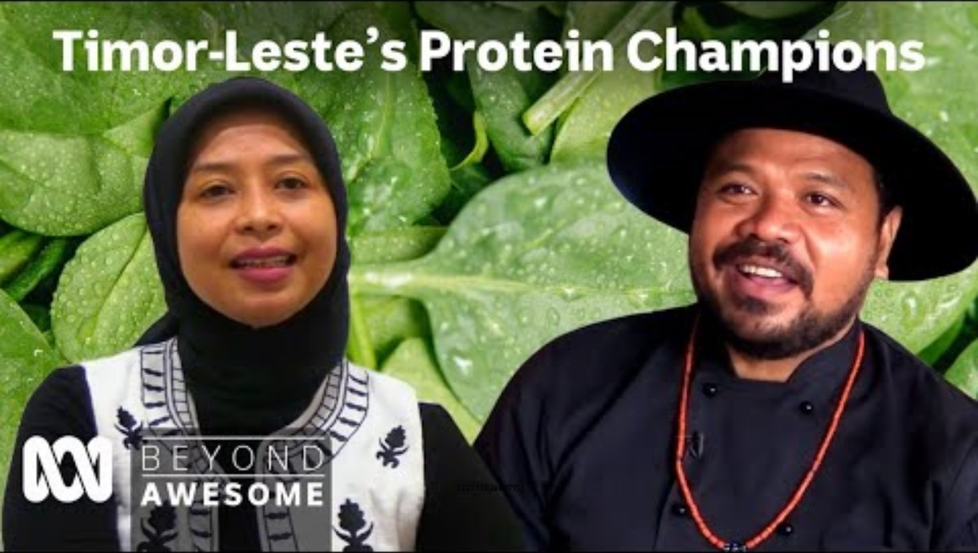
Timor-Leste’s Protein Champions video
Notes:
Enable content on the security warning to ensure the embedded video can be played.

