Slide 1
How does Australia interconnect with the Pacific to manage environmental hazards?
Lesson 1
Notes:
© Department of Foreign Affairs and Trade

Slide 2
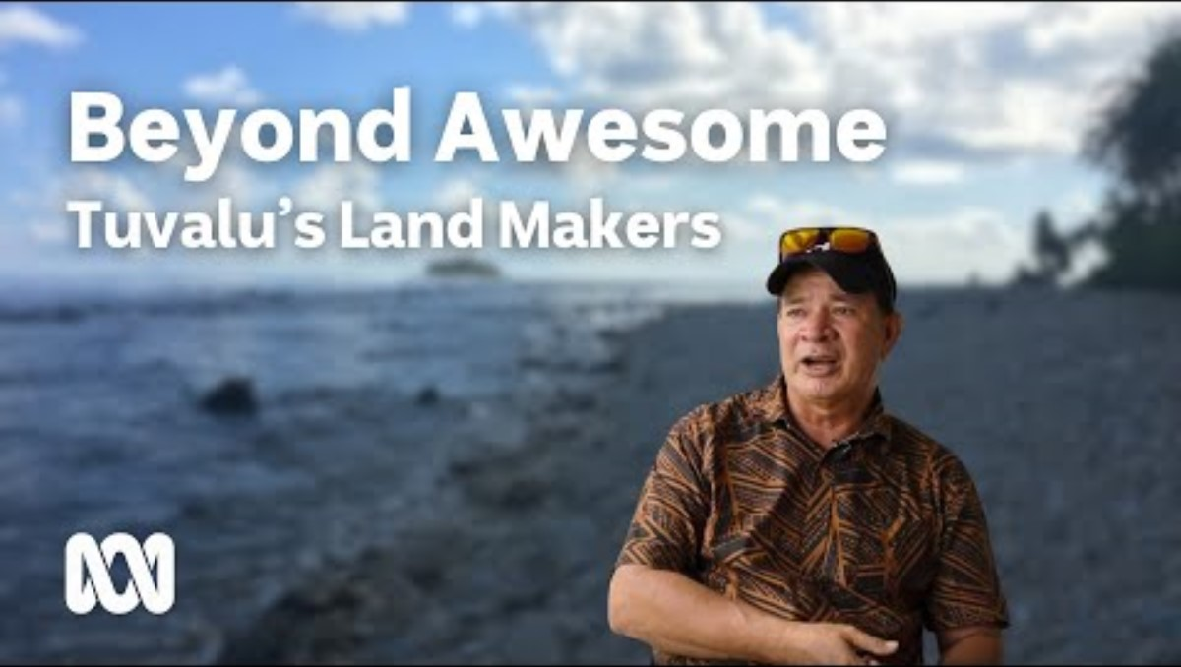

Slide 2: Video: Beyond Awesome: Tuvalu’s land makers
Notes:
Enable content on the security warning to ensure the embedded video can be played.

Slide 3
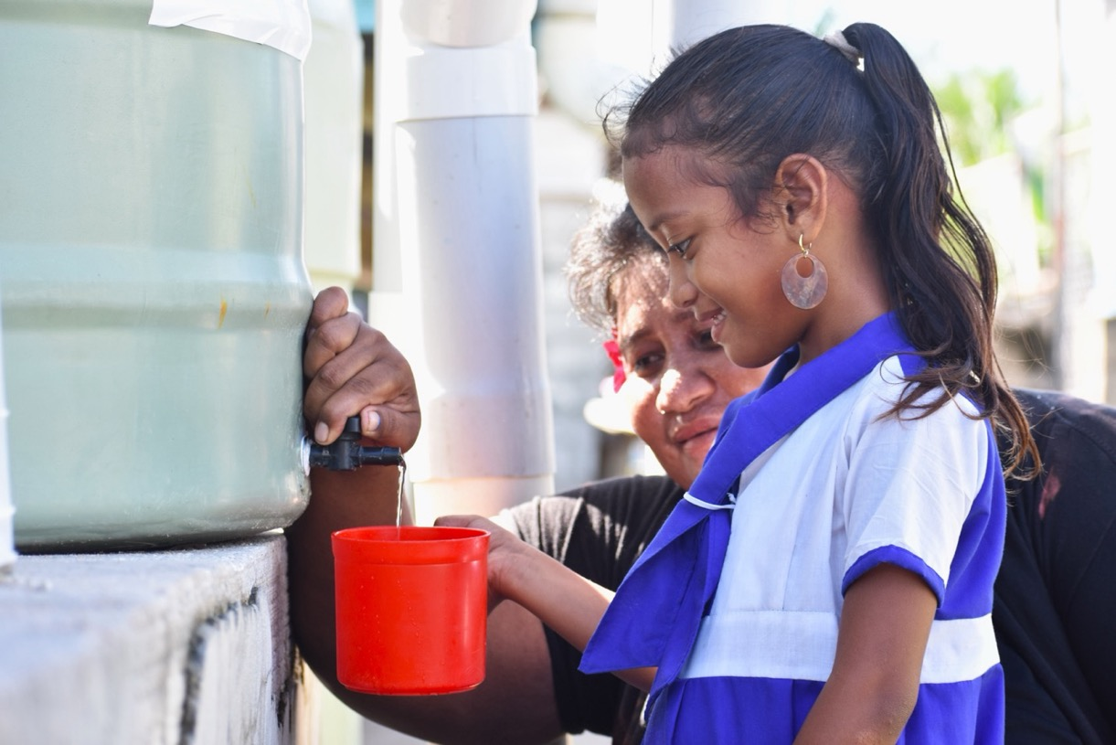
Lesson 1:
Learning intentions
To understand how Australia is supporting regional interconnections through official development assistance.
To identify terms used when managing hazards.
Notes:
© ChildFund Kiribati/Department of Foreign Affairs and Trade, CC BY

Slide 4
How does Australia assess natural hazards within the Pacific?
Lesson 2
Notes:
https://multimedia.dfat.gov.au/fotoweb/archives/5019-PUBLIC-Library/PublicAssets/MasterArchive/000179032.jpg.info

Slide 5
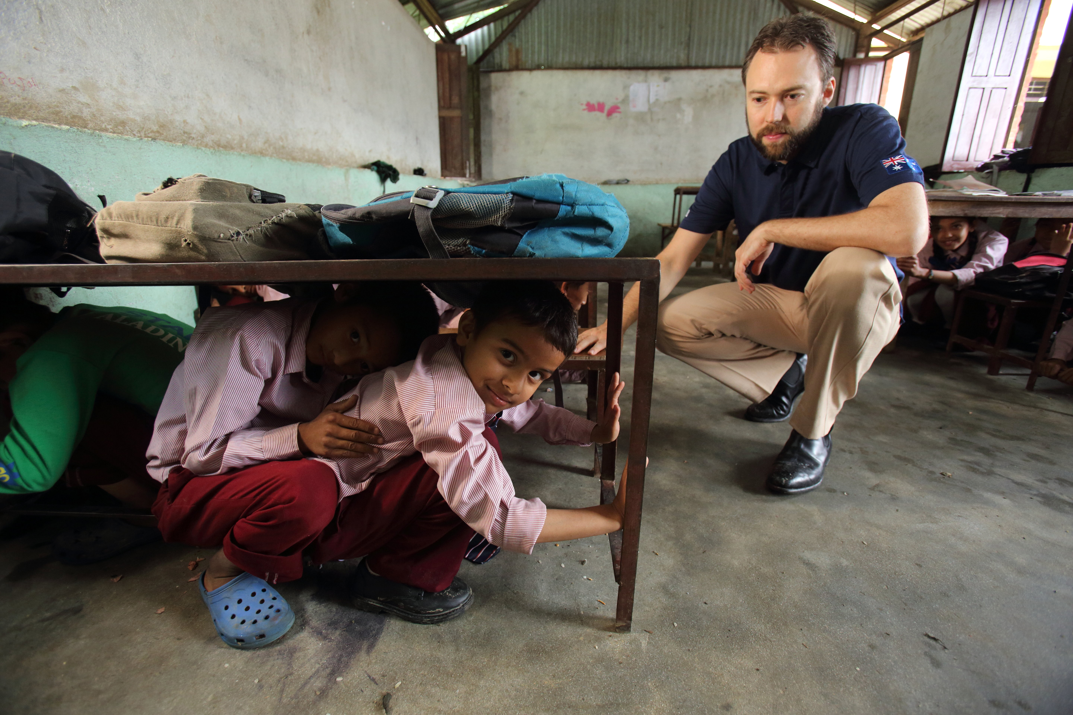
Lesson 2:
Learning intentions
To assess the risk of hazards impacting land and water resources across the Pacific.
To research and use data to inform decision-making.
Notes:
© Jim Holmes/Department of Foreign Affairs and Trade, CC BY

Slide 6
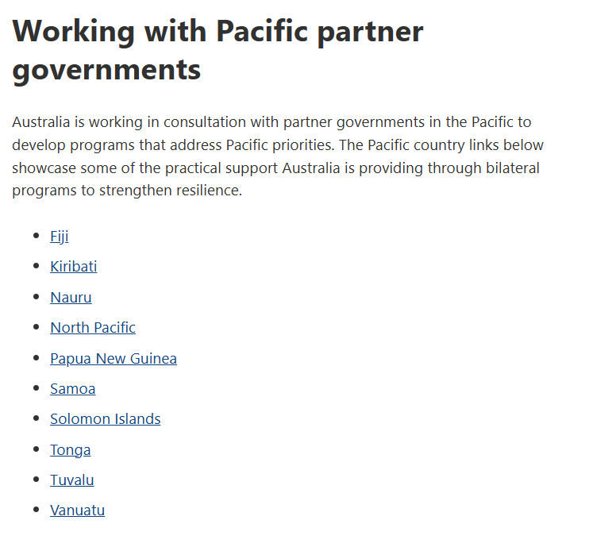
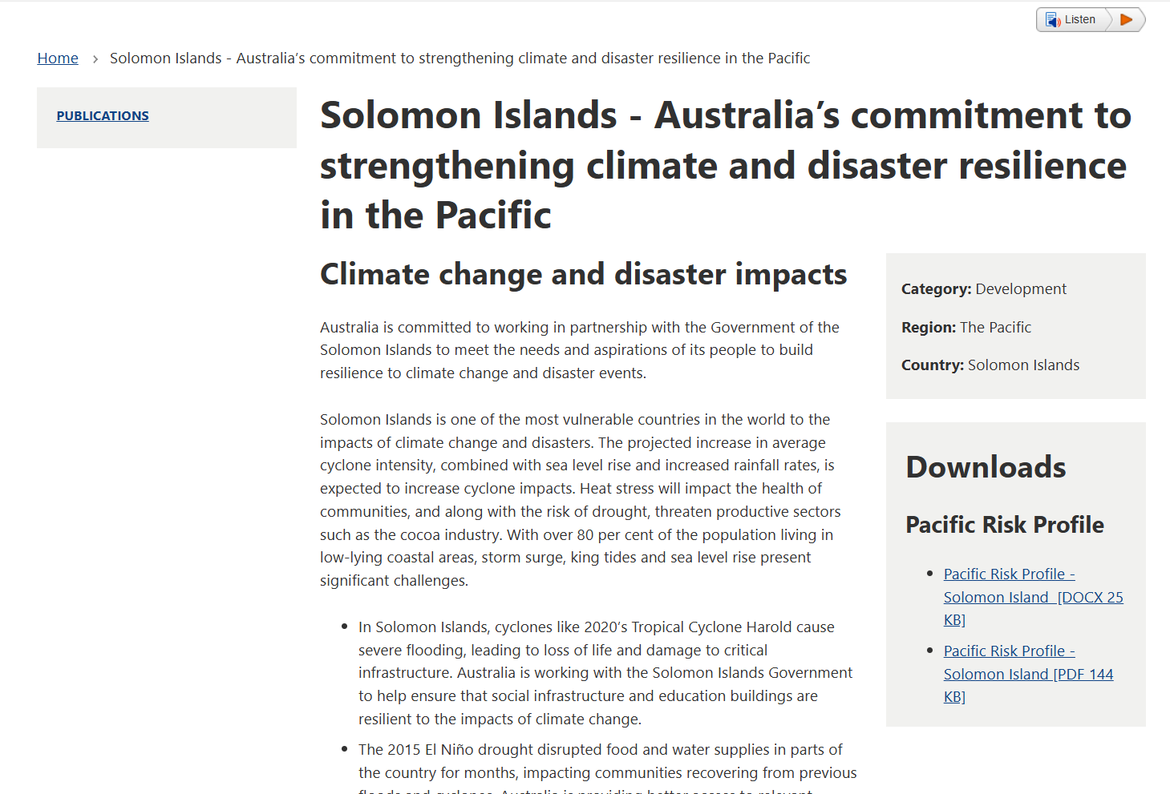
Assessing risks in the Pacific
Select the link in the worksheet:
Pacific regional – climate change and resilience.
Scroll down to the ‘Working with Pacific partner governments’ subheading and choose a country.
In the Downloads panel on the right, select the PDF option.

Slide 7
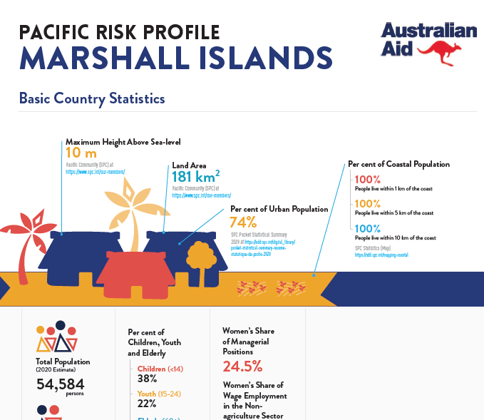
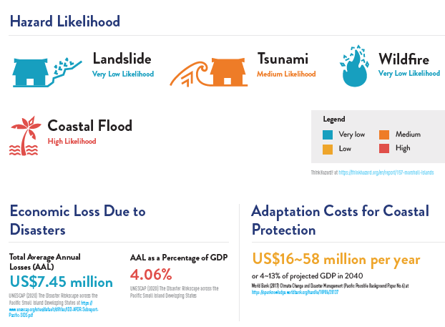
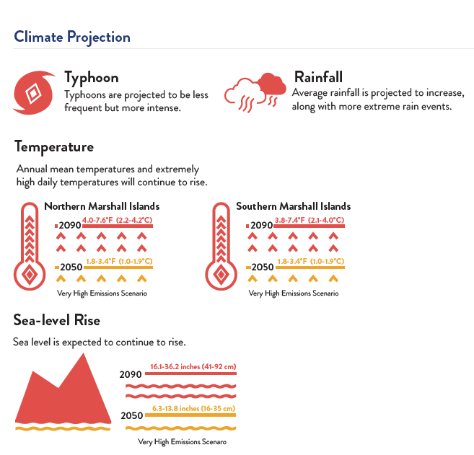
Pages to research in each risk profile
Page 1
Page 2
Page 4

Slide 8
Pacific risk assessment
Country
% of coastal population within 1 km of the ocean
Land area
Total population
% of population facing volcanic risk
Hazards with a high likelihood
Costs of coastal protection per year
Climate projection
Typhoon or cyclonic activity
Rainfall
Sea-level rise by 2050

Slide 9
Pacific risk assessment (example)
Country | Marshall Islands | Federated States of Micronesia
% of coastal population within 1 km of the ocean | 100% | 89%
Land area | 181 km² | 701 km²
Total population | 54,584 | 105,504
% of population facing volcanic risk* | n/a | n/a
Hazards with a high likelihood | Coastal flood | Typhoon
Costs of coastal protection per year | 16–58 million | 8–28 million
Climate projection
Typhoon or cyclonic activity | Less frequent but more intense | Less frequent but more intense
Rainfall | Will increase, with more extreme rain events | Will increase, with more extreme rain events
Sea-level rise by 2050 | 16–35 cm | 17–35 cm

Slide 10
Identify 3 statistics posing the greatest risk
Firstly, the Marshall Islands has 100% of its population living within 1 km
of the coastline. This means all of society are at risk of losing their homes
during a hazard.
Secondly, the economic cost of protecting the islands coastline is a huge
burden on a population which is very small, making it hard for these communities to sustain their lifestyle without assistance.
Finally, the environmental predictions of more intense rain events will likely only increase the frequency of coastal flooding, making it feel like the hazard recovery stage never ends.

